Slide 1
Assessor Training
5 Day Training Program

Slide 2
Overview of of 5 days
Introduction of ZED Maturity Assessment Model
1
2
ZED Enablers
ZED Outcome Parameters
ZED Parameters
3
Assessor Skills
4
Presentations, Evaluation and Valedictory
5

Slide 3
Index
S. No. | Contents | Slide Number
 | Your Role and Introduction to ZED | 5
 | Scheme Guidelines | 11
 | The ZED Maturity Assessment Model | 26
1 | Production Management | 34-108
2 | Quality Management | 109-143
3 | Environment Management | 144-193
4 | Design Management | 194-215
5 | Natural Resources Management | 216-225
6 | Human Resource Management | 226-238
7 | Intellectual Property Management | 239-261
8 | Energy Management | 262-284
9 | Safety Management | 285-298
10 | Performance Management | 299-311
11 | Understanding Assessment Process | 310-317
12 | Consulting Process | 318-341

Slide 4

Your Role & Introduction to ZED

Slide 5



Slide 6
THE ZED JOURNEY
Release of Funds for Pilot Project by DIPP
Pilot Project report released
ZED model conceptualized
SFC Meeting conducted
First SSC meeting
Sep ‘14
Mar ‘15
Dec ‘15
Feb ‘16
22-Aug ‘16
Jan ‘15
May ‘15
Jan ‘16
11-Jul ‘16
16-Jan. ‘17
7-Mar,’17
First draft of the ZED Model prepared
Ministry of MSME initiated Scheme approval process
Pilot Project Completed
Scheme NOTIFIED
Training of Master Trainers
Training of Master Trainers
We are here

Slide 7
The Scheme
Name
FINANCIAL SUPPORT TO MSMEs IN ZED CERTIFICATION SCHEME
The Scheme is an extensive drive of the Government of India to enhance global competitiveness of MSMEs by providing them financial support in assessment, rating and handholding of its manufacturing processes on Quality and Environment aspects
“The Government has decided to implement the ZED Certification Scheme for 22,222 MSMEs unit with a total budget of Rs. 491 Crores (including Government of India contribution of Rs. 365 Crores) during the 12th Five Year Plan”

Slide 8
Roadmap
PILOT PROJECT
(Completed in Jan, 2016)
Scale-up
National Rollout
Pilot Project to test ZED Model
Evolve an ecosystem around ZED
Test existing value proposition and reveal deficiencies
Financial Support through subsidy by MoMSME
Assess, rate and handhold 22,222 MSMEs units in the next 2-3 years
Finalize value proposition for the ZED Scheme
Build Capacities and capabilities to Scale-up the model
Target to cover 1.25 mn MSMEs in the next 5-7 years

Slide 9
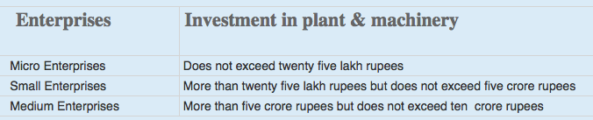
A few basic facts (1/2)
This is a voluntary scheme and is applicable to Micro, Small & medium Enterprises – Manufacturing Sector only. QCI has been nominated as the NMIU of the scheme.
Certification after assessment of a Manufacturing Unit’s systems & processes based on ZED Parameters.
An MSME WILL NOT BE ELIGIBLE to go for ZED Certification if the legal & regulatory compliances are not followed.
Definitions of Micro, Small & Medium Enterprises is in accordance with the provision of MSMED Act, 2006.
Manufacturing Enterprises are enterprises engaged in the manufacture or production of goods pertaining to any industry specified in the first schedule to the industries (Development and Regulation Act, 1951) or employing plant and machinery in the process of value addition to the final product having a distinct name or character or use. The Manufacturing Enterprise are defined in terms of investment in Plant & Machinery.

Slide 10
A few basic facts (2/2)
The generic model for Service Sector has been made and a pilot project to test and evolve the model is under consideration by DIPP, MoCI
Though Large industries are not covered in this scheme, the model is applicable across all sectors and size
An MSME must be registered under the UAM (Udyog Aadhaar Memorandum) to avail the benefits under the ZED scheme. Registrations under UAM are free. It may be noted that the Ministry has not appointed any representative for Udyog Aadhaar Registration.
UAM is a one-page simple registration form for online filing of UAM which replaces the filing of Entrepreneur’s Memorandum Part I & II. The filing of UAM can be done on http://udyogaadhaar.gov.in
Registration is online and user-friendly
UAM can be filed on self-declaration basis
No documentation required
No Fee for filing
File more than one Udyog Aadhaar with same Aadhaar Number.

Slide 11
Scheme Guidelines

Slide 12

Objectivities of ZED scheme
Objectives
Develop an Ecosystem for Zero Defect Manufacturing in MSMEs.
Promote adaptation of Quality tools/systems and Energy Efficient manufacturing.
Enable MSMEs for manufacturing of quality products.
Encourage MSMEs to constantly upgrade their quality standards in products and processes.
Drive manufacturing with adoption of Zero Defect production processes and without
impacting the environment.
Support ‘Make in India’ campaign.
Develop professionals in the area of ZED manufacturing and certification.

Slide 13

Activities under ZED Scheme
Activities
Industry awareness programs, regional/state/national workshops, training of officials of DIs, TCs, DICs
Accreditation of Assessment & Consulting agencies, Training and certification of Assessors & Consultants
Online systems including e-platform for assessment and e-content for awareness & training
Assessment, Rating & Certification of MSMEs
Gap analysis & Handholding for improving rating of MSMEs
International Benchmarking

Slide 14




Methodology – key components
Awareness
and
Training
Awareness Programmes through Implementing Agencies like QCI, NPC, Chambers, MSME-DIs, MSME Technology Centers, Industry Associations, BEE, etc.
Training & Certification of eligible Master Trainers, Assessors and Consultants
To develop e-learning modules for capability building
Third party site-assessment
Assessments by Certified Assessors of accredited Credit Rating Agencies, and other accredited agencies etc.
Online auto-allocation of assessors and monitoring of Assessment process
Web App based Site-Assessments
Third party consultancy (gap analysis and handholding)
Consultancy by Certified Consultants of empanelled Consulting Agencies/Bodies, and Individual Consultants
Allocation of consultants and monitoring of Consulting process
App based reporting of Site-Visits
Certification
Final Rating and Certificates to be issued by QCI

Slide 15
Scheme governance
Routine functionalities
SSC chaired by Development Commissioner of MSME to guide, review, monitor and provide overall direction for implementation of the scheme
Quality Council of India (QCI) to function as the NMIU for the scheme
Overall guidance and direction
Screening and Steering Committee (SSC)
Chaired by DC-MSME
Facilitation, Implementation, Coordination and Monitoring
National Monitoring and Implementing Unit (NMIU)
QCI
Implementing Agencies
Rating & Other Agencies
Consultants & Consulting Bodies

Slide 16





ZED Rating & Certification
ZED is a Maturity Assessment Model
Assessment of a Unit on minimum 30 out of 50 parameters, including 20 mandatory parameters
Additional 25 parameters for MSMEs supplying to Defense Sector
Each parameter comprises of 5 Maturity levels
Level 1 (0 Marks)
Learner
Level 2 (2 Marks)
Beginner
Level 3 (3 Marks)
Organized
Level 4 (4 Marks)
Achiever
Level 5 (5 Marks)
World Class

Slide 17
How does ZED rating system work?
5 levels of ZED rating system
An example
Company X is being rated on 30 parameters
Of these
30 para-meters
On 4 parameters the MSME is at Level 4
PLATINUM
On another 8 parameters it is at Level 3
>4.0
upto 5.0
DIAMOND
On remaining 18 parameters it is at Level 2
>3.5 upto 4.0
GOLD
Hence, the scores will be calcu-lated as
Parameters
Level
Marks
4
4
16
>3.0 & upto 3.5
8
3
24
SILVER
18
2
36
>2.5 & upto 3.0
Total
76
BRONZE
Company X Rating
(Total points/applicable parameters): 76 / 30 = 2.53
>2.2 & upto 2.5
COMPANY X is rated as: ZED SILVER
<2.2 No rating
NOTE: Score rounded off to 2 Decimal Places

Slide 18
7 Step Process flow for ZED rating
1
Registration
Online Registration by MSMEs
2
Online Self-assessment
MSMEs to self-assess based on ZED parameters
3
Desktop assessment
Assessment based on documents submitted by MSMEs
7 Steps towards ‘Excellence’
4
Site assessment
On-site assessment of only MSMEs, selected in Desktop Assessment
5
ZED rating & certification
Final ZED rating and certificate (valid for 4 years)
6
Gap analysis & handholding
Option to avail services of gap analysis & handholding
7
Re-assessment
Option to apply for re-assessment
Surveillance: On-site surveillance 2 times in a cycle

Slide 19

Benefits of ZED Scheme for MSMEs
Credible recognition for international investors seeking investment in India
Part of supply chain of national & international OEMs
Streamlined operations and lower costs
Superior quality, reduced rejection and higher revenues
Increased environmental consciousness and social benefits
“ZED Mark” to enable an MSME to be seen as a company with a difference
Other benefits expected to be announced by the Government in the near future

Slide 20
Financial Support to MSMEs by Government Micro: 80%, Small: 60%, Medium: 50%
Total Cost
Cost to MSMEs according to its Type
1
Registration & Online Self-assessment
Micro Small Medium
No Cost No Cost No Cost
Registration,
Desktop
Assessment
&
Site-
Assessment
2
Desktop assessment
Rs. 10,000/-
Micro Small Medium
Rs. 2000/- Rs. 4000/- Rs. 5000/-
3
Site assessment
Rs. 80,000/-
Micro Small Medium
Rs. 16000/- Rs. 32000/- Rs. 40000/-
TOTAL ASSESSMENT COST to MSME
Rs. 18000/- Rs. 36000/- Rs. 45000/-
4
Additional Defence Rating
Rs. 40,000/-
Micro Small Medium
Rs. 8000/- Rs. 16000/- Rs. 20000/-
Defence
Assessment,
Consulting
& Re-
Assessment
5
Gap analysis & handholding (optional)
Rs. 1,90,000/-
Micro Small Medium
Rs. 38000/- Rs. 76000/- Rs. 95000/-
6
Re-assessment/Re-rating
Rs. 40,000/-
Micro Small Medium
Rs. 8000/- Rs. 16000/- Rs. 20000/-
Additional Subsidy of 5% for MSMEs owned by SC/ST/Women & MSMEs located in NER and J&K
Certification Costs are included in Site-assessment, Defence Rating and Re-assessment components
Surveillance Fee to be paid by MSMEs will be decided in due course

Slide 21
FINANCIAL ASSISTANCE - Conditions
The full cost of the specific activity will be paid by the MSME before the start of the activity, and the subsidy is provided after completion of that activity and depending on certain conditions as explained below
Activity
Subsidy Details
1
Registration & Online Self-assessment
NO COST to MSME
2
Desktop assessment
Rs. 10,000/-
Subsidy provided to MSME irrespective of outcome
3
Site assessment
Rs. 80,000/-
Subsidy provided to MSME irrespective of outcome
4
Additional Defence Rating
Rs. 40,000/-
Subsidy provided to MSME irrespective of outcome
5
Gap analysis & handholding (optional)
Rs. 1,90,000/-
Subsidy provided to only those MSMEs which have achieved minimum Bronze rating after Site Assessment
6
Re-assessment/
Re-rating*
Rs. 40,000/-
Subsidy provided to only those MSMEs which graduate at least one level from their previous rating, after re-assessment. Eg: No Rating to Bronze, Bronze to Silver etc.
* MSMEs with No Rating after Site Assessment can also go for Re-assessment

Slide 22
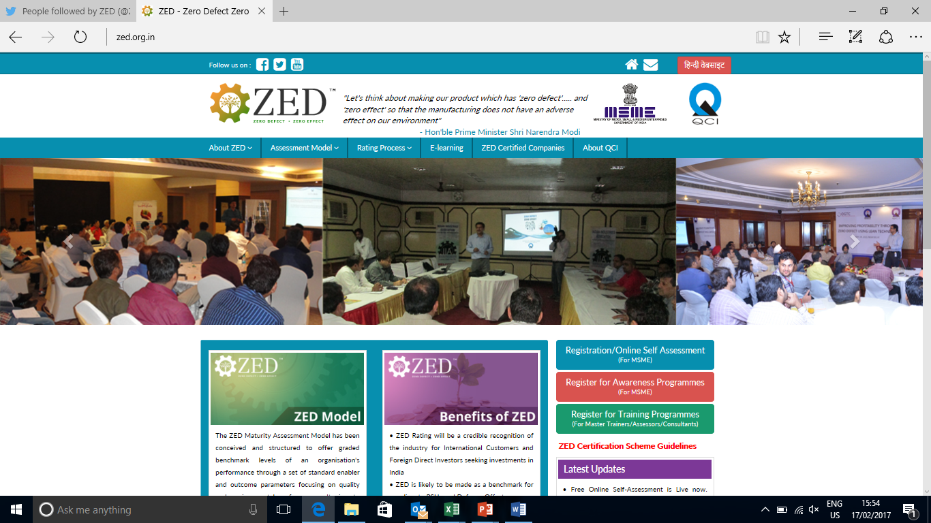
www.zed.org.in
ZED Registration Portal
FOR ONLINE REGISTRATIONS

Slide 23
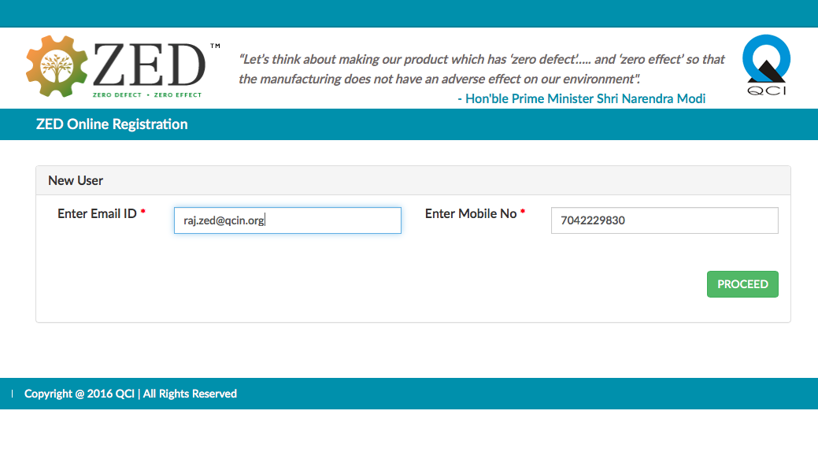
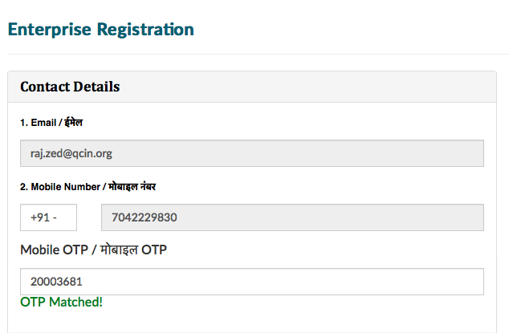

ZED Registration Portal

Slide 24
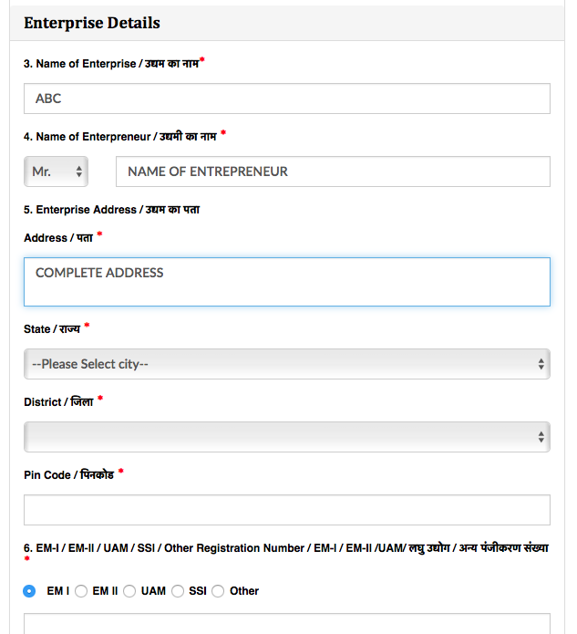
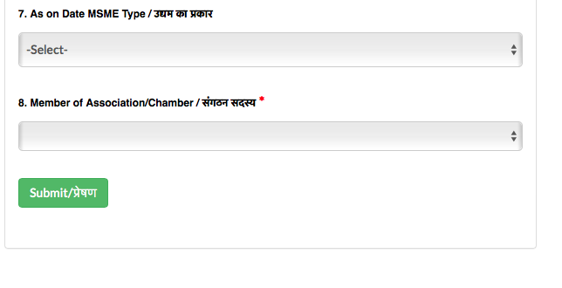
ZED Registration Portal

Slide 25
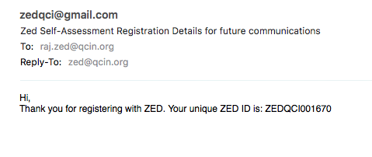
ZED Registration Portal

Slide 26
The ZED Maturity Assessment Model

Slide 27
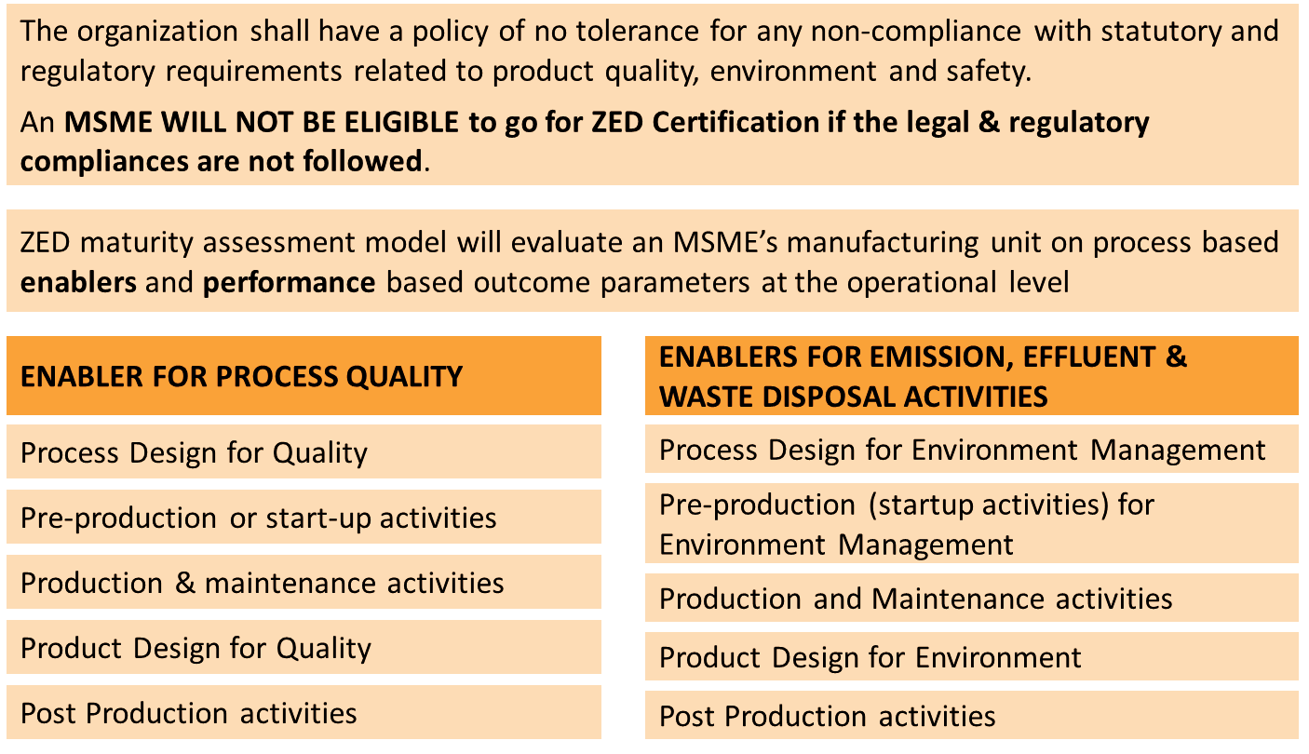
The ZED Model (1/2)

Slide 28
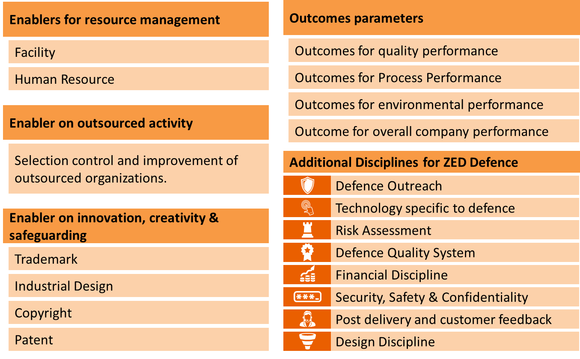
The ZED Model (2/2)

Slide 29
Major Interventions covered in ZED Parameters

Slide 30
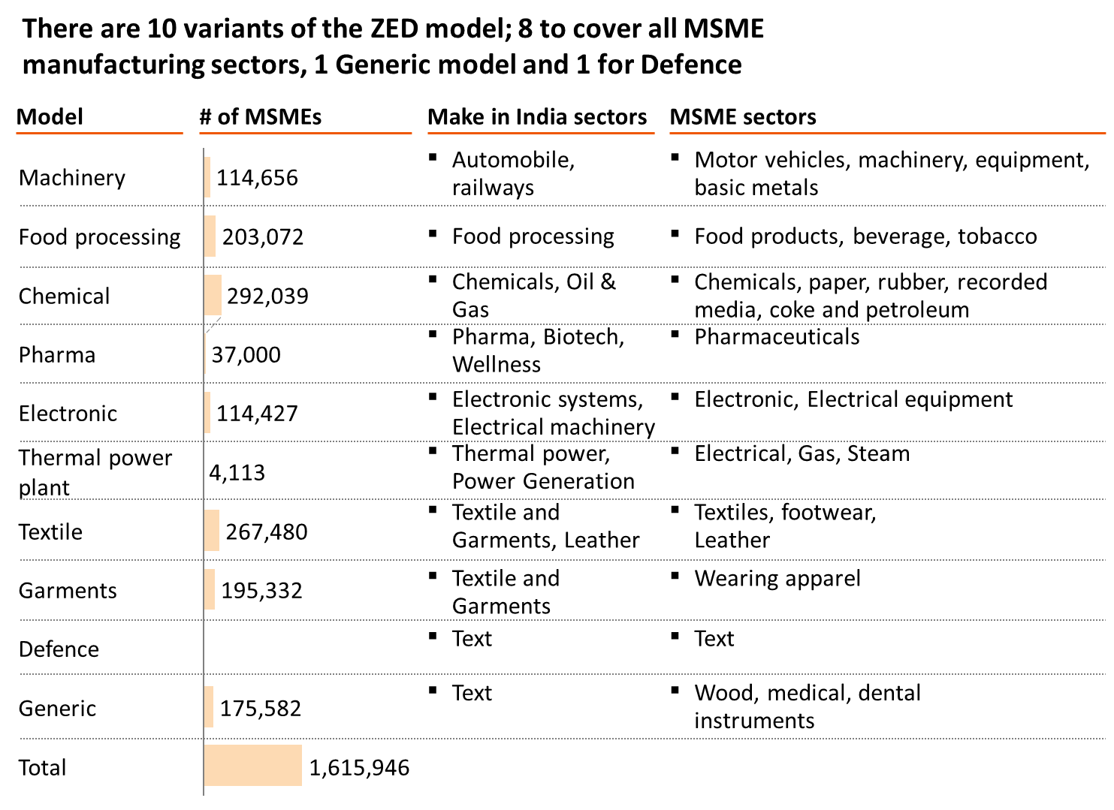

Slide 31
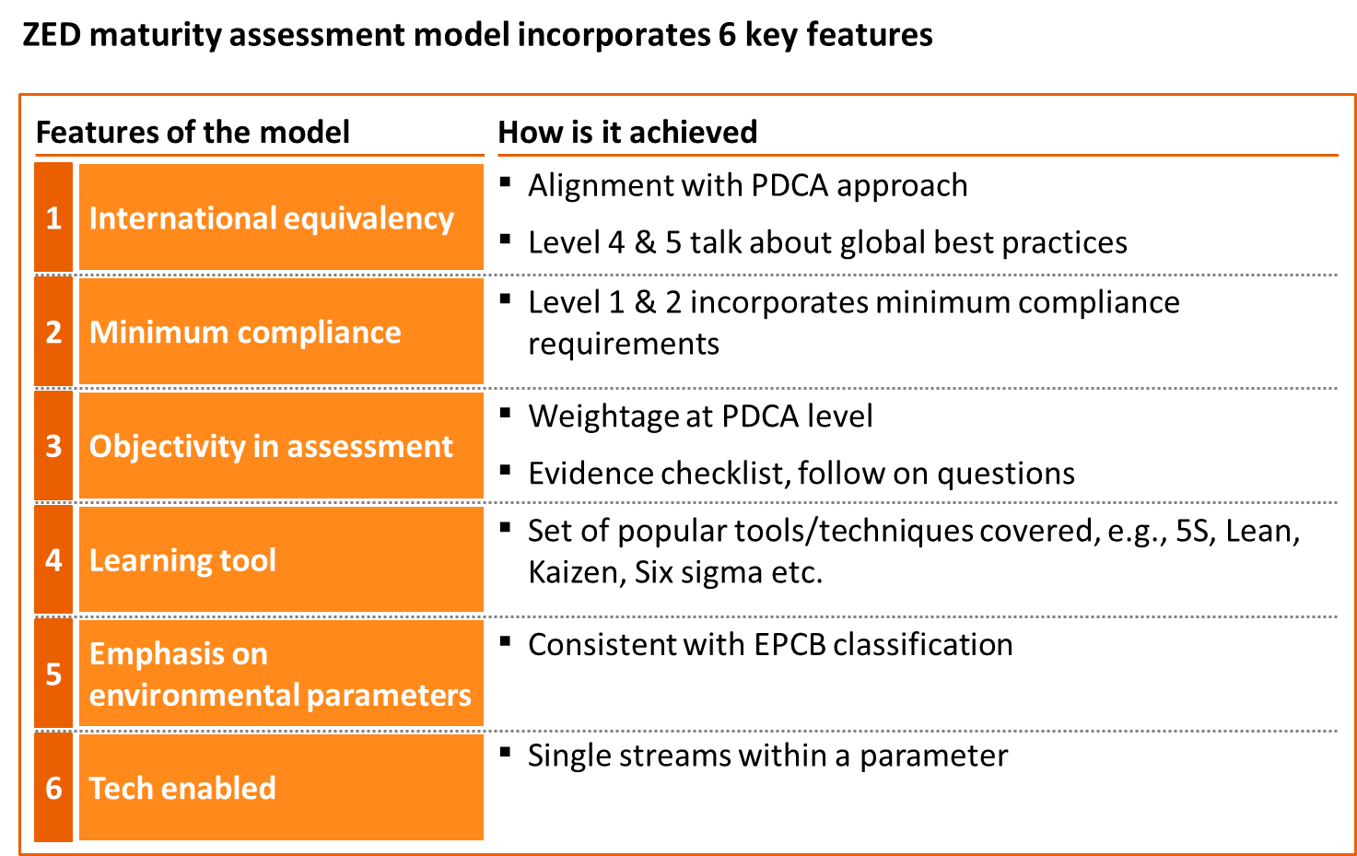

Slide 32
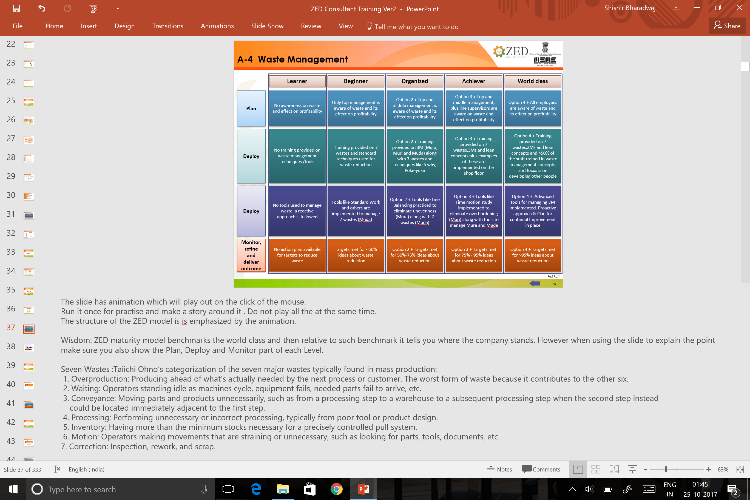
ZED Maturity Level

Slide 33
ZED model has been provided a framework equivalent to PDCA to ensure international equivalency
Description of Level 4 and Level 5 is representative of global best practices
Plan-Deploy-Monitor framework has been added for each parameter

Slide 34
Day 1 Session 3

Slide 35
PRODUCTION MANAGEMENT

Slide 36
Production Management
# | Clause | Topic
1 | A-4 | Waste Management
2 | C-1 | Swachh Workplace
3 | C-2 | Daily Work Management
4 | A-1 | Technology Upgradation
5 | A-3 | Low Cost Automation
6 | C-3 | Planned Maintenance
7 | P-4 | OEE
8 | K-1 | Plant Layout
9 | K-2 | Materials Management
10 | K-3 | Material Handling
11 | B-2 | Supplier Development
12 | M-1 | Outsourcing
13 | E-1 | Transport & Storage
14 | E-2 | Timely Delivery
15 | E-3 | Customer Education
16 | E-4 | Customer Servicing

Slide 37
A-4 Waste Management

Slide 38
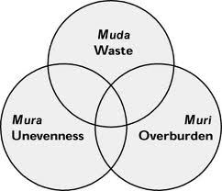
Work place design for reducing Muda, Mura, Muri (3M) in operations.
Notes:
Muda, Mura, Muri :Three terms often used together in the Toyota Production System (and called the Three Ms) that collectively describe wasteful practices to be eliminated.
Muda : Any activity that consumes resources without creating value for the customer. Within this general category it is useful to distinguish between type one muda, consisting of activities that cannot be eliminated immediately, and type two muda, consisting of activities that can be eliminated quickly through kaizen. An example of type one muda is a rework operation after a paintbooth, which is required to obtain a finish acceptable to the customer from a paint process that is not highly capable. Because a completely capable paint process for fine finishes has eluded manufacturers for decades, it is not likely that this type of muda can be eliminated quickly. An example of type two muda is multiple movements of products and inventories between steps in a fabrication and assembly process. These steps can be quickly eliminated in a kaizen workshop by moving production equipment and operators into a smoothly flowing cell.
Mura: Unevenness in an operation; for example, a gyrating schedule not caused by end-consumer demand but rather by the production system, or an uneven work pace in an operation causing operators to hurry and then wait. Unevenness often can be eliminated by managers through level scheduling and careful attention to the pace of work.
Muri Overburdening equipment or operators by requiring them to run at a higher or harder pace with more force and effort for a longer period of time than
Muda, Mura, and Muri in Conjunction: muda, mura, and muri often are related so that eliminating one also eliminates the others.
Wisdom:
And in most companies we still see the Mura of trying to “make the numbers” at the end of reporting periods. This causes sales to write too many orders toward the end of the period and production mangers to go too fast in trying to fill them, leaving undone the routine tasks necessary to sustain long-term performance. This wave of orders -- causing equipment and employees to work too hard as the finish line approaches -- creates the “overburden” of Muri. This in turn leads to downtime, mistakes, and backflows – the Muda of waiting, correction, and conveyance. The inevitable result is that Mura creates Muri that undercuts previous efforts to eliminate Muda.
Instruction:
Start with clear definition of Mura , Muri & Muda . The ask the participants to join in with their understanding . Conclude by saying that Muda has already been classified into 7 wastes as per lean and tools are developed to tackle them . What tools are developed for Mura & Muri. Bring to an understanding that lean tools are developed to tackle Mura , Muri and Muda which collectively describe all the waste.

Slide 39
A-4 Waste Management
Learner
Beginner
Organized
Achiever
World class
Plan
No awareness on waste and effect on profitability
Only top management is aware of waste and its effect on profitability
+ Top and middle management is aware of waste and its effect on profitability
+ Top and middle management, plus line supervisors are aware on waste and effect on profitability
+ All employees are aware of waste and its effect on profitability
Deploy
No training provided on waste management techniques /tools
Training provided on 7 wastes and standard techniques used for waste reduction
+ Training provided on 3M (Mura, Muri and Muda) along with 7 wastes and techniques like 5 why, Poke-yoke
+ Training provided on 7 wastes,3Ms and lean concepts plus examples of these are implemented on the shop floor
+ Training provided on 7 wastes,3Ms and lean concepts and >50% of the staff trained in waste management concepts and focus is on developing other people
Deploy
No tools used to manage waste, a reactive approach is followed
Tools like Standard Work and others are implemented to manage 7 wastes (Muda)
+ Tools Like Line Balancing practiced to eliminate unevenness (Mura) along with 7 wastes (Muda)
+ Tools like Time motion study implemented to eliminate overburdening (Muri) along with tools to manage Mura and Muda
+ Advanced tools for managing 3M Implemented. Proactive approach & Plan for continual Improvement in place
Monitor, refine and deliver outcome
No action plan available for targets to reduce waste
Targets met for <50% ideas about waste reduction
+ Targets met for 50%-75% ideas about waste reduction
+ Targets met for 75% - 95% ideas about waste reduction
+ Targets met for >95% ideas about waste reduction
Notes:
The slide has animation which will play out on the click of the mouse.
Run it once for practise and make a story around it . Do not play all the at the same time.
The structure of the ZED model is is emphasized by the animation.
Wisdom: ZED maturity model benchmarks the world class and then relative to such benchmark it tells you where the company stands. However when using the slide to explain the point make sure you also show the Plan, Deploy and Monitor part of each Level.
Seven Wastes :Taiichi Ohno’s categorization of the seven major wastes typically found in mass production:
1. Overproduction: Producing ahead of what’s actually needed by the next process or customer. The worst form of waste because it contributes to the other six.
2. Waiting: Operators standing idle as machines cycle, equipment fails, needed parts fail to arrive, etc.
3. Conveyance: Moving parts and products unnecessarily, such as from a processing step to a warehouse to a subsequent processing step when the second step instead
could be located immediately adjacent to the first step.
4. Processing: Performing unnecessary or incorrect processing, typically from poor tool or product design.
5. Inventory: Having more than the minimum stocks necessary for a precisely controlled pull system.
6. Motion: Operators making movements that are straining or unnecessary, such as looking for parts, tools, documents, etc.
7. Correction: Inspection, rework, and scrap.
Wisdom: Discuss the tools that attack each form of waste . If Overproduction is the biggest waste which is the tool used to control over production?
Relate the first Slide on Mura , Muri and Muda to this one.

Slide 40
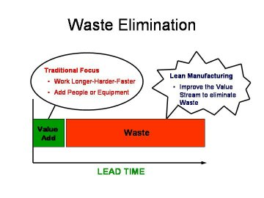
How to reduce Waste (Muda)?
1. Detect Waste
2. Eliminate Waste
WASTE
3. Prevent Waste
Notes:
Discuss : If the waste is measured in terms of time . That is if the throughput time or lead time is to be reduced then what are the tools available to do that ?
Identification of waste is just the beginning , removal the second step but the preventing from waste arising again is the job of management.
mention again how Mura, Muri and Muda play out again .
Lean or Toyota Production system has “ Stability “ as one of the key assumptions . If the environment is not stable it will make removal of waste difficult.
Question : What tools do we use to create a constant load on production ?

Slide 41
C-1 Swachh Workplace

Slide 42
Create a clean, tidy, organized and cheerful workplace for improving productivity by involving all

Slide 43
C-1 Swach workplace
Learner
Beginner
Organized
Achiever
World class
Plan
No communication and training imparted to anyone on 5S
50%-100% workforce trained on 5S by management or external consultants
+ 100% workforce trained on 5S activities, best zones identified and recognized on a monthly basis
+ Visual management on 5S is seen everywhere. Continuous Improvement Activities are evident and ongoing
+ Standard work + Daily 5S (self-driven ) is evident along with visual management of 5S
Deploy
Work area is full of clutter (scrap etc.) and floor space dirty
1S implemented (discrimination between necessary and unnecessary to discard the latter)
+ 2S (Ensure everything has a designated place) and 3S (ensure cleanliness of workplace) implemented
+ 4S (Standardization of procedures) have been implemented using various tools, e.g., job cycle charts, visual cues, checklist etc.
+ All 5Ss implemented (training and audit in place)
Monitor, refine and deliver outcome
No framework exists for 5S audit assessment
Well defined 5S audit assessment framework in place, pictures taken highlighting improved appearance. Audit assessment score for 1S and 2S >80% across zones
+ 5S Audit assessment score for 2S and 3S > 80% across zones
+ 5S Audit assessment score for 4S > 80% across zones
+ 5S Audit assessment score for 5S > 80% across zones
Notes:
Definition :Five Ss Five related terms, beginning with an S sound, describing workplace practices conducive to visual control and lean production.
The five terms in Japanese are:
Seiri: Separate needed from unneeded items— tools, parts, materials, paperwork— and discard the unneeded.
Seiton: Neatly arrange what is left— a place for everything and everything in its place.
Seiso: Clean and wash.
Seiketsu: Cleanliness resulting from regular performance of the first three Ss.
Shitsuke: Discipline, to perform the first four Ss.
The Five Ss often are translated into English as Sort, Straighten, Shine, Standardize, and Sustain. Some lean practitioners add a sixth S for Safety: Establish and practice safety procedures in the workshop and office.
Wisdom: 5S applies to the whole of the company . Though this may be more easily noticeable on the shop floor . This practise of 5S meshes the FIFO principle and neatly arranging things . Usually the Seiri & Seiton are mostly used together . Seiso is cleaning mostly to do make sure that leaks & metal chops do not casue too much of damage. It is not about using too much of paint .
Keeping the rejected in red box is also sorting but this is not the main purpose of 5S

Slide 44
C-2 Daily Work Management

Slide 45
Create a continually improving workplace for enhancing quality, productivity and safety by involving all on daily basis

Slide 46
C-2 Daily Works Management
Learner
Beginner
Organized
Achiever
World class
Plan
Daily targets are set by fighting on day to day basis
Adhoc target setting on Quality, Cost and Delivery
+ Target setting done for Safety and Morale along with Quality, Cost and Delivery with clearly defined sub-parameters for each of QCDSM
+ Dashboard established across product lines for monitoring performance on QCDSM
+ Target Setting for QCDSM clearly linked with the long term strategy. Plan should be derived from the organisation's Vision / Mission and the long term /annual objectives
Deploy
No visual target management system in place
Formal visual management highlighting targets to be achieved in a day on a board
+ Visual boards to showcase the daily , weekly and monthly performance of workmen
+ Digital board highlighting the performance on QCDSM on a daily basis, MTD/YTD Target (plan & achievement).
+ Digital board highlighting positive & negative/critical issues and reasons in performance gaps. Performer of the week/day/month is identified in addition to highlighting performance on QCDSM
Deploy
No workman participation in daily meetings
Workmen participate in daily meetings, however agenda and effectiveness not established ( Formal / informal )
+ Majority of the workmen participate in daily stand -up short meetings with defined agenda
+ All workmen participate in daily meeting. Flexibility to adjust staffing when the situation warrants. Cross Training, Job rotation and shared resources (90% to 100% workmen involvement).
+ 100% participation + Practice of recording of ideas and improvement plans during the shift and its implementation on floor. SGA and suggestions schemes are helping achieve improvement targets
Monitor, refine and deliver outcome
No concept of corrective actions to address gaps in QCDSM targets
Adhoc corrective actions implemented to address gaps in QCDSM targets
+ All corrective actions are implemented to address gaps in QCDSM targets
+ All corrective actions are implemented and risk mitigation done to avoid gaps in QCDSM targets elsewhere, e.g. other lines
+ All corrective actions are implemented and risk mitigation done to avoid gaps in QCDSM targets elsewhere e.g. other lines and effectiveness is also measured
Monitor, refine and deliver outcome
No targets have been set for QCD improvements
<50% targets have been met for QCD improvements
+ 50-75% targets have been met for QCD improvements
+ 75-95% targets have been met for QCD improvements
+ >95% targets have been met for QCD improvements
Notes:
Definition : Daily Works Management ( DWM) is a tools for dissipation of information , assigning tasks and conducting a short meeting on the shop floor involving all the shop floor managers, workers and supervisors. Good display board usually has display of data such as quality , and deliveries and skill matrix and also the big issues that the shop floor is dealing with.
Display charts usually show trends, Pareto, root cause and action plan for a particular parameter. This also means that a lot of data based decisions and information is dissipated within an organisation.
Wisdom: Not all organisations can have a deploy a manpower to create a fancy board that needs daily update. Smaller organisation will display only very important instructions. One great feature of the Totyota Production system is that it requires very less management intervention in daily work. So one purpose of DWM is to make sure that all information and instructions needed by a worker to carry out his work is readily available not dependent on shop floor managers or supervisors.
Conduct a group discussion to find out what should be on display according to the size of the organisation and skill levels of workers. Also discuss what not to put on the board. What will happen an organisation is harsh on people making errors? Will this work ? Discuss

Slide 47
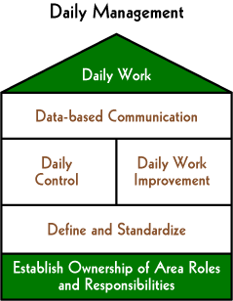
Daily Work Management

Slide 48
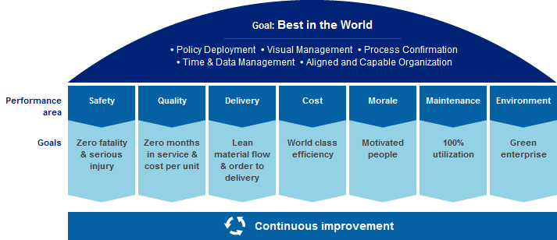
Daily Work

Slide 49
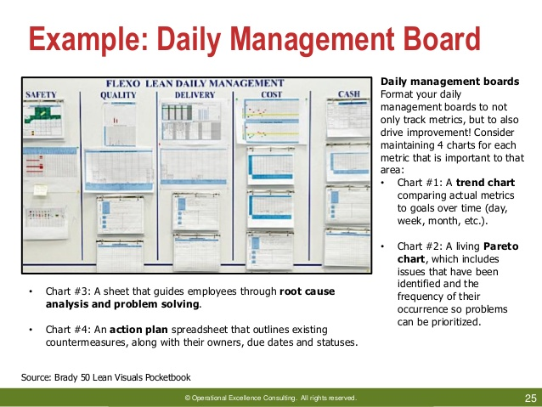
Daily Work Management Board

Slide 50
A-1 Technology Upgradation

Slide 51
Design, develop & upgrade or source technology commensurate with product design that meets changing customer and market need on a consistent basis

Slide 52
A-1 Technology selection & continual Upgradation
Learner
Beginner
Organized
Achiever
World class
Plan
No technology upgradation plans
Technology upgradation exists but is reactive (planning initiated only when something goes wrong)
+ Proactive technology plans in place incorporating customer/market needs for technology selection
+ Technology planned proactively incorporating customer/market needs using process/design failure analysis
+ Proactive technology planning with linkage to outcome w.r.t quality, availability & performance, Process capability enhancement & Opex improvement
Deploy
None of the critical machines are automated
Few critical machines are automated but setting is mostly manual
+ 20-50% critical machines have automated setting
+ 50-75% critical machines have automated setting
+ >75% critical machines have automated setting
Monitor, refine and deliver outcome
No system for monitoring processes/machines
Manual monitoring is done for all machines
+ Alarms /trips installed to monitor machines
+ Alarms /trips with feedback loop for correction established to monitor machines
+ 30-60% of machines have automated monitoring and control systems and self monitoring e.g. Andon systems
Notes:
This parameter is part of the Process Design for Quality discipline. The aim is to look at how the company selects a technology to meet the customer requirements. However in case of an existing technology what efforts has a company put into upgrading it . Automated alarms or trips or better monitoring modifications with more visual control help a company in better manpower utilization.
In any productivity improvement program the first step is to differentiate between manual work and machine work . Since quite a lot of work is not being done by machine and a worker loads and unloads a job, a good automation coupled with good manufacturing plan can help a company use one worker for many machines.
Definition:
Andon: A visual management tool that highlights the status of operations in an area at a single glance and that signals whenever an abnormality occurs. An andon can indicate production status (for example, which machines are operating), an abnormality (for example, machine downtime, a quality problem, tooling faults, operator delays, and materials shortages), and needed actions, such as changeovers. An andon also can be used to display the status of production in terms of the number of units planned versus actual output. A typical andon, which is the Japanese term for “lamp,” is an overhead signboard with rows of numbers corresponding to work- stations or machines. A number lights when a problem is detected by a machine sensor, which automatically pulls a cord or pushes a button. The illuminated number summons a quick response from the team leader. Colored lighting on top of machines to signal problems (red) or normal operations (green) is another type of andon.
Jidoka: Providing machines and operators the ability to detect when an abnormal condition has occurred and immediately stop work. This enables operations to build in quality at each process and to separate men and machines for more efficient work. Jidoka is one of the two pillars of the Toyota Production System along with just-in-time. Jidoka highlights the causes of problems because work stops immediately when a problem first occurs. This leads to improvements in the processes that build in quality by eliminating the root causes of defects. Jidoka sometimes is called autonomation, meaning automation with human intelligence. This is because it gives equipment the ability to distinguish good parts from bad autonomously, without being monitored by an operator. This eliminates the need for operators to continuously watch machines and leads in turn to large productivity gains because one operator can handle several machines, often termed multiprocess handling.
Wisdom: Under what conditions does a small or medium manufacturing unit go for technology upgradation? Discuss on how we arrive at buying a new machine or technology ? What fears does a company have while making this investment ? What are pitfalls in doing the ROI calculation and how can they be managed?
Discuss how Jidoka & Andon can be used for improving productivity ? Quote on example

Slide 53
A-3 Low Cost Automation

Slide 54
Replacing manual efforts with alternate mechanized operations developed locally to reduce quality variations, time & cost of operations

Slide 55
A-3 Low Cost Automation
Learner
Beginner
Organized
Achiever
World class
Plan
No awareness or emphasis on low cost automation
Low cost automation is mainly done to improve productivity by senior management
+ Low cost automation is aimed at improve productivity, quality and capacity utilization and goals are set
+ Low cost automation is aimed at addressing energy conservation along with productivity, quality and capacity utilisation
+ Continuous identification of improvement areas to apply low cost automation systems in place along with ensuring energy conservation
Deploy
Low cost automation is not done
Low cost automation is done on adhoc basis
+ Low cost automation done in small groups using various tools (e.g. Kaizen sheets, one point lessons)
+ Low cost automation is evident by usage of Pneumatic, hydraulic , electric , hybrid , electronic controlled systems in a wide variety of manufacturing areas
+ Low cost automation has led to reduced man effort on machines by more than 50% especially on loading , feeding , setting , material handling , quality inspection & packaging
Monitor, refine and deliver outcome
Improvement goals for low cost automation are not measured
Improvement goals met in case of <50%
+ Improvement goals met in case of >50%-75%
+ Improvement goals met in case of 75% to 95%
+ Improvement goals met in case of >95% of cases
Notes:
Definition : It is a technology that creates some degree of automation around the existing equipment, tools, method and people, using mostly standards components available in the market.
A wide range of activities like loading , feeding , clamping , machining , welding inspection etc are good areas for LCA.
Second characteristic is that the payback period of such investment is very short .
Wisdom:
Kaizen activities could be a systematic approach for looking at LCA. However doing Kaizen has its sequence , first do the manual kaizen , then process kaizen and then machine kaizen. A huge amount of automation at low cost is done when we do process kaizen & manual kaizen. Starting machine Kaizen is the last resort but a good low cost modification can bring huge productivity gain.
Discuss on how low cost automation has aided the growth of many companies. Usually the small incremental growth of output after an installation a new technology is due to these low cost automation. This helps in increasing output while keeping operating expense down.

Slide 56
What is Low Cost Automation?
Low Cost Automation(LCA) is the introduction of simple pneumatic, hydraulic, mechanical and electrical devices into the existing production machinery, with a view to improving their productivity.
LCA is a technology that creates some degree of automation around the existing equipment, tools, methods, and people, using mostly standard components available in the market.
LCA allows low investment so that the pay back period is short, typically of the order of a few weeks to less than a year.

Slide 57
Advantages of LCA
Low investment: While capital equipment is expensive and has long payback period, LCA is built around existing resources. Hence, the investments required are lower and payback period short.
Labour productivity can be enhanced using LCA.
Low Capacity: Expensive automation needs large turnover to be cost-effective. LCA can be viable at low volume of production, typically in SMEs.
Less Wastage: Better utilization of material, less Work In Progress (WIP) and less rejection. LCA can help curtail such wastage.

Slide 58
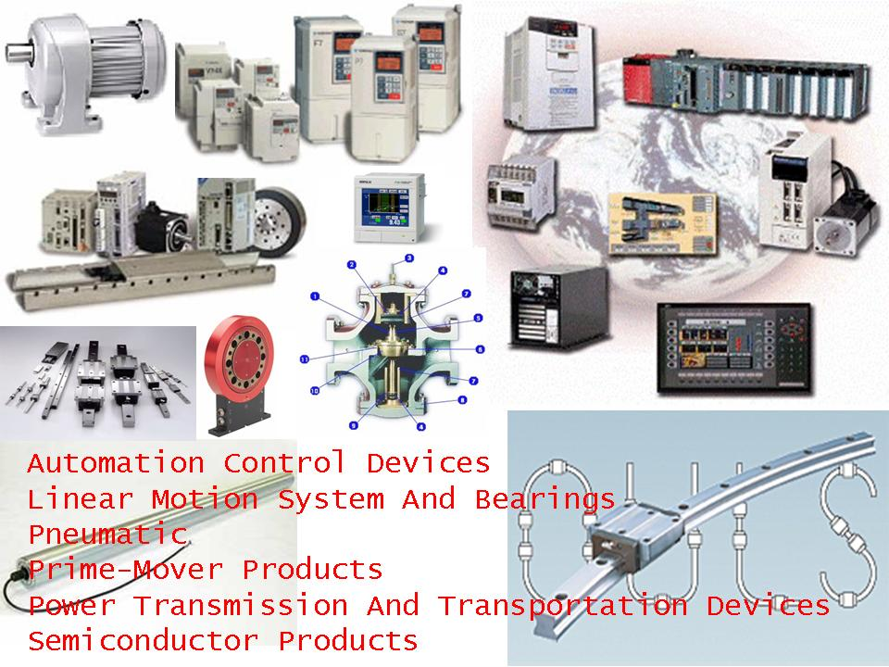
LCA Mechanisms

Slide 59
Exercise-2
Pertaining to the following requirements:
1. Waste Management,
2. Swachh Workplace
3. Daily Work Management in a SME
4. Low cost Automation
5. Technology Upgradation
Develop:
Three main questions to assess the requirement
Three main steps to implement

Slide 60
C-3 Planned Maintenance

Slide 61
Scheduled maintenance at fixed intervals, ensuring that the equipment or item is operating reliably at reduced cost and downtime

Slide 62
C-3 Planned maintenance
Learner
Beginner
Organized
Achiever
World class
Plan
No Preventive maintenance plan in place
Preventive Maintenance plan is available for <50% critical machines
+ Preventive Maintenance plan is available for 50%-75% of critical machines
+ Preventive Maintenance plan is available for 100% critical machines
+ Preventive Maintenance plan is available for all machines (including non-critical)
Deploy
No system of planned maintenance
Adherence to planned maintenance plan is <80%
+ adherence to planned maintenance plan is 80%-95%
+ Adherence to planned maintenance plan is >95%
+ 100 adherence for planned maintenance plan plus World Class Maintenance practices have become part of company culture e.g. TPM
Deploy
Equipments are repaired as and when breakdown occurs
There is clear understanding of equipment functions and safety risks (Step 0 of autonomous maintenance)
+ Step 1-2-3 of autonomous maintenance implemented
Step 1 - Initial cleaning and tagging
Step 2 - Counter-measures for contamination/dirt
Step 3 - Cleaning inspection and lubrication standards
+ Step 4-5 of autonomous maintenance implemented
Step 4 - General Inspection
Step 5 - Autonomous Inspection
+ Step 6-7 of autonomous maintenance implemented
Step 6 - Standardisation
Step 7 - Autonomous management
Monitor, refine and deliver outcome
Effectiveness of maintenance is not measured
Effectiveness of maintenance is measured on adhoc basis
+ MTTR and MTBF measured for <30% of critical machines
+ MTTR and MTBF measured for 30-60% of critical machines
+ MTTR and MTBF measured for >60% of critical machines and it shows an improving trend
Notes:
Definition :Total Productive Maintenance (TPM) A set of techniques, originally pioneered by Denso in the Toyota Group in Japan, to ensure that every machine in a production process always is able to perform its required tasks. The approach is termed total in three senses. First, it requires the total participation of all employees, not only maintenance personnel but line managers, manufacturing engineers, quality experts, and operators. Second, it seeks total productivity of equipment by focusing on all of the six major losses that plague equipment: downtime, changeover time, minor stops, speed losses, scrap, and rework. Third, it addresses the total life cycle of equipment to revise maintenance practices, activities, and improvements in relation to where equipment is in its life cycle. Unlike traditional preventive maintenance, which relies on maintenance personnel, TPM involves operators in routine maintenance, improvement projects, and simple repairs. For example, operators perform daily activities such as lubricating, cleaning, tightening, and inspecting equipment.
Seven steps of Autonomous Maintenance
Cleaning and Inspection
This is a similar stage to the 5S Shine stage with a similar purpose. We need to remove all dirt and grime from the machine, not for the purposes of making the machine pretty but to uncover and highlight any and all problems within the machine. This will require the machine to be taken out of production, all fluids drained and covers removed so that every part of the machine can be inspected and cleaned. We seek to remove the grime of past years and bring the machine back to how it was when it was first purchased, thoroughly inspecting each and every part of the machine to highlight any damage or wear.
The cleaning and inspection should be done by the operators and maintenance crew responsible for the machine so that they become familiar with the machines details and can see where dirt accumulates and how and what problems are occurring.
Remove Causes of Contamination and improve Access
When we clean and inspect our machines we should look at where the dirt that we remove is coming from; is it being produced inside the machine or is it coming into the machine from outside. We should seek to either remove or minimise these sources of contamination that cause us to need to clean our machines.
We should also look at any areas that are difficult to reach or that may be unsafe to improve access to them so that future cleaning and inspection can be done without problems and as quickly as possible.
Cleaning and Lubrication Standards
The first two stages set the stage for the operators to define the maintenance steps that they can conduct to prevent further deterioration of the machine. They have to define what they will clean, lubricate, tighten and inspect, how they will do it, how often and so forth to ensure that they keep the machine in its optimum condition.
Train for general Inspections
We now have the experts (maintenance technicians, team leaders) conduct in depth training with the operators to explain the function and purpose of each component of the machine as well as training in problem solving skills such as the 5 whys.
We then have the operators re-inspect the machines with their new-found knowledge and highlight any new problems discovered in much the same way that we did in stage one.
Conduct Autonomous Inspections
With what they have learned in stage 4 the operators modify the standards and instructions that they put in place for the first three stages of autonomous maintenance to streamline and improve their maintenance tasks.
The tasks at this stage are also compared and rationalized with the maintenance departments own maintenance schedules allowing tasks to be allocated correctly and prevent duplication of effort.
Implement Visual Maintenance Management
Just as in 5S, one of the main aims of TPM is standardisation, we seek to standardise the maintenance work that we do and also try to make the workplace as “visual” as possible. We create formal standards for our autonomous maintenance and look at improving the visual management of our machines. We highlight the direction of flow of fluids through pipework, which way levers and valves have to be turned to open and close, highlight “safe” or “normal” operating values on gauges and sight glasses in green and undesirable readings in red, all to make things as obvious as possible to anyone if things are operating correctly. The various principles of 5S should be thoroughly applied not just to the machine but the relevant associated equipment, tools and materials.
Continuous Improvement
We repeat and improve on all that we have found and done in the previous stages to continually improve and reinforce what we are doing with autonomous maintenance. We maintain good records of what we have done and the failures that occur and so forth that can then be fed back to the maintenance technicians to be integrated into future designs of machines to improve reliability and make maintenance easier.
Team leaders, managers and maintenance technicians should also audit the work done by the operators on a regular basis to be able to both congratulate the operators on a job well done and to give them the benefits of their knowledge.
Wisdom: Bring out the essential difference in Preventive, Predictive and productive maintenance . Usually preventive is already predetermined and over the a time the user shall know the exact behaviour of the machine and thus can predict the failures. To do so he will require to capture a data and calculate MTTR & MTBF .
However a zero breakdown is considered too conservative but a trend of reducing downtimes is more desirable . Discuss why ?

Slide 63
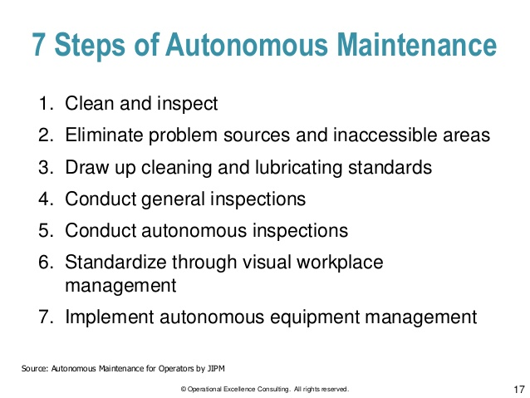

Slide 64
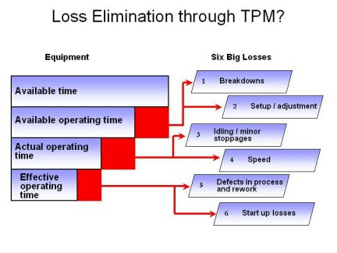
Six Big Losses of Equipment

Slide 65
P-4 Overall Equipment Effectiveness
Notes:
Definition:
Overall Equipment Effectiveness (OEE) A total productive maintenance (TPM) measure of how effectively equipment is being used
OEE is calculated from three elements: The availability rate measures downtime losses from equipment failures and adjustments as a percentage of scheduled time. The performance rate measures operating speed losses— running at speeds lower than design speed and stoppages lasting a few seconds. The quality rate expresses losses due to scrap and rework as a percentage of total parts run.
These elements are multiplied to obtain OEE: Availability Rate × Performance Rate × Quality Rate = OEE
If Availability is 90%, Performance is 95%, and Quality is 99% then 0.90 × 0.95 × 0.99 = 84.6% OEE
OEE typically focuses on what are termed the six major losses— failures, adjustments, minor stoppages, reduced operating speeds, scrap, and rework

Slide 66
To assess the impact of planned maintenance

Slide 67
P-4 Overall Equipment Effectiveness
Initial
Beginner
Organized
Achiever
World class
Monitor, refine and deliver outcome
No awareness on OEE, not being calculated as of now
Training has been Imparted to measure OEE, data collection started. OEE is up to 50%
+ OEE is between 50% and 60%
OEE is between 60% and 85%
OEE>85%
Notes:
Wisdom : Can you have a OEE for the plant ? How should one use OEE in management ? Can we increase OEE and still suffer from delivery issues and more quality problems?
Usually if OEE of any one of the equipment is more than 95% then it is quite likely that it is a constraint and limiting your ability to make more money. However many companies add more to OEE so that it makes more sense in their conditions.
Have a good discussion or ask a participant if he /She has a good example of real time OEE use for improving the maintenance program

Slide 68
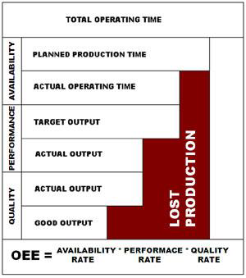
Overall Equipment Effectiveness (OEE)
Overall Equipment Effectiveness (OEE) is the key metric to measure the performance of individual equipment. However, when machines operate jointly in a manufacturing line, OEE alone is not sufficient to improve the performance of the system as a whole
Example: One company
producing deep drawn steel
components using a power
press, which is having
-Equipment Availability:50%
-Performance Rate: 70% &
-Quality Rejection Rate: 20%
OEE = A X P X Q
= 0.5 X 0.7 X 0.8 =28%

Slide 69
Exercise-2
How to implement following enablers in a SME:
1. Technology upgradation
2. Low Cost Automation
3. Planned Maintenance
4. OEE
Develop practical action plan and schedule for progressing from level 1 to level 3 maturity
Specify the current state and target state with timeline
How will you ensure you have reached desired state?
What action will you take if not attained the target?

Slide 70
K-1 Plant Layout

Slide 71
Planning for the location of all machines, utilities, employee workstations, material storage areas, pathways, service areas, space necessary for the operation of processes, and for the flow of materials and people movement within plant area

Slide 72
K-1 Plant Layout
Learner
Beginner
Organized
Achiever
World class
Plan
Existing layout does not have provisions for future expansion or changes to the product mix
Specific team established responsible for plant layout to ensure layout conducive to linear material flow
+ Layout supports full segregation of materials based on grades and types, rework, reject status on the shop floor
+ Reduction in material distance, time and manpower is measured and reviewed for continual improvement
+ Focus on Multipurpose machines / equipments to avoid space constraints
Deploy
No specific team available to ensure improvements In layout
People are trained and teams are formed for improvements in layout. Specific teams established responsible for linear flow
+ Layouts are reviewed periodically and improved
+ Comparison of various layout options with the help of cross functional team. Lean principles & processes are implemented in the organization
+ Lean Layout solutions have improved safety and reduced production lead times; Cellular designs
Monitor, refine and deliver outcome
Unorganized way of plant lay outing , machines / equipments are kept unsystematically , no specific flow is maintained
Some efforts are made to improve plant layout, e.g. Wastes attributed to unplanned layout are identified, pathway markings available
+ Layout considers flow from raw material receipt to dispatch point with straight line pathways
+ Visual management of total flow and plant layout exist
+ Regular monitoring of benefits of improved layout is done for PDCA

Slide 73
JIT Layout
Reduce waste due to movement
JIT Layout Tactics
Build work cells for families of products
Include a large number operations in a small area
Minimize distance
Design little space for inventory
Improve employee communication
Use Poka-yoke (fail safe) devices
Build flexible or movable equipment
Cross-train workers to add flexibility

Slide 74
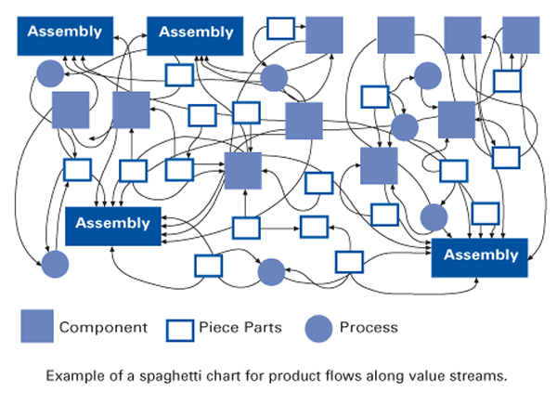
Randomly developed Layout
Notes:
Definition :
Process Village :A grouping of activities by type rather than in the sequence needed to design or make a product. Historically, most organizations created process villages for activities ranging from grinding on the shop floor to credit checking in the office. Lean organizations try to relocate process steps, wherever possible, from villages into process sequences for product families.
Aim of the plant layout is to improve material flow.
In a bid to utilize space on the shop floor or show better space utilization machines are installed in a area where space utilization is better. Due to this a material may have to travel a lot of distance before it can be ready for dispatch . Good plant layout practise will focus on reducing the waste of motion , inventory and handling while making it easier for visual management . A flow line also requires less of supervision and the workers knows where the material is lying on which he has top process.
Wisdom: Start with asking what is the job of a supervisor ? What does one see him do on the shop floor ? How of his job is just co ordinating ?
Then introduce the concept of visual management to solve these issues. Bring out a discussion that material movement from one machine to next need not be co ordinated by a supervisor and less manpower will be needed on the shop floor for moving the material to the next operation.

Slide 75
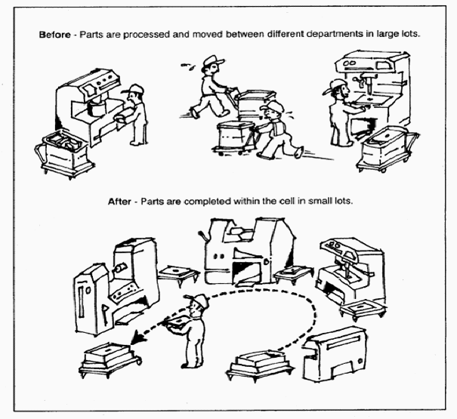
Types of Layout
Islands (isolated processes)
Connected Islands
Connected islands with full work control
Cells
Notes:
Definition:
Cell :The location of processing steps for a product immediately adjacent to each other so that parts, documents, etc., can be processed in very nearly continuous flow, either one at a time or in small batch sizes that are maintained through the complete sequence of processing steps. A U shape is common because it minimizes walking distance and allows different combinations of work tasks for operators. This is an important consideration in lean production because the number of operators in a cell will change with changes in demand. A U shape also facilitates performance of the first and last steps in the process by the same operator, which is helpful in maintaining work pace and smooth flow.
Wisdom: Which cell layout is better ? Left or right ? If the utilisation efficiency of equipment is high in the case of left layout why shouldn’t we go for that ? Touch on number of people working , inventory levels and wait time . Then conclude that right side is better because it is the layout which increases flow of material through the operations.

Slide 76
K-2 Materials Management

Slide 77
Facilities for the safe and systematic storage under controlled conditions, of raw materials, consumables, spares, in-process material, semi-finished products and assemblies, finished products, packaged products, with due identification, traceability systems to permit easy access and retrieval

Slide 78
K-2 Material Management
Learner
Beginner
Organized
Achiever
World class
Plan
SCM practices remain unstructured and ill-defined. Individual heroics and working around the system are what makes things happen. Organisational structures are based on the traditional functions ; no horizontal supply chain processes
Basic SCM processes such as order commitment, procurement and inventory management are defined and documented
+ Advance planning and scheduling (APS) begins to occur, providers are given access to actual planning schedules so that they can have the right equipment available and resource -alert at the right point ; A well-defined demand /supply balancing processes that combines forecasting and planning with sourcing and manufacturing is evident at this level
+ The company, its vendors and suppliers, co-operate at process level. SCM measures and management systems are deeply imbedded in the organisation. Joint contract agreements are used ; Firms create "win-win” solution through closure cooperation, frequent communication and partnership
+ Trust and mutual dependency are the glue holding the extended supply chain together. The firms have applied activity based costing to determine the cost per unit across the end to end network, they work together on the most cost-effective methodology while keeping customer rating at industry-best standards
Deploy
No system in place to minimize inventory
Adhoc methods to control inventory
+ Demand characteristics like volatility , seasonality, latency and short order lead times are routinely factored in for managing the supply chain
+ Inventory management is based on the control and optimization of product supply. Clear processes and roles for making replenishment , production and sourcing decisions are in place
+ Suppliers are enabled to produce and deliver materials in a timely, low cost fashion that allows to further minimize inventory and cost of materials while elevating supplier’s competitiveness
Monitor, refine and deliver outcome
Frequent delays in availability of materials
80-90% timely availability of materials
90-95% timely availability of materials
>95% timely availability of materials
Just in time for the materials for all products / assemblies / components
Monitor, refine and deliver outcome
Higher inventory levels are maintained to ensure there are no stock-outs
Materials management team analyses demand consumption pattern to decide the stock levels
+ The decided stock levels are maintained and reviewed to ensure reduction in inventory
+ The reduction in inventory at all stages such as raw material , WIP, Finished goods, etc. is measured and reviewed for improvement
+ Warehouse management system , Information sharing and communication based on Internet has led to improved Inventory Turnover ratio consistently on year-on-year basis
Notes:
Material Management : The primary purpose is to increase availability while reducing inventory . Inventory reduction is much different from inventory management . Management deals with classification , location , storage and reporting about the assets the reduction in inventory requires dynamic system which calculate and order materials based on consumption .
Increasing the availability , by that we mean reducing stock out, is the main job of materials department . Purchasing plays a big part . However the purchasing person takes only five actions .
Places an order
Chases an order
Reduces an ordered quantity
Defers a delivery date
Cacels an order
In case a company has to better manage its materials supply and inventory it should taking these decisions.
Wisdom : It is seen in most companies that we are dealing with shortages . In fact most of the review meeting in the morning are called shortages meeting . How is it that while we have shortages we also carry a large amount of inventory always . So is it the shortages or the excess inventory that is the problem ?
While we are buying at cheaper per unit rate how is the cost of operation always going up ? In other words our productivity is falling . We are spending more and more on achieving the same throughput.

Slide 79
K-3 Material Handling

Slide 80
An integrated system of activities , equipment and procedures related to the moving , storing, protecting and controlling of materials that delivers the required material or product at the designated location at the right time in a safe and controlled manner
Notes:
Material handling is the movement, protection, storage and control of materials and products throughout manufacturing, warehousing, distribution, consumption and disposal. As a process, material handling incorporates a wide range of manual, semi-automated andautomated equipment and systems that support logistics and make the supply chain work.

Slide 81
K-3 Material Handling Systems
Learner
Beginner
Organized
Achiever
World class
Plan
Material handling systems are manual
Focus area of Material handling systems is to reduce cost, eliminate movement related quality issues
+ Focus area of Material handling systems is to eliminate waste time of operators /other resources and build quality into workplace system
Improvement goals and plans are made with the team after awareness training and participation
+ Material handling systems have been designed commensurate with products sensitivity and incidence of handling defects. Objective of the organisation is to keep the employees safe, keep the products supplied to the customer safe and improve supply management
+ Automated material handling systems in place and lean concepts implemented
Plan
No training on material handling and hazardous materials
Training only given to crane operators on material handling and hazardous materials
+ Few operators are trained through informal techniques on material handling and hazardous materials
+ Formal training is imparted and only critical operators are trained on material handling and hazardous materials
+ All concerned people trained on material handling and hazardous materials. Crane operators / hazardous material handling operators are certified
Deploy
Material handling is not seen as an activity that can improve productivity and quality
Team organized to identify handling issues at each stage, e.g.. Material receipt , Inspection/ acceptance, Storage etc.
+ Plan is in place to establish material handling system which is efficient, flexible, easy to deploy, scalable and affordable. Detailed SOP's and processes / Ready references for usage of right tool for the job; Quality defects /damages attributed to handling are identified and CAPAs undertaken
+ Benefits of material handling systems are being measured in terms of:
Response and retrieval time
Productivity of inventory
Elimination of unnecessary operations
Maximized floor space utility
Security and safety
Good house keeping
ption 4 + Continual PDCA for sustaining and improving material handling systems

Slide 82
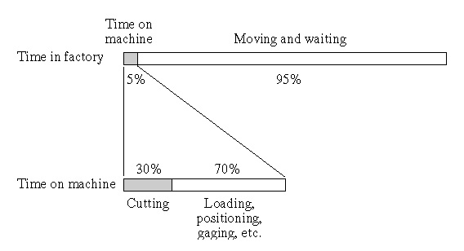
Time Spent in Material Handling

Slide 83
Exercise-2
Pertaining to the following requirements:
1. Plant Maintenance
2. OEE
3. Plant Layout
4. Materials management
5. Material Handling
Develop:
Three main questions to assess the requirement
Three main steps to implement

Slide 84
B-2 Supplier Development

Slide 85
Identify & develop supplier capability to enable supply of consistent conforming products and services to the organization and for outsourcing non-core activities while meeting the quality and reliability parameters
Notes:
Definition:
Supplier Development is the process of collaborating with suppliers to improve their processes and product manufacturing capabilities. Supplier knowledge and technology of the commodity they supply can be leveraged through supplier development with the OEM (Original Equipment Manufacturer) or service provider to reduce cost and lower project risk
Thus, a supplier development program must be aimed at improving suppliers performance, not browbeating them into charging less or simply auditing and rewarding them. Instead, supplier development is all about providing suppliers with what they need to be successful in the supply chain. Two of the most important functions of a supplier development program are:
Providing information about products, expected sales growth, etc. Poor communication is one of the biggest wastes with a lean supply chain. Lack of information translates into additional costs (usually in the form of just-in-case inventory). Suppliers need to become extensions of their customers.
Training in the application of lean and quality tools. Asking suppliers to drop their price without giving them the know-how to lower their costs through lean implementation is not sustainable long-term. In other words, this will drive suppliers out of business, which goes against the purpose of supplier development.
If suppliers had more information about the entire supply chain and had a true lean transformation underway, they would become more profitable and provide a better quality ane lower-cost product on-time.

Slide 86
B-2 Supplier Development
Learner
Beginner
Organized
Achiever
World class
Plan
No approach exists for new supplier development
Material/ data sheet / spec derivation used for new supplier development
+ Identified potential sources / areas for development of suppliers
+ Work together and create product development plan and organize resources
+ Work as a partner; Invest in R&D for technology development
Deploy
No development plan for managing existing suppliers
Development plan based on feedback from field / QC / Customer with critical suppliers
+ Periodic reviews conducted and plan fully implemented with critical suppliers
+ Supplier rating system in place based on periodic reviews of existing suppliers
+ Performance management including supplier rating is used for business allocation to different suppliers
Monitor, refine and deliver outcome
No systemic process in place for supplier evaluation
SOP developed for supplier evaluation ; Adhoc implementation
ption 2 + SOP developed for supplier evaluation ; 100% implementation
+ Supplier rating is basis for repeat ordering
+ Supplier core competency developed for productivity, quality and delivery

Slide 87
M-1 Outsourcing

Slide 88
Organization’s system for identification, evaluation, selection, monitoring of performance, providing feedback to outsourced organizations with the objective of enhancing value of partnership to both
Notes:
Outsourcing is a practice used by different companies to reduce costs by transferring portions of work to outside suppliers rather than completing it internally.
Outsourcing is an effective cost-saving strategy when used properly. It is sometimes more affordable to purchase a good from companies with than it is to produce the good internally.
Advantages of Outsourcing
Outsourcing can free up cash, personnel, facilities and time resources for a company.
It can result in cost savings from lower labor costs, taxes, energy costs and reductions in the cost of production.
In addition to cost savings, a company may also employ an outsourcing strategy in order to focus on its core business competencies. This allows the company to devote more resources to what it does well, which can improve efficiency and increase its competitiveness. Production can be streamlined and production time shortened while reducing operational costs.
Those non-core functions that are outsourced will usually go to outside organizations for whom that function is a core business competency, further benefiting the business through the improved management of those functions.
A company may also choose to outsource in order to avoid government regulations or mandates, such as environmental regulations or safety regulations and requirements.
Wisdom: Discuss why is the tier structure done in Auto supply chain ? Why is the contract manufacturing more done in electronics manufacturing industry ? What does look for when selecting a new supply source ?

Slide 89
M-1 Outsourced Activities : Selection, Control and Improvement
Learner
Beginner
Organized
Achiever
World class
Plan
No SOP in place for drawing contract agreements
SOP for drawing contract agreements
+ Contract agreements are in place
+ Established a formal legal relationship. Developed capability to build and enforce formalized contracts
+ Long term contracts / rate contracts for all key outsourced activities
Deploy
No formal selection process in place to select vendors for outsourcing
Defined selection process in place for selecting vendors for outsourcing but not followed effectively
+ A formal selection and evaluation process for vendors exists and periodic evaluation as per the evaluation process is done
+ Organisation has developed a deep and broad supplier base. Scout, identify and select potential partners proactively
+ Organisation has a deep understanding of what is core and what is non-core for business.
Monitor, refine and deliver outcome
Work outsourced without any evaluation of skills and resources
Performances of only key vendors are reviewed
+ A formal selection and evaluation process for vendors exists and periodic evaluation as per the evaluation process is done
+ Clear metrics and incentives are in place. Frequent dialogue and collaborative discussions for product / service improvements and sharing of knowledge. Vendors considered as partners and work with them to evaluate the current processes to identify improvement opportunities such as technology changes etc.
+ The strengths of outsourcing partners are identified based on reviews and used for innovation in products. Develop and apply advance sourcing strategies and deep clarity on make and buy decisions with implementation framework

Slide 90
E-1 Transport and Storage

Slide 91
Facilities & methods for storage and transportation are appropriate to ensure product quality is retained till it reaches the customer

Slide 92
E-1 Transportation and Storage
Learner
Beginner
Organized
Achiever
World class
Plan
Organization not aware of usage of proper methods of transportation /storage of products based on the various product types
Customer needs and requirements for transportation/storage defined and finalized
+ Improvement activities/Kaizen in place for improvement of transportation and storage conditions in addition to defined customer needs
+ Resources are trained on transportation / storage techniques Practices like FIFO, visual management in addition to defined customer needs
+ Trained resources with effectiveness check done and same implemented in operations like Modern storage facilities in place, ABC Analysis performed/preventive actions taken to improve
Deploy
Approach does not exist for packaging and transport
SOPs developed including conservation and preservation for packaging and transport
+ Statutory / regulatory requirements met for packaging and transport
+ Customer requirement and design requirement are met for packaging and transport in addition to statutory and regulatory
+ Proactive design through FMEA approach in addition to customer, statutory and regulatory requirements
Monitor, refine and deliver outcome
No improvement plan for transportation and storage
Some adhoc improvement in transportation and storage
+ Customer (internal/external) feedback captured, analysed and acted upon to improve transportation and storage
+ Reducing trend of customer complaint over 3 years in transportation and storage
+ ZERO customer complaints with respect to transportation/storage

Slide 93
E-2 Timely Delivery

Slide 94
Adherence to delivery timelines

Slide 95
E-2 Timely Delivery
Learner
Beginner
Organized
Achiever
World class
Plan
Effectiveness of timely delivery techniques not measured
Adhoc measurement of effectiveness of timely delivery techniques
+ Organisation has established project planning and implemented techniques like PERT, CPM to monitor project schedule
+ Lean principles / projects are deployed to enhance timely delivery adherence
+ World class organization standards are taken as benchmark and improvement initiatives/programs are deployed to meet the benchmark
Deploy
Process contract agreement not defined and documented
Adherence to process delivery contracts is <50%
Adherence to process delivery contracts is 50-75%
Adherence to process delivery contracts is 75-99%
Adherence to process delivery contracts is 100%
Monitor, refine and deliver outcome
No system in place to track and monitor missing contracts
Delivery delays identified
+ Delivery delays identified and Corrective actions taken
+ Corrective actions taken on delivery delays and risk mitigation done to prevent recurrence
+ Corrective actions taken on delivery delays and risk mitigation done to prevent recurrence and effectiveness is also measured

Slide 96
OTIF
How do you measure OTIF?
A delivery day and/or time must be on an order.
Track your performance on each order. (You may be able to extract this data from your computer system) However, technology isn't necessary to track OTIF. You could simply use a check mark for "on-time" and an 'X' for "not on-time." This could be marked on the dispatch sheet and then entered up on an excel Spreadsheet. Take this opportunity to include the reason any items were not dispatched.
Work out the result as a percentage of the total number of orders.
Notes:
We start with measuring Due Date performance.
To commit the date, a company has to know how its capacity is booked. So we check if they have a process of understanding the load on their resources
If they have overloaded the resources then they can’t deliver on time due to capacity constraint. But the planning would have sent out the requirement for material to be purchased which should arrive much before it is required , this will lead to carrying more inventory and will eventually lead to cash shortage which will be seen in the credit limit usage of the company.
To synchronize the whole supply chain operation we need to do capacity planning based on the orders booked and then build the material and delivery schedule to best avoid cash crunch.

Slide 97
How to improve OTIF?
Have a daily meeting to discuss outstanding issues that are affecting OTIF, based on “Fails” from the previous day. Whatever the solution, the fact remains that several departments are now united in solving a performance problem that affects them all.
Concentrate on your rate of improvement. Be prepared to change or challenge the way you do things. If the definition of Insanity “doing things the same way and expecting a different result” holds true, then changes to procedures and processes will be necessary to achieve higher results.

Slide 98
E-3 Customer Education

Slide 99
Awareness is given to the user for proper use of the product during its life cycle to ensure that it performs as per requirement

Slide 100
E-3 Customer Education for product usage, maintenance and service
Learner
Beginner
Organized
Achiever
World class
Plan
There is no documented process/policy of transfer of knowledge on product usage to customers
Process has been laid down and a team established to manage customer knowledge
Leaflets / user manuals available in addition to process and team for managing customer knowledge
Usage of videos and other mediums (white papers, eBooks and newsletters etc.) for product demonstration
In person training at customer end by using videos and other mediums (white papers, eBooks and newsletters etc.) for product demonstration
Deploy
No adherence to customer education process
>30% adherence to customer education process
30-60% adherence to customer education process
60-95% adherence to customer education process
> 95% adherence to customer education process
Monitor, refine and deliver outcome
There is no target and review mechanism to see effectiveness of the customer education process
Reactive approach is followed to handle customer queries related to product understanding
Targets and review mechanism for the customer education process in place and Improvement ideas are taken from customers
Customer satisfaction index established and actions are taken basis the index received. CAPAs in place and Customers testimonials are taken and displayed within organizations
World-class technology enablement (e.g. webinars, eBooks, e-learning courses , IVR ) to highlight and solve customer pain points and educate customers

Slide 101
E-4 Customer Servicing

Slide 102
Have processes to provide service to the customer, to meet his post supply needs

Slide 103
E-4 Customer service
Learner
Beginner
Organized
Achiever
World class
Plan
No separate team for customer service
Team exists for customer service and process laid down, queries documented but not implemented
Customer service queries are documented and implemented by a dedicated team
Customer service champs planned and desired service levels achieved in addition to documentation of queries
Effectiveness of the resolutions is tracked
Deploy
No tracking mechanism for % of queries resolved within TAT
<50% queries resolved within TAT
50%-75% queries resolved within TAT
75%-95% queries resolved within TAT
>95% queries resolved within TAT
Monitor, refine and deliver outcome
No system in place to track and monitor customer complaints
Gaps in customer service identified
Gaps in customer service identified and Corrective actions taken
Gaps in customer service identified, corrective actions taken and risk mitigation done to prevent recurrence
Effectiveness of corrective actions measured in addition to gap identification and risk mitigation done to prevent recurrence

Slide 104
Exercise-1
How to implement following enablers in a SME:
1. Outsourcing
2. Transport & Storage
3. Timely Delivery
4. Customer Education
5. Customer Servicing
Develop practical action plan and schedule for progressing from level 1 to level 3 maturity
Specify the current state and target state with timeline
How will you ensure you have reached desired state?
What action will you take if not attained the target?

Slide 105
Exercise-2
How to implement following enablers in a SME:
1. Supplier Development
2. Outsourcing
3. Transportation & Storage
4. Timely Delivery
5. Customer Education
6. Customer Service
Three main questions to assess the requirement
Three main steps to implement

Slide 106
Day 2 Session 1

Slide 107
Design Management

Slide 108
Design Management
# | Clause | Topic
1 | D-1 | Design Capability
2 | D-2 | Design Process

Slide 109
D-1 Design Capability

Slide 110

Quality Assurance in Design

Slide 111
Design Capability
Have internal resources or access to design capabilities to enable the designing, development and constant up gradation of product and service features.

Slide 112
D-1 Design Capability
Learner
Beginner
Organized
Achiever
World class
Plan
Organization has no design function, changes are made as and when required
Organization has design and development groups to design product as per customer needs
+ Design group in place with design review being a common practice
+ Design group in place with proactive design capability. All possible reasons for low capability are investigated
+ Proactive design planning by design group + Active market research for meeting future needs and Capability is improved by analysing low capability areas
Deploy
No process exists for making design improvements
Design improvements are based on inhouse knowledge with some customer inputs
+ Life Testing (Normal and accelerated) performed on samples for design improvements but results not evaluated
+ Design for Reliability (DFR) in place incorporating risk analysis and DFMEA conducted
+ Creative solutions are determined basis the tools like Prioritization matrix . Redesign performed basis DFR , customer feedback and internal failures
Monitor, refine and deliver outcome
No monitoring/assessment of design capability
Design capability is assessed on a reactive basis e.g. an index of customer complaints and extent of failures found during manufacturing
+ Design capability is proactively assessed e.g. based on variation in product performance and analysis between actual and target performance
+ Design capability is continuously assessed. Benchmarks are used to compare capability on various design characteristics. There is at least 1 design patent / IPR filed
+ Product design capability is assessed in sigma level through a comprehensive score card incorporating several elements including parts, processes and performance. There are at least 2design patent / IPR available.

Slide 113
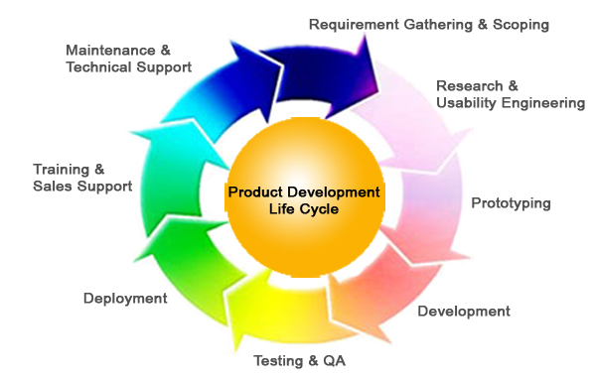
Product Development Lifecycle

Slide 114
Planning Product Quality
In order to offer quality components, assemblies & processes have three major functions:
Design
Manufacturing
Quality Assurance
These have to work together in the planning stages of product design, tooling & inspection/test. Superior plan can be developed after examining all alternatives.

Slide 115
D-2 Design Process

Slide 116
Design process & methodologies
Have a systematic approach for design, review and validation to ensure product design meets customer needs and expectations.

Slide 117
D-2 Design process and methodologies
Learner
Beginner
Organized
Achiever
World class
Plan
No process of design planning
'Design planning to ensure customer requirements are met
'+ Design planning to ensure that the customer specifications and regulatory requirements are met
'+ Design planning to ensure that the manufacturing capability is met along with customer specifications and regulatory requirements
'+ Simulation tools like FEA, CAD, CAE used to create design
Deploy
No design validation studies done
' Design Validation studies done but no prototyping done
' Design validation done at SME through prototyping
' Design validation done through field trials e.g. OEM testing
' Design validation done through simulation at SME R&D
Monitor, refine and deliver outcome
'All the designs are received from customers only, Change control process is not followed
'- Reactive approach in place for review and error rectification in designs
'- Customer complaints with respect to designs are maintained with reasons for failures investigated & suitable actions taken for prevention
'Designs are reviewed and approved by cross function team and customer on periodic basis
ECN/ECR(Engineering change note/record) process is in place
'- Designs are optimized for robustness using QE techniques as suggested in ISO 16336 on RPD (Robust Parameter Design) and Takes IPR for designs.

Slide 118
Design Process
Design & development planning
Design & development inputs
Design & development outputs
Design & development review
Design & development verification
Design & development review
Control of design & development changes

Slide 119
Introduction
Quality of Product & Service are now more focus than they ever has been as a Strategic elements in maintaining leadership & business. Factors that have to say on Quality consideration are:
External factors
Competition
Consumer Organisations
Product Liability issues
Consumer attitudes
Internal factors
Excess costs of poor quality
Issues related to quality of work life
Fear of loss of reputation

Slide 120
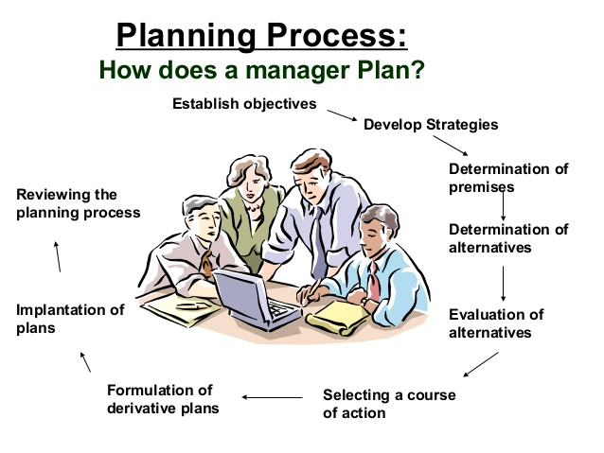

Slide 121
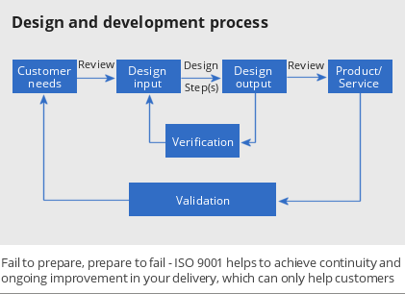
Design & Development Process
Design & development planning
Design & development inputs
Design & development outputs
Design & development review
Design & development verification
Design & development validation
Control of design & development changes

Slide 122
Quality by Design (QbD)
Quality by Design (QbD) is a concept first outlined by well-known quality expert Joseph M. Juran who believed that quality could be planned, and that most quality crises and problems relate to the way in which quality was planned in the first place.
Proactive & risk based approach for predictable & predefined quality
Planning quality into the process
A leading indicator for better controls & to handle quality crises and problems early in the cycle

Slide 123
Quality by Design (QbD)
It is important to control the Quality of design inputs(provided by the purchaser to control the output in various forms such as form of drawings, calculation, specifications & procedures.
The processes which have led to Design involves:
Methods: Approach involves Organisation, Documentation, Verification & Audit
Organisation:
This provides the basis on policy decision can be made as effective administration of project on continuing basis.
Managerial lines of command
Function of various departments
Responsibility of Departments

Slide 124
Quality by Design (QbD)
Documentation
a. A system of documentation must be formulated & operated
b. Necessary R&D work must be covered
c. Final specifications for procurement , warrant production of drawings, calculation, manufacturing procedures, selection of materials, etc.
Among them document required- Enquiry specification, Tender, Pre-Tender designs & tender assessments.
Additionally, detailed design documents, drawings, manufacturing designs, safety documents & commissioning documents

Slide 125
Quality by Design (QbD)
Design Verification
a. Design control measures shall be applied to verify the adequacy of design
b. Consist of re-examining the design, spot checking the calculation or analysing & assessing the results.
Ways of verifying designs depending on the:
complexity,
degree of standardisation,
state of art
similarity of the previously proven designs.

Slide 126
Quality by Design (QbD)
Design Validation
Validation & audit may be carried out:
By the purchaser or Quality Assurance department of the vendor being assessed
The prime purpose of evaluation is to ensure that a vendor organisation is capable of meeting all aspects of Quality Audit in Design.
The purpose of an audit is to check that these are being implemented & are effective. It seeks to confirm that a particular element of the design is correct.

Slide 127
Exercise-1
Pertaining to the following requirements:
1. Design Capability
2. Design Process
Develop:
Three main questions to assess the requirement
Three main steps to implement

Slide 128
Day 2 Session 1

Slide 129
Safety Management

Slide 130
Safety Management
# | Clause | Topic
1 | A-5 | Safe Working Environment
2 | R-3 | Safety Performance

Slide 131
A-5 Safe Working Environment

Slide 132
Planning for implementation for safe working of all processes and personnel.
Notes:
Heinrich's Law: that in a workplace, for every accident that causes a major injury, there are 29 accidents that cause minor injuries and 300 accidents that cause no injuries.^{[3]} Because many accidents share common root causes, addressing more commonplace accidents that cause no injuries can prevent accidents that cause injuries.
Heinrich's work is claimed as the basis for the theory of Behaviour-based safety by some experts of this field, which holds that as many as 95 percent of all workplace accidents are caused by unsafe acts. Heinrich came to this conclusion after reviewing thousands of accident reports completed by supervisors, who generally blamed workers for causing accidents without conducting detailed investigations into the root causes.
While Heinrich's figure that 88 percent of all workplace accidents and injuries/illnesses are caused by "man-failure" is perhaps his most oft-cited conclusion, his book actually encouraged employers to control hazards, not merely focus on worker behaviours. "No matter how strongly the statistical records emphasize personal faults or how imperatively the need for educational activity is shown, no safety procedure is complete or satisfactory that does not provide for the . . . correction or elimination of . . . physical hazards,"
What this study has declared is that major injuries are sporadic so we should take action on the more recurrent and less compromising events to decrease the chance of total accident losses from transpiring.

Slide 133
A-5 Safe Working Environment
Learner
Beginner
Organized
Achiever
World class
Plan
No formal safety policy in place
Safety policy briefly mentioned in overall company policy
+ Formal safety policy exists and addresses issues related to employees and contract workers
+ Formal safety policy addresses the concern of suppliers and community at large in addition to employees and contract workers
+ Formal safety policy addresses the concern of all primary and secondary stakeholders, along with sustainability goals
Deploy
No communication regarding safety policy
Communication imparted regarding safety policy to employees, but not followed by a regular schedule
+ Safety policy displayed in the factory, regular communication is followed.
Safety day/week/month is celebrated
+ Safety policy communicated through comprehensive means (displayed on notice board, employees handbook)
+ Safety policy reinforced everyday during meetings / speeches e.g. start daily meeting with focus on safety
Deploy
No training imparted on safety
Training imparted but no standard schedule
+ Formal/informal safety training done e.g. mock drill
+ Classroom and practical sessions on safety conducted for 100% employees
+ Training effectiveness measured for all safety related trainings with safety audits in place showing 90% adherence
Deploy
Safety related accidents are attended reactively
Major safety incidents are investigated and CAPAs undertaken
+ Safety techniques demonstrated through visual management, safety information reviewed in detail on periodic basis
+ Safety information reviewed, leading to identification and implementation of CAPAs
+ Step by step risk management plan in place. Poka-yoke for safety has been done as per industry benchmark
Deploy
No specific system for investigation of accidents/incidents
Minimal process to avoid fines and complaints on safety conditions
+ SOPs established to meet statutory and regulatory requirements related to safety
+ SOP established for safe working environment throughout the factory
+ Organisation has OHSAS system in place. Well established system of Hazard Identification & Risk Assessment for all processes
Monitor, refine and deliver outcome
No reviews done for safety techniques
Reviews for safety techniques done on adhoc basis
+ Daily safety dashboard established, frequent reviews planned and documented
+ “Near Misses” with respect to safety are recorded, analysed and acted upon. CAPAs are documented and reviewed
+ Pro-active and preventive steps are in place for safety techniques and visual management is also adopted

Slide 134
What is SMS?
SAFETY | MANAGEMENT | SYSTEM
Condition where risks are managed to acceptable levels | Allocation of resources | Organized set of principles, programs, processes and procedures

Slide 135
“A systematic approach to managing safety, including the necessary organizational structures, accountabilities, policies and procedures.”

Slide 136
Safety Culture
Reporting Culture - Willing front line participation is imperative because you are in direct contact with threats
Informed Culture - Effective require the collection, analysis and dissemination of information from incidents and near-misses, as well as proactive checks
Flexible Culture - Possessing the capability of adapting effectively to changing demands (operational or safety)
Learning Culture – Willingness and competence to draw the right conclusions from safety information and implement major reforms where the need is indicated

Slide 137
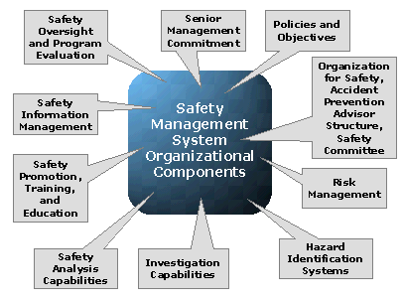
Components of SMS

Slide 138
R-3 Safety Performance

Slide 139
To assess the awareness and practices to improve
Safety management

Slide 140
R-3 Safety Score
Learner
Beginner
Organized
Achiever
World class
Monitor, refine and deliver outcome
Measurement of safety parameter such as man-hours lost , near misses, disability and fatality is not being recorded
<10% decrease in man-hours lost due to industry accidents with respect to last year
+ <20% decrease in man-hours lost due to industry accidents with respect to last year
+ Overall man-hours due to industry accidents <0.1%
+ Zero man- hour lost due to industry accidents
Monitor, refine and deliver outcome
Fatal accident or temporary disabilities happened within 1 year and no CAPA has been undertaken
CAPA has been undertaken to avoid accident
+ No fatal accidents or temporary disabilities in the last 1 year
+ No fatal accidents or temporary disabilities in the last 3 years
+ No fatal accidents or permanent disabilities in the last 3 years

Slide 141
Exercise-1
Pertaining to the following requirements:
1. Safe Working Environment
2. Safety Performance
Develop:
Three main questions to assess the requirement
Three main steps to implement

Slide 142
Day 2 Session 2

Slide 143
QUALITY MANAGEMENT

Slide 144
Quality Management
# | Clause | Topic
1 | A-2 | Process Capability
2 | B-1 | Process Validation
3 | C-4 | Process Control
4 | O-1 | Outgoing Quality
5 | O-2 | In-house Quality
6 | O-3 | Field Performance Quality
7 | P-2 | Scrap Reduction
8 | P-3 | Improvement in Process Capability

Slide 145
A-2 Process Capability Assessment & Enhancement

Slide 146
Realize the process potential, stabilizing and continuously improving process performance

Slide 147
A-2 Process Capability Assessment and Enhancement
Learner
Beginner
Organized
Achiever
World class
Plan
Process control is based on feedback from customers or QC and basic awareness on statistical process tools
Process control is done using control charts for monitoring performances in some cases
+ Corrections are made to the processes on the basis of process trend
+ Processes are controlled using results from online SPC in <80% critical machines
+ Processes are controlled using results from online SPC in >80% critical machines
Deploy
No statistical processes are implemented to measure process performance
Process performances are measured and documented in inspection sheet
+ Statistical processes are implemented on 20-50% critical machines for process capability assessment
+ Statistical process are implemented on 50-75% critical machines for process capability assessment
+ Statistical processes are implemented on >75% critical machines for process capability assessment
Deploy
No concept of corrective actions
Adhoc corrective actions implemented
+ All corrective actions are implemented
+ All corrective actions are implemented and risk mitigation done to avoid similar issues elsewhere e.g. other lines
+ All corrective actions are implemented and risk mitigation done along with measurement of effectiveness
Monitor, refine and deliver outcome
Process capability is not monitored
Shop floor is aware and measures process capability (Cp, Cpk) on adhoc basis
+ Process capability is measured (Cp, Cpk) for 20%-50% critical processes and used for any improvement initiatives
+ Process capability is measured (Cp, Cpk) for >50% and <75% critical processes, target value of Cpk>=1
+ Process capability is measured (Cp, Cpk) for 75% critical processes, target value of Cpk>=1.33

Slide 148
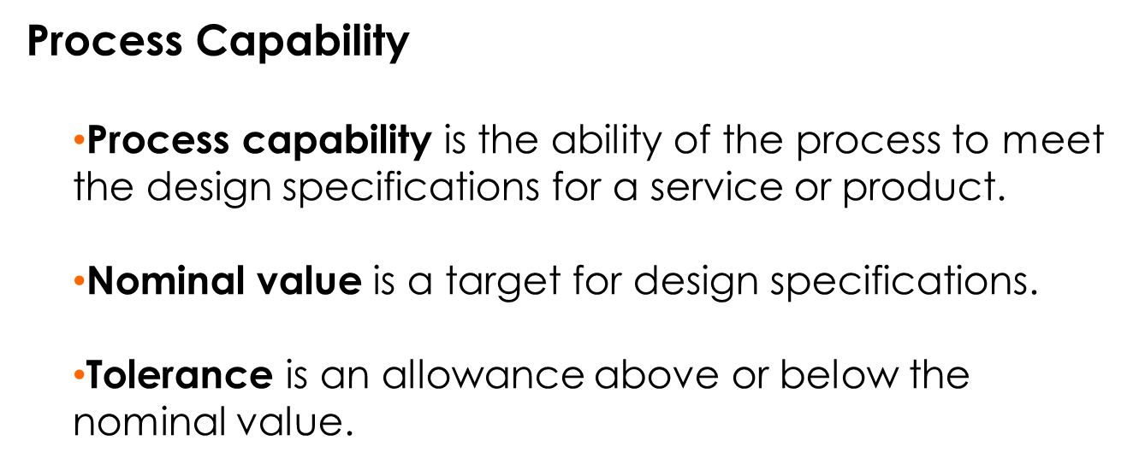

Slide 149
Process Capability Ratio
Process Capability Ratio, C_{p}, is the tolerance width divided by 6 standard deviations (process variability).
Upper specification - Lower specification
6σ
C_{p} =
Notes:
33

Slide 150
Process Capability Index, C_{pk}
Process Capability Index, C_{pk}, is an index that measures the potential for a process to generate defective outputs relative to either upper or lower specifications.
=
x – Lower specification
3σ
=
Upper specification – x
3σ
C_{pk} = Minimum of
,
We take the minimum of the two ratios because it gives the worst-case situation.
Notes:
33

Slide 151
Effects of Reducing Variability on Process Capability
Nominal value
Six sigma
Four sigma
Two sigma
Lower
specification
Upper
specification
Mean
Notes:
22

Slide 152
Control Charts

Slide 153
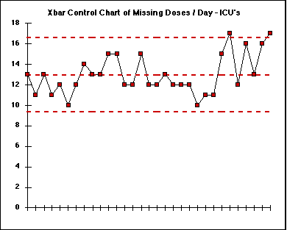
Examples of Control Charts
Notes:
http://www.robertluttman.com/vms/Week5/page6.htm
Statistical Thinking Tools-Control Charts for the Average
Date:February 12, 2001
Bob Luttman, Robert Luttman & Associates
Example of a control chart that has points outside the UCL. This process may need to be reworked. The problem is becoming worse, you can see that the data is consistently above the mean towards the end of the data.

Slide 154
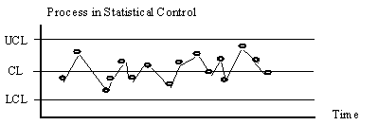
Examples of Control Charts
Notes:
Processes and Process Variability, Date accessed: Feb 12, 2001
http://www.sytsma.com/tqmtools/ctlchtprinciples.html
Example of a process that is in-control.

Slide 155
B-1 Process Validation

Slide 156
Proving through suitable tests and confirmations on the product that the process has the capability to deliver design requirement on a consistent basis

Slide 157
B-1 Process Validation
Learner
Beginner
Organized
Achiever
World class
Plan
Process validation not done and no tests/confirmations are carried out
Tests/confirmations for process validation are carried out on adhoc basis; processes documented e.g. learnings recorded at each step
+ Process validation done for critical/key processes e.g. First piece validation/pilot manufacturing/prototype manufacturing in place
+ Process validation ensures that improvements are done to meet the changing needs like future trends, vendor and supplier inputs
+ Special projects for improving the process capability of products for all product lines on consistent basis in addition to process validation for critical processes
Deploy
No process in place to ensure that processes meet specifications and quality requirements
Intermediate quality checks are performed for process validation
+ Periodic review process in place. Post validation, process parameters are measured, documented and communicated.
+ Detailed process reviews happen, results shared with vendors and suppliers
+ Customer feedbacks are reviewed, analysed and processes validated, results shared with vendors and suppliers
Monitor, refine and deliver outcome
No concept of corrective actions to improve processes to ensure design requirements
Adhoc corrective actions implemented to improve processes to ensure design requirements
+ All corrective actions are implemented to improve processes to ensure design requirements
+ All corrective actions are implemented and risk mitigation done to avoid similar issues elsewhere e.g. other lines
+ All corrective actions are implemented and risk mitigation done along with measurement of effectiveness

Slide 158
C-4 Process Control

Slide 159
Application of statistical quality control method, to monitor and control processes, to identify variances as a basis for continual improvement

Slide 160
C-4 Process Control
Learner
Beginner
Organized
Achiever
World class
Plan
No approach exists for process control
Process control approach followed on adhoc basis
+ Process control approach available for critical processes
+ Process control approach available and scope well defined for all processes
+ Online controls in place for process controls
Deploy
No standards/SOPs available to define control plans
SOPs / work instructions initiated to control few critical/key processes
+ Details SOPs / Work instructions are available on the basis of control plans to ease the process understanding
+ Frequent revisions are made in Control plans / SOPs and work instructions are based on any process change. Product samples (First piece inspection) are also kept near workstation for referencing purpose
+ Electronic version of control plans / SOPs / Work instructions are deployed
Deploy
No documented process control plan improvement in place
Process control plans in place with adherence of <40%
+ Process control plans in place with adherence 40%-60%
+ Process control plans in place with adherence of 60%-90%
+ Process control plans in place with adherence above 90%
Monitor, refine and deliver outcome
No concept of CAPA to address variances in processes
CAPA to control variances identified in <50% of critical processes
+ CAPAs to control variances identified in >50% of critical processes
+ CAPAs to control variances are identified and implemented in all cases
+ CAPAs to control variances taken in all cases and recorded; effectiveness is also measured

Slide 161
O-1 Outgoing Quality

Slide 162
Outgoing (customer end) quality performance level / % improvement

Slide 163
O-1 Outgoing quality performance level
Learner
Beginner
Organized
Achiever
World class
Monitor, refine and deliver outcome
'>5ppm
'2-5ppm.
'0.9 - 2 ppm. >50% customers rate the organisation as meeting their expectations
'0.3-0.9 ppm. >50% customers rate the organisation in top 25%
'<0.3 ppm. 50% customers rate the organisation in top 10%
Monitor, refine and deliver outcome
No System established for measuring customer satisfaction Index
Customer compliant register is maintained
Option 2 +. A customer satisfaction form is in place & the satisfaction score is between 3.5 to 4.0 (on a scale of 1.0 to 5.0, 5 is the best)
+ A customer satisfaction form is in place & the satisfaction score is between 4.0 to 4.5 (on a scale of 1.0 to 5.0, 5 is the best)
+ A customer satisfaction form is in place & the satisfaction score is greater than 4.5 (on a scale of 1.0 to 5.0, 5 is the best)

Slide 164
Exercise-1
Pertaining to the following requirements:
1. Process Capability
2. Process Validation
3. Process Control
4. Outgoing Quality
Develop:
Three main questions to assess the requirement
Three main steps to implement

Slide 165
O-2 In-house Quality

Slide 166
In-house quality performance level / % improvement

Slide 167
O-2 In Process Quality Performance Level?
Learner
Beginner
Organized
Achiever
World class
Monitor, refine and deliver outcome
In-process manufacturing quality not measured
In-process manufacturing quality is < 50% of industry benchmark
In-process manufacturing quality is 50-75% of industry benchmark
In-process manufacturing quality is 75-95% of industry benchmark
In-process manufacturing quality is >95% of industry benchmark
Monitor, refine and deliver outcome
No system established for measuring in-process audit score
Process adherence audit system established & audit score is between 80% and 85%
+ Process adherence audit system established & audit score is between 85% and 95%
Process adherence audit system established & audit score is between 95% and 98%
Process adherence audit system established & audit score is greater than 98%

Slide 168
O-3 Field Performance Quality

Slide 169
Field performance level / % improvement

Slide 170
O-3 Field performance level (based on customer defined targets for field performance)
Learner
Beginner
Organized
Achiever
World class
Monitor, refine and deliver outcome
<98% field performance level
98.1-99% or <50% of industry benchmark of field performance level
1000-5000PPM or 50-75% of industry benchmark of field performance level
100-1000 PPM or 75-95% of industry benchmark of field performance level
<100PPM or >95% of industry benchmark of field performance level
Monitor, refine and deliver outcome
Level of warranty/guarantee/recall is not measured
Level of warranty/guarantee/recall is < 50% of industry benchmark
Level of warranty/guarantee/recall is 50-75% of industry benchmark
Level of warranty/guarantee/recall is 75-95% of industry benchmark
Level of warranty/guarantee/recall is >95% of industry benchmark

Slide 171
P-2 Scrap Reduction

Slide 172
Scrap reduction by continuous improvement

Slide 173
P-2 Scrap (% of Gross Sales)
Learner
Beginner
Organized
Achiever
World class
Monitor, refine and deliver outcome
>2% scrap as a % of gross sales
0.75% - 2% scrap as a % of gross sales or <50% of industry benchmark
0.5%-0.75% scrap as a %age of gross sales or 50-75% of industry benchmark
0.2%-0.5% scrap as a %age of gross sales or 75-95% of industry benchmark
<0.2% scrap as a %age of gross sales or >95% of industry benchmark

Slide 174
P-3 Process Capability (Cp/Cpk)

Slide 175
To asses the impact of process improvement practices

Slide 176
P-3 Process Capability (Cp/Cpk)
Learner
Beginner
Organized
Achiever
World class
Monitor, refine and deliver outcome
No concept of Cp/Cpk value
30%-50% CQAs have Cpk value of >1.0
50%-75% CQAs have Cpk value of >1.0
75%-95% CQAs have Cpk value of >1.0
>95% CQAs have Cpk value of >1.0

Slide 177
Exercise-2
Pertaining to the following requirements:
1. In-house Quality
2. Field Performance Quality
3. Scrap Reduction
4. Process Capability (Cp/Cpk)
Develop:
Three main questions to assess the requirement
Three main steps to implement

Slide 178
Day 2 Session 3

Slide 179
Intellectual Property Management

Slide 180
Intellectual Property Management
# | Clause | Topic
1 | N-1 | Trade Mark
2 | N-2 | Industrial design
3 | N-3 | Copy Right
4 | N-4 | Patent

Slide 181
Laws for IP Protection
Trademarks Act 1976
Patent Act 1983
Copyright Act 1987
Industrial Design Act 1996
Geographical Indications Act 2000
Law of Tort
Confidential information

Slide 182
Invention vs Innovation
Microprocessor:
Consider the microprocessor. Someone invented the microprocessor. But by itself, the microprocessor was nothing more than another piece on the circuit board. It’s what was done with that piece — the hundreds of thousands of products, processes and services that evolved from the invention of the microprocessor — that required innovation
Steve Jobs owes a lot to the introduction of the PC. And IBM was the company behind it.
Ironically, the IBM PC didn’t contain any new inventions per se (see iPod example). Under pressure to complete the project in less than 18 months, the team actually was under explicit instructions not to invent anything new. The goal of the first PC, code-named “Project Chess,” was to take off-the-shelf components and bring them together in a way that was user-friendly, inexpensive and powerful.
And while the world’s first PC was an innovative product in the aggregate, the device they created — a portable device that put powerful computing in the hands of the people — was no less impactful than Henry Ford’s Model T, which reinvented the automobile industry by putting affordable transportation in the hands of the masses.
iPad : The iPod wasn’t the first
portable music device (Sony popularized the “music anywhere, anytime” concept 22 years earlier with the Walkman);
device that put hundreds of songs in your pocket (dozens of manufacturers had MP3 devices on the market when the iPod was released in 2001);
Apple was actually late to the party when it came to providing an online music-sharing platform. (Napster, Grokster and Kazaa all preceded iTunes.)
Apple invented nothing. Its innovation was creating an easy-to-use ecosystem that unified music discovery, delivery and device. And, in the process, they revolutionized the music industry.

Slide 183
N-1 Trade Mark

Slide 184
Safe guarding organizational logo/ brand logo for individual products

Slide 185
N-1 Trademark
Learner
Beginner
Organized
Achiever
World class
Plan
No awareness about IPRs
Potential for Violation of intellectual property rights of others
Knowledge about IPRs but no steps taken to work for defining Trademarks for the Organisation
Undertanding & Action to Building focus on establishing Trademarks as a strategic Tool.
Involving external agenies + Maketing companies to help build capability on building trademarks. Application of The learning to Building a National Brand.
Integration / Promotion of trademarks as an effective tool to geneate demand and work towards Building and International Brand
Deploy
No knowledge of brands
Limited understanding of brands
+ Branding efforts have been started & focus is on trademarks as a key branding tool
+ Company & its products are considered as national brand by its customers
+ The company and its products are recognised as national as well as international brands with all products being registered
Monitor, refine and deliver outcome
No knowledge of IPRs, may violate intellectual property rights of others. No Trademark /logo obtained from relevant authorities
Knowledge about IPRs is available. Trademark for the industry registered
+ Trademark has been registered for the Industry and also for < 50% of the products
+ Trademark is used as a branding tool and <75% of the products are registered
+ Trademark is used as a branding tool and >75% of the products are registered

Slide 186
What is a trademark?
A trademark is a word, phrase, symbol, or design, or a combination of these that identifies and distinguishes the source of goods of one party from those of others.
Notes:
Definition of Trademark:
A trademark is a sign capable of distinguishing the goods or services of one enterprise from those of other enterprises. Trademarks are protected by intellectual property rights.
How can I protect my trademark?
At the national/regional level, trademark protection can be obtained through registration, by filing an application for registration with the national/regional trademark office and paying the required fees. At the international level, you have two options: either you can file a trademark application with the trademark office of each country in which you are seeking protection, or you can use WIPO’s Madrid System.
What rights does trademark registration provide?
In principle, a trademark registration will confer an exclusive right to the use of the registered trademark. This implies that the trademark can be exclusively used by its owner, or licensed to another party for use in return for payment. Registration provides legal certainty and reinforces the position of the right holder, for example, in case of litigation.
How long does trademark protection last?
The term of trademark registration can vary, but is usually ten years. It can be renewed indefinitely on payment of additional fees. Trademark rights are private rights and protection is enforced through court orders.
What kinds of trademark can be registered?
A word or a combination of words, letters, and numerals can perfectly constitute a trademark. But trademarks may also consist of drawings, symbols, three-dimensional features such as the shape and packaging of goods, non-visible signs such as sounds or fragrances, or color shades used as distinguishing features – the possibilities are almost limitless.
Do any of you know what a trademark is? (call on a couple of the students)
Read the definition from the slide.
Do you know why trademarks are important? (call on a couple of students)
Trademarks are important because if you make a quality product, you want to make sure that customers can quickly identify your product without confusing it with other products, especially other lower quality products. Reputation is important, and trademarks help protect your reputation.

Slide 187
N-2 Industrial Design

Slide 188
Safe guarding new or modified designs developed by an organization
Notes:
What is an industrial design?
In a legal sense, an industrial design constitutes the ornamental or aesthetic aspect of an article.
An industrial design may consist of three dimensional features, such as the shape of an article, or two dimensional features, such as patterns, lines or color.
What kind of protection does an industrial design right offer?
In principle, the owner of a registered industrial design or of a design patent has the right to prevent third parties from making, selling or importing articles bearing or embodying a design which is a copy, or substantially a copy, of the protected design, when such acts are undertaken for commercial purposes.
What kind of products can benefit from industrial design protection?
Industrial designs are applied to a wide variety of products of industry and handicraft items: from packages and containers to furnishing and household goods, from lighting equipment to jewellery, and from electronic devices to textiles. Industrial designs may also be relevant to graphic symbols, graphical user interfaces (GUI), and logos.
How are industrial designs protected?
In most countries, an industrial design needs to be registered in order to be protected under industrial design law as a “registered design”. In some countries, industrial designs are protected under patent law as “design patents ”.
Industrial design laws in some countries grant – without registration – time- and scope limited protection to so-called “unregistered industrial designs”.
Depending on the particular national law and the kind of design, industrial designs may also be protected as works of art under copyright law.
What is the difference between an industrial design right and a patent?
An industrial design right protects only the appearance or aesthetic features of a product, whereas a patent protects an invention that offers a new technical solution to a problem. In principle, an industrial design right does not protect the technical or functional features of a product. Such features could, however, potentially be protected by a patent.

Slide 189
N-2 Industrial Design
Learner
Beginner
Organized
Achiever
World class
Plan
No knowledge of IPRs, and may be violating clauses on industrial design
Knowledge about IPR clauses on Industrial design. Organization has started thinking beyond functionality and is looking into aesthetics too
+ Organisation is proactive and protection is provided for a shape configuration, surface pattern, colour, or line (or a combination of these) which when applied produces or increases aesthetics and improves the visual appearance of design. Process in place for renewal of existing design
+ Legal system in place to protect against infringement of industrial design rights of organisation
+ All products are registered for Industrial Design in the name of company and enjoy market acceptability at national and international level
Deploy
No product registered for industrial design in the name of company
Up to 15% products registered for industrial design in the name of company
15%-30% products registered for industrial design in the name of company
30%-50% products registered for industrial design in the name of company
>50% products registered for industrial design in the name of company

Slide 190

What is an Industrial Design?
Industrial Design:
A design is the protection of the ornamental or aesthetic aspect of a product
A design makes a product attractive and appealing for the consumers
Notes:
How could this telephone be protected?

Slide 191
N-3 Copyright

Slide 192
Safe guarding original documented publications of an organization against unauthorized use
Notes:
What is copyright?
Copyright (or author’s right) is a legal term used to describe the rights that creators have over their literary and artistic works. Works covered by copyright range from books, music, paintings, sculpture, and films, to computer programs, databases, advertisements, maps, and technical drawings
What can be protected using copyright?
Exhaustive lists of works covered by copyright are usually not to be found in legislation. Nonetheless, broadly speaking, works commonly protected by copyright throughout the world include:
literary works such as novels, poems, plays, reference works, newspaper articles;
computer programs, databases;
films, musical compositions, and choreography;
artistic works such as paintings, drawings, photographs, and sculpture;
architecture; and
advertisements, maps, and technical drawings.
Copyright protection extends only to expressions, and not to ideas, procedures, methods of operation or mathematical concepts as such. Copyright may or may not be available for a number of objects such as titles, slogans, or logos, depending on whether they contain sufficient authorship.

Slide 193
N-3 Copyright
Learner
Beginner
Organized
Achiever
World class
Plan
No knowledge of IPRs, and may be violating clauses on Copyright
Knowledge about IPR clauses on copyright
+ Organisation is proactive and protection is provided to the products in the form of a copyright
+ Legal system in place to protect against infringement of copyrights of organisation
+ Products are registered for copyright in the name of company and enjoy market acceptability at national and international level
Deploy
No products registered for copyrights in the name of the company
<25% of the products are registered for copyrights in the name of company
25%-50% of the products are registered for copyrights in the name of company
50%-75% of the products are registered for copyrights in the name of company
All products and process are registered for Copyrights in the name of company.

Slide 194
Purpose of Copyright
To give the creator control and a monopoly on royalties for a period of time promotes creativity
Notes:
All creators, including photographers and illustrators are entitled to be paid if their work is used, commercially or otherwise. This encourages creativity and makes more images available for use.
What rights does copyright give me? What are my rights as author of a work?
There are two types of rights under copyright:
economic rights, which allow the rights owner to derive financial reward from the use of his works by others; and
moral rights, which protect the non-economic interests of the author.
Most copyright laws state that the rights owner has the economic right to authorize or prevent certain uses in relation to a work or, in some cases, to receive remuneration for the use of his work (such as through collective management).
The economic rights owner of a work can prohibit or authorize:
its reproduction in various forms, such as printed publication or sound recording;
its public performance, such as in a play or musical work;
its recording, for example, in the form of compact discs or DVDs;
its broadcasting, by radio, cable or satellite;
its translation into other languages; and
its adaptation, such as a novel into a film screenplay.
Examples of widely recognized moral rights include the right to claim authorship of a work and the right to oppose changes to a work that could harm the creator's reputation.

Slide 195
How Copyright protects works
Copyright protects "original works of authorship" that are fixed in "a tangible form of expression." The fixed form does not have to be directly perceptible so long as it can be communicated with the aid of a machine or other device

Slide 196
N-4 Patent

Slide 197
Safe guarding new products/ processes and Technologies against unauthorized use

Slide 198
N-4 Patent
Learner
Beginner
Organized
Achiever
World class
Plan
No Plan or Process in Place
Ad-hoc Planning But no Concrete steps has been taken in establishing a plan for filing of patents
Process of generating ideas & Focus towards innovation is in place.
Process to Filing of Patents is in place and the same is being used for filing of the Patents
Capability to generate maximum benefits from innovative ideas and technological capabilities
Strong market position and earns additional revenues through licensing
-Integration of technology & patent strategies into business
Deploy
No knowledge of IPRs, and may violate clauses on patents
Knowledge about IPRs, but do not own any patent, currently using old technology without legal complexity
+ Has filed for a patent for product/ process/ technology and organisation has started building a culture of generating ideas , a formal process of capturing, shortlisting, executing innovative ideas is in place, workmen and all other employees are motivated to work towards innovation
+ Owns domestic patents for indigenous product/process/technology and Organisation is monitoring inventions as a result of considerable efforts and long term investments in R&D, many simple and inexpensive technical improvements, of great market value, have yielded significant income and profits to their inventors or companies
+ Owns international patents for indigenous product/process/technology and organisation has developed a strong market position and earns additional revenues through licensing
Notes:
What is a patent?
A patent is an exclusive right granted for an invention, which is a product or a process that provides, in general, a new way of doing something, or offers a new technical solution to a problem. To get a patent, technical information about the invention must be disclosed to the public in a patent application.
What kind of protection does a patent offer
In principle, the patent owner has the exclusive right to prevent or stop others from commercially exploiting the patented invention. In other words, patent protection means that the invention cannot be commercially made, used, distributed, imported or sold by others without the patent owner's consent.
Is a patent valid in every country
Patents are territorial rights. In general, the exclusive rights are only applicable in the country or region in which a patent has been filed and granted, in accordance with the law of that country or region
How long does a patent last
The protection is granted for a limited period, generally 20 years from the filing date of the application.

Slide 199
What is a Patent?
A right to exclude others from: making, using, offering for
sale, selling or importing the patented invention
Not a right to use the invention
Quid Pro Quo: sufficient disclosure
For 20 years from date of filing

Slide 200
What can be Patented?
Process or Method
Machine or Apparatus
Article of Manufacture
Composition of Matter
Chemical Compounds
Physical Mixtures
Improvements of Any of the Above

Slide 201
Infringement
“Infringement” of a patent occurs when a competitor makes, uses, sells, offers to sell or imports an embodiment of the invention without the permission of the patent owner.
Patents only cover those products or processes described by the claims
An infringing product or process must have each element of the claim
The accused product or process may have more than required by the claim

Slide 202
Exercise-1
Pertaining to the following requirements:
1. Trade Mark
2. Industrial Design
3. Copyright
4. Patent
Develop:
Three main questions to assess the requirement
Three main steps to implement

Slide 203
Day 2 Session 3

Slide 204
Performance Management

Slide 205
10. Performance Management
Quality Performance
Process Performance
Environmental Performance
Energy Performance
Safety Performance
Employee Involvement Performance
Business Performance

Slide 206
Overall Company Performance
# | Clause | Topic
1 | R-4 | Inventory Turnover
2 | R-1 | Sales Turnover Growth
3 | R-2 | Profitability Growth

Slide 207
R-4 Inventory Turnover

Slide 208
To measure the improvement in flow
Notes:
Definition:
Inventory Turns : A measure of how quickly materials are moving through a facility or through an entire value stream, calculated by dividing some measure of cost of goods by the amount of inventory on hand. Probably the most common method of calculating inventory turns is to use the annual cost of goods sold (before adding overhead for selling and administrative costs) as the numerator divided by the average inventories on hand during the year. Thus: Using the cost of goods rather than sales revenues removes one source of variation unrelated to the performance of the production system— fluctuations in selling prices due to market conditions. Using an annual average of inventories rather than an end-of-the-year figure removes another source of variation- an artificial drop in inventories at the end of the year as managers try to show good numbers.
Inventory turns can be calculated for material flows through value streams of any length. However, in making comparisons remember that turns will decline with the length of the value stream, even if performance is equally “lean” all along the value stream. For example, a plant performing only assembly may have turns of 100 or more but when the parts plants supplying the assembly plant are added to the calculation, turns often will fall to 12 or fewer. And if materials are included all the way back to their initial conversion— steel, glass, resins, etc.— turns often will fall to four or fewer. This is because the cost of goods sold at the most downstream step doesn’t change but the amount of materials in inventories grows steadily as we add more and more facilities to our calculation.
Inventory turns are a great measure of a lean transformation if the focus is shifted from the absolute number of turns at each facility or in the entire value stream to the rate of increase in turns. Indeed, if turns are calculated accurately using annualized averages of inventories, they can be “the one statistic that can’t lie.”

Slide 209
R-4 Inventory Turnover
Learner
Beginner
Organized
Achiever
World class
Deploy
Inventory days not measured for RM/WIP/FG (Raw Material, Finished Goods)
Measured only for FG
+ Measured and Actions taken to ensure delivery for FG
+ Measured and Actions taken to ensure delivery for FG/RM/WIP
+ Just in time practiced
Monitor, refine and deliver outcome
Inventory turnover is not measured
Inventory turnover is <5
+ Inventory turnover is >5-15
+ Inventory turnover is >15-25
+ Inventory turnover is >25

Slide 210
R-1 Turnover Growth

Slide 211
To assess the growth in business

Slide 212
R-1 Turnover Growth
Learner
Beginner
Organized
Achiever
World class
Monitor, refine and deliver outcome
Stagnant growth in turnover
Turnover growth of 10% over last financial year
+ Turnover growth of 10% over last 3 financial years
+ Turnover growth of 15% over last 3 financial years
+ Turnover growth of 15% over last 5 financial years
Monitor, refine and deliver outcome
No growth due to new product lines
<10% growth due to new product lines
10%-20% growth due to new product lines
20%-40% growth due to new product lines
>40% growth due to new product lines

Slide 213
R-2 Profit Growth

Slide 214
To measure the impact of improvements on bottom-line

Slide 215
R-2 Operating Profit/ % Improvement (measured as gross profit)
Learner
Beginner
Organized
Achiever
World class
Monitor, refine and deliver outcome
Stagnant growth in the operating profit
Growth of 10% in the operating profit over last financial year
+ Growth of 10% in the operating profit over last 3 financial years. Risk management analysis done
+ Growth of 15% in the operating profit over last 3 financial years
+ Growth of 15% in the operating profit over last 5 financial years

Slide 216
Exercise-1
Pertaining to the following requirements:
1. Inventory Turnover
2. Turnover Growth
3. Profit Growth
Develop:
Three main questions to assess the requirement
Three main steps to implement

Slide 217
Day 2 Session 4

Slide 218
HUMAN RESOURCE MANAGEMENT

Slide 219
Human Resource Management
# | Clause | Topic
1 | L-1 | People Development
2 | L-2 | Employee Involvement
3 | P-1 | Outcome- TEI

Slide 220
L-1 People Development

Slide 221
Coordinated activities of imparting knowledge and skills and enhancing desired attributes among persons that are necessary to perform one or more role based tasks, and the evaluation that the desired competencies have been achieved

Slide 222
L-1 People Development Plan
Learner
Beginner
Organized
Achiever
World class
Plan
No system/ processes for creating people development plans
Employees understand their roles and responsibilities and their current capability to perform the roles and responsibilities
+ Comprehensive employee development plans are created for employees
+ A system has been established for people development with individual development plans for all employees , on-going coaching and feedback and a formal performance review
+ Regular feedback from employees used to improve initiatives for employee development
Deploy
Adhoc basis for deploying people for different tasks
Basic skill mapping system in place backed by planned training and coaching for deploying people for different tasks
+ Detailed technical skill mapping done for deploying people for different tasks. Multiskilling of operators in few areas
+ Competencies extend to soft skills, environmental, safety, energy conservation areas for deploying people for different tasks. Multiskilling of operators across areas
+ Competency matrix available for deploying people for different tasks. Plan in place for allied skill development
Monitor, refine and deliver outcome
People development plans do not exist
Less than 50% adherence to people development plans
50-75% adherence to people development plans
75-95% adherence to people development plans
>95% adherence to people development plans

Slide 223
L-2 Employee Involvement

Slide 224
People’s participation in planning and execution of policies that relate to or impact their work. Employee involvement presupposes the organization’s commitment to improving the partnership and developing shared understanding between the people and their managers

Slide 225
L-2 Employee Involvement Activity
Learner
Beginner
Organized
Achiever
World class
Plan
Not available
Available but not followed
Available and followed occasionally
Available, followed and improvements done
+ Improvements done and effectiveness checked
Deploy
No involvement of employees in decision making, improvement or change as all decisions are taken by top management.
Employees involved in activities are limited to a few areas e.g., Shop-floor level empowerment given to managers /supervisors
+ Employee engagement programmes such as Kaizen / quality circles / suggestion schemes in place / Concept of team based working introduced
+ Business plans & performances shared with all employees with targets at all levels drawn in consultative mode. Teams empowered to manage their work areas, with manager playing facilitators' role
+ Organisation is consistently rated in the Top Quartile in engagement score. High level of employee engagement with employee led innovations and proactive involvement of large employee pool epitomizing this culture
Monitor, refine and deliver outcome
No Policy in place
Some financial benefits / awards established
+ Visual display of award winners on shop- floor
+ Employee recognition scheme available and followed every month
+ Senior management actively involved in recognition of employees and their families

Slide 226
Levels of Employee Involvement
High involvement — Employees have complete decision making power (e.g., SDWTs – Self Directed Work Team)
Full consultation — Employees offer recommendations (e.g., gain sharing)
Selective consultation — Employees give information, but don’t know the problem
High
Medium
Low

Slide 227
P-1 Total Employee Involvement

Slide 228
Improvement in employee involvement

Slide 229
P-1 Total Employee Involvement
Learner
Beginner
Organized
Achiever
World class
Monitor, refine and deliver outcome
Nothing in place to ensure employee involvement
<40% employees have been involved and their ideas for improvements are generated , tracked and implemented
40%- 60% employees have been involved and their ideas for improvements generated, tracked and implemented
60% to 80 % employees have been involved and their ideas for improvements generated, tracked and implemented
Greater than 80 % employees have been involved and > 50% employees have given atleast one Idea for improvement
Monitor, refine and deliver outcome
No criteria exists to measure total employee involvment
Parameters for measuring TEI defined and are being monitored
+ Results on TEI parameters show consistent increase over last 3 years
+ Results on all parameters shows more than 50% improvements on 3 years YOY basis
+ Company results are bench-marked as best in class in industry and shows >50% improvement on YoY basis

Slide 230
Exercise-1
Pertaining to the following requirements:
1. People Development
2. Employee Involvement
3. Total Employee Involvement
Develop:
Three main questions to assess the requirement
Three main steps to implement

Slide 231
Day 2 Session 4

Slide 232
Energy Management

Slide 233
Optimal use of natural resources

Slide 234
Energy Management
# | Clause | Topic
1 | F-3 | System for Energy Efficiency
2 | H-2 | Planned Maintenance
3 | Q-2 | Energy Performance

Slide 235
F-3 System for Energy Efficiency

Slide 236
Design Plant & equipment, layouts, buildings, practices, monitoring mechanisms to reduce energy consumption, and to make manufacturing, transportation and storage systems energy efficient when compared to baseline energy consumption levels
Notes:
Energy management is the art and science of optimum use of energy to maximise profits (minimise costs) and thereby improve the economic competiveness. The energy should be used efficiently, economically and optimally.
Energy management can also be defined as the science involving planning, directing, con­trolling the supply and consumption of energy to maximise productivity and comforts and minimise the energy costs and pollution with conscious, judicious and effective use of energy.
The energy management involves strategy, policy, organisational changes, energy audit, energy conservation measures, administrative actions, training and awareness programmes, monitoring of energy conservation efforts etc

Slide 237
F-3 Systems for Energy Efficiency
Learner
Beginner
Organized
Achiever
World class
Plan
No planning for energy savings in place
Important energy performance indicators have been defined
+ Energy performance parameters are fully defined
+ Energy saving is a key focus area of the organisation. This is reflected in planning across the organisation, regular energy audits, and energy efficient purchases
+ Energy performance indicators defined and are linked to business strategy and business performance
Deploy
Installed meters are either not working or not used for internal controls and inferences
Separate meters are installed in high energy consumption areas and logs are maintained
+ Meters are installed in areas of energy consumption and regularly monitored
+ System in place for regular calibration and robust maintenance of all energy measurement equipment
+ World class Hi technology used with long term focus on energy conservation and improvement in addition to calibration of meters in areas of high energy consumption
Deploy
No Planning for Energy Saving in Place
Few basic equipments such as power capacitors installed. No technology investments planned. Efforts are mainly people driven for which they are trained
+ Energy saving devices like variable frequency drives and power capacitor banks are installed. Targets are fixed for energy conservation and accordingly plans are made. Progress reviewed at HOD level
+ System of regular review by top management on energy conservation measures and best available technologies for improving energy efficiency
+ Advocating energy management system to external audiences and forming new energy management partnerships for innovation and R&D
Monitor, refine and deliver outcome
No mechanism for ensuring energy efficiency
System in place for yearly checking energy efficiency
+ System in place for semi-yearly checking energy efficiency
+ Quarterly internal audit and yearly external audit of energy efficiency is carried out
+ Publishes its 'energy efficiency" report
Monitor, refine and deliver outcome
No improvement observed in variances
<50% improvement observed in variances
+ 50%-75% improvement observed in variances
+ 75%-95% improvement observed in variances
+ >95% improvement observed in variances

Slide 238
F-3 Systems for Energy Efficiency
Learner
Beginner
Organized
Achiever
World class
Plan
No planning for energy savings in place
Important energy performance indicators have been defined
+ Energy performance parameters are fully defined
+ Energy saving is a key focus area of the organisation. This is reflected in planning across the organisation, regular energy audits, and energy efficient purchases
+ Energy performance indicators defined and are linked to business strategy and business performance
Deploy
Installed meters are either not working or not used for internal controls and inferences
Separate meters are installed in high energy consumption areas and logs are maintained
+ Meters are installed in areas of energy consumption and regularly monitored
+ System in place for regular calibration and robust maintenance of all energy measurement equipment
+ World class Hi technology used with long term focus on energy conservation and improvement in addition to calibration of meters in areas of high energy consumption

Slide 239
F-3 Systems for Energy Efficiency
Learner
Beginner
Organized
Achiever
World class
Deploy
No Planning for Energy Saving in Place
Few basic equipments such as power capacitors installed. No technology investments planned. Efforts are mainly people driven for which they are trained
+ Energy saving devices like variable frequency drives and power capacitor banks are installed. Targets are fixed for energy conservation and accordingly plans are made. Progress reviewed at HOD level
+ System of regular review by top management on energy conservation measures and best available technologies for improving energy efficiency
+ Advocating energy management system to external audiences and forming new energy management partnerships for innovation and R&D
Monitor, refine and deliver outcome
No mechanism for ensuring energy efficiency
System in place for yearly checking energy efficiency
+ System in place for semi-yearly checking energy efficiency
+ Quarterly internal audit and yearly external audit of energy efficiency is carried out
+ Publishes its 'energy efficiency" report
Monitor, refine and deliver outcome
No improvement observed in variances
<50% improvement observed in variances
+ 50%-75% improvement observed in variances
+ 75%-95% improvement observed in variances
+ >95% improvement observed in variances

Slide 240
Definition of Terms & Assessing Demand
Energy Conservation: is any behavior that results in the use of less energy. Turning the lights off when you leave the room and recycling aluminum cans are both ways of conserving energy.
Energy Efficiency: is the use of technology that requires less energy to perform the same function. A compact fluorescent light bulb that uses less energy than an incandescent bulb to produce the same amount of light is an example of energy efficiency. However, the decision to replace an incandescent light bulb with a compact fluorescent is an act of energy conservation.
Assess energy demand
Keep records
Consumption data
Time of readings
Temperature
Other factors affecting demand
Weekday/weekend
Special events
Frequency of readings
Weekly
Daily

Slide 241

Why is energy wasted?
Poorly designed buildings and installations
Insufficient insulation
Undersized ventilation ducts
Inadequate control systems
Poor control settings
Inefficient plant operation
Out of date technology
Poor maintenance
Poor operating and working practices

Slide 242
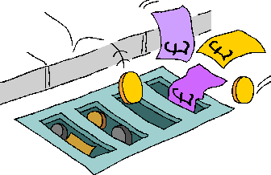
Collect data
Build up picture of pattern of energy consumption and cost from energy invoices
All invoices for relevant time period
Delivery notes for oil, solid fuel, LPG
Identify estimated meter readings – check with previous years
Inadequate/unavailable invoices – contact utility company/fuel supplier
Collect geographic data
Location, altitude, orientation
Weather data, degree day data
Manufacturing data (if appropriate)
Production output
Check data for anomalies
Small building using more energy than larger one
High energy use at night when unoccupied

Slide 243

Analysing energy records
Key variables
Heating
External temperature - dominant
Wind speed )
Humidity ) <=10% variation
Solar gain )
Lighting
Hours of darkness

Slide 244
Annual energy consumption
Simplest analysis
Assess overall energy performance of building
Produces a percentage breakdown of annual energy consumption and cost data
Convert all energy consumption data into standard units (kWh)
Standard conversion factors & gross calorific values
Percentage breakdowns of total consumption and cost of each energy type
Present data
Total annual energy consumption
Cost
Percentage breakdown of each fuel type
Historical trends

Slide 245

Energy Supply
Identify tariffs and supply contracts of organisation
Ensure organisation is using correct electricity tariff to suite its load profile
Calculate load profile
Regular meter readings – include daytime, night time & weekends
For large electrical loads
Need to be more accurate
Measure every 30 mins, use portable meters if necessary
Investigate large peaks in load

Slide 246
Plant and equipment
Survey major items of plant and equipment to determine their operating efficiency
Include pipe distribution networks
Boilers
‘tune’ to minimise flue gas heat loss
Identify if flue gas heat recovery is feasible
Refrigeration
Check efficiency
Opening practices
Is heat recovery feasible
Pipework
Insulation & leaks
Planned replacement of old plant
Building fabric
Identify using U values areas of greatest heat loss
Thermal imaging
Excess ventilation – open doors

Slide 247
Energy and the Environment
Energy sources have different impacts or effects on the environment. Some of these effects may include:
emissions
waste
land or water use impacts
others.

Slide 248
H-2 Planned Maintenance

Slide 249
Ensure the maintenance of all equipment installed to keep the energy consumption level at the optimum, prevent energy wastage and leakages

Slide 250
H-2 Planned Maintenance of Energy Control Systems
Learner
Beginner
Organized
Achiever
World class
Plan
No PM plan for energy control systems
PM plan available for <50% energy control systems
PM plan for 50%-70% critical energy control systems
PM plan available for 70%-99% energy control systems
PM plan for all energy control systems
Deploy
No system of planned maintenance for energy control systems
Adherence to planned maintenance is <50%
Adherence to planned maintenance is 50%-75%
Adherence to planned maintenance is 76%-99%
Adherence to planned maintenance is 100%
Monitor, refine and deliver outcome
Effectiveness not measured for energy control systems
Adherence measured on adhoc basis for energy control systems
+ MTTR and MTBF measured at <30% energy control systems
+ MTTR and MTBF measured at 30-60% energy control systems
+ MTTR and MTBF measured at >60% energy control systems and it shows an improving trend

Slide 251
Q-2 Energy Management Performance

Slide 252
To assess the energy efficiency and energy conservation performance of the company

Slide 253
Q-2 Monitor, refine and deliver outcome
Learner
Beginner
Organized
Achiever
World class
Monitor, refine and deliver outcome
Energy performance parameters are not fully defined
Important energy performance parameters are defined and monitored
+ All energy performance indicators defined and monitored, e.g. Indicators for (1) Reduction in lighting required (2) Installing more energy-efficient lighting system (3) Usage of day lighting (4) Air distribution system loss (5) Water/Stream distribution system loss (6) Improve boiler and furnace efficiency (7) Selection of efficient /star rated cooling and heating systems (8) Installation of energy efficient motors
+ All energy performance parameters are defined and >50% of the targets set are met
+ All energy performance parameters are defined and >80% of the targets set are met
Monitor, refine and deliver outcome
No energy saving
Up to 2% reduction in energy consumption over previous year
+ Achieves between 2% to 5% reduction over previous year in specific energy consumption for the products
+ Achieves over 5% and up to 10% reduction over previous year in specific energy consumption for the products
+ Achieves over 10% reduction over previous year in specific energy consumption for the products

Slide 254
Exercise-1
Pertaining to the following requirements:
1. System for Energy Efficiency
2. Planned maintenance
3. Energy Management Performance
Develop:
Three main questions to assess the requirement
Three main steps to implement

Slide 255
Day 3 Session 1

Slide 256
Defense Sector - Parameters

Slide 257
Defence Sector - Parameters
# | Clause | Topic
1 | DA | Defence Outreach
2 | DB | Defence Quality System
3 | DC | Risk Assessment
4 | DD | Design Descipline
5 | DE | Technology Specific to Defence
6 | DF | Security, Safety & Confidentiality
7 | DG | Post Delivery and Customer feedback
8 | DH | Financial Discipline

Slide 258
Defence Sector - Defence Outreach
# | Clause | Topic
1 | DA-1 | Design (includes packaging) for reliability and regulatory adherence
2 | DA-2 | Planning and audit of configuration management system

Slide 259
DA-1 Design (includes packaging) for reliability and regulatory adherence
Learner
Beginner
Organized
Achiever
World class
Plan
'No design activity is present
'Design is limited to low value/low complexity component and process
'Separate design unit/resources available
'The design norms present to include asset reliability, maintainability during asset life and extreme operating conditions
'Design norms present to include asset reliability, maintainability during asset life and extreme operating conditions. Dedicated resources to check design adherence
Deploy
'Customer provide specifications and design
Design done by working closely with customers/OEM design team
Design norms are defined and customer requirements are included in all stages of design. Design favours GSQR for army and equivalent
Design is checked for regulatory adherence and approved by customers
Dedicated resources to check Regulatory adherence and manage end-end design cycle from conceptual design phase till production part approval
Deploy
No specific norms for packaging exit. Standard bubble packaging is used
Packaging done based on customer defined norms
Process for packaging design present. separate packaging control department exists
Packaging design customised for each product class and shipment location
Packaging design customised for each product class and shipment location Packaging control mechanism based on continuous feedback from customers
Monitor, refine and deliver outcome
'All the designs are received from customers only, Change control process is not followed
'Reactive approach in place for review and error rectification in designs
'Customer complaints with respect to designs are maintained with reasons for failures investigated & suitable actions taken for prevention
'Designs are reviewed and approved by cross function team and customer on periodic basis
ECN/ECR(Engineering change note/record) process is in place
'Designs are optimized for robustness using QE techniques as suggested in ISO 16336 on RPD (Robust Parameter Design) and Takes IPR for designs.

Slide 260
DA-2 Planning and audit of configuration management system
Learner
Beginner
Organized
Achiever
World class
Plan
No process exist for configuration management
Configuration identification and change control mechanism is present.
Dedicated team/resources for configuration identification and change control.
Detailed plan available for all product categories on for configuration identification and change control.
Comprehensive program exists for configuration identification, change control, status accounting and audit.
Deploy
No process exist to ensure configuration management
Configuration changes approved by customers
Configuration changes approved jointly by the design team of MSME and customers
Mechanism exists for physical configuration audit
Customer feedback on configuration changes are incorporated in the asset Lifecyle
Monitor, refine and deliver outcome
No monitoring/assessment of design capability
Design capability is assessed on a reactive basis e.g an index of customer complaints and extent of failures found during manufacturing
Design capability is proactively assessed e.g based on variation in product performance and analysis between actual and target performance
Design capability is continuously assessed. Benchmarks are used to compare capability on various design characteristics.
There is at least 1 design patent / IPR filed
Product design capability is assessed in sigma level through a comprehensive score card incorporating several elements including parts , processes and performance.
There are at least 2design patent / IPR available.

Slide 261
Exercise
Pertaining to the following requirements:
Design (includes packaging) for reliability and regulatory adherence
Planning and audit of configuration management system
Develop:
Three main questions to assess the requirement
Three main steps to implement

Slide 262
Defence Sector - Defence Quality System
# | Clause | Topic
1 | DB-1 | Defence Quality Standards
2 | DB-2 | Organisation and leadership mindset for quality?
3 | DB-3 | Quality management processes
4 | DB-4 | Testing facility (Defence specific)
5 | DB-5 | Control of monitoring, measuring and testing equipment
6 | DB-6 | Traceability of Raw materials, In Process and Final Product
7 | DB-7 | Incoming inspections
8 | DB-8 | In-Process Quality Control
9 | DB-9 | Product Testing and Final Inspection
10 | DB-10 | Quality Improvement, performance feedback and Six Sigma approach

Slide 263
DB-1 Defence Quality Standards
Learner
Beginner
Organized
Achiever
World class
Plan
Company has no understanding of defence quality stds
Only top management is aware of defence quality standards
Top management and supervisors are aware of defence quality standards
Top management, supervisors and shop floor employees are aware of defence quality standards
Defence quality standards are displayed on the shop floor. Continuous training being done to ensure implementation
Deploy
No implementation of defence quality standards
Company has established their systems to standards like IPC, NADCAP, IEC, ASTM etc. but do not followed them
Company has established their systems to standards like IPC, NADCAP, IEC, ASTM, Mill standards as applicable to Indian, USA, Europe, EMC standards etc. and partially follow them wherever applicable
Company has established workmanship standards like IS, IPC, NADCAP, IEC, ASTM etc. and follow them wherever applicable, as per the customer requirement.
Company has established workmanship standards like IS, IPC, NADCAP, IEC, ASTM etc. and strongly follow them wherever applicable irrespective of customer requirement.
Company is also certified for the applicable defense product/process/
systems standards and provides training to its employees on regular interval.

Slide 264
DB-2 Organisation and leadership mindset for quality?
Learner
Beginner
Organized
Achiever
World class
Plan
Values and ethics are not emphasised by the MSME leadership
Values and ethics are partially emphasised by the MSME leadership
Values and ethics are completely emphasised by the MSME leadership
All employees provide complete emphasis on values and ethics
Schedule prepared to conduct program for routine emphasis on values and ethics
Deploy
No separate quality organization for quality control and assurance
A separate quality organization which is part of production department and responsible for quality control and assurance
A separate quality organization which is completely independent of production department and responsible for quality control and assurance
Separate quality organization for quality control & assurance with defined responsibility of senior management representative.
Separate quality organization for quality control and assurance with senior management representative directly reporting to CEO

Slide 265
DB-3 Quality management processes
Learner
Beginner
Organized
Achiever
World class
Plan
Quality control process is not defined
Quality Control process defined but not implemented
Quality Control process defined and implemented
Quality Control process defined and implemented. Quality Manual available but no training provided
Quality Control process defined and implemented. Quality Manual available and training provided
Deploy
No evidence of implementation of quality control procedures
Adherence to the Quality procedures and work standards defined for product realization.
Adherence to the Quality procedures and work standards defined for product realization along with periodic audits and reviews.
Adherence to the Quality procedures and work standards defined for product realization with complete documentation and periodic audits and reviews.
Adherence to the Quality procedures and work standards defined for product realization with complete documentation and periodic audits and reviews. Organization has relevant QMS certification.

Slide 266
DB-4 Testing facility (Defence specific)
Learner
Beginner
Organized
Achiever
World class
Plan
No mechanism exists to test products/materials outside
Organisation has contracts signed with other facilities with JSS55555
Contracts/ MoU present to access other testing facility with full ESS suite
Contracts/ MoU present to access other testing facility with full ESS suite
Contracts/ MoU present to access other testing facility with full ESS suite
Can access on need basis Full EMI testing facility outside
Deploy
Industrial grade infrastructure is not available
Limited testing facility available for environmental testing as per JSS55555
Full ESS suite available in-house for testing related to temperature, temperature cycling, dust, vibration, humidity salt spray and altitude
Full ESS suite available in-house for testing related to temperature, temperature cycling, dust, vibration, humidity salt spray and altitude with in house testing capability for pre compliance for EMI testing.
Full ESS suite available in-house for testing related to temperature, temperature cycling, dust, vibration, humidity salt spray and altitude with in house testing capability for pre compliance for EMI testing.
Availability of software tools/simulator for testing extreme extreme conditions.

Slide 267
DB-5 Control of monitoring, measuring and testing equipment
Learner
Beginner
Organized
Achiever
World class
Plan
No procedure exist for control of monitoring and measuring improvement?
The process is satisfactorily defined for control of monitoring & measuring equipment but no training provided
The process is satisfactorily defined for control of monitoring & measuring equipment and training provided to <50% employees
The process is satisfactorily defined for control of monitoring & measuring equipment and training provided to 50%-75% employees and process implemented
The process is satisfactorily defined for control of monitoring & measuring equipment and training provided to all employees and process implemented
Deploy
None of the critical to quality monitoring, measurement and testing equipment are calibrated
All critical to quality monitoring, measurement and testing equipment are duly calibrated
All critical to quality monitoring, measurement and testing equipment are duly calibrated.
The company has made arrangement for calibration at alternate sourcing or services of some test facilities in case of failure of primary test equipment
In-house calibration instrument/equipment.
Master Reference Standards are traceable to National/ International Standards or equivalent; however some are specified by manufacturer.
In-house calibration instrument/equipment.
All Master Reference Standards traceable to National/ International Standards or equivalent
Monitor, refine and deliver outcome
No system in place for for tracing and addressing the critical items/ components tested with out of calibration equipment
System in place for for tracing and addressing the critical items/ components tested with out of calibration equipment but not implemented
System is available and implemented to trace and address all critical items/ components tested and passed by instruments/ equipment found later on out of calibration
System is available and implemented to trace and address all critical items/ components tested and passed by instruments/ equipment found later on out of calibration and addressed >75% of all such cases in the past
System is available and implemented to trace and address all critical items/ components tested and passed by instruments/ equipment found later on out of calibration and addressed all such cases in the past

Slide 268
DB-6 Traceability of Raw materials, In Process and Final Product
Initial
Beginner
Organized
Achiever
World class
Plan
No process defined for Raw materials, In Process and Final Product.
The process is defined for raw materials, in-process and final product to be uniquely identified to permit traceability forward and backward
Traceability is maintained for environment of inventories procured from international sources for equivalence
The process is defined and documented for Raw materials, In Process and Final Product with reasonable implementation.
Traceability to task performer is available for critical to quality processes
Traceability standards are extended to critical vendors and sub contractors
Traceability to task performer is available for critical to quality and all special processes.
Traceability standards are extended to all vendors and sub contactors
Deploy
No standard practices on document and records generation, storage, retrieval and disposal
Basic process on document generation, version control and retrieval in place
End to end process on document generation, version control and retrieval is defined and implementation is started
End to end process on document generation, version control and retrieval is defined and fully implemented
End to end process on document generation, version control and retrieval is defined and fully implemented
An audit system in place to review the process and make improvements on regular basis

Slide 269
DB-7 Incoming inspections
Learner
Beginner
Organized
Achiever
World class
Plan
DB -6 Traceability of Raw materials, In Process and Final Product
Adequate staff for quality inspection and lab facility is available
System for recall is in place, quality dept. is adequately equipped to check the physical, chemical & mechanical properties of raw material and incoming materials
Adequate written inspection guidelines are available in the vernacular language
Supplier is fully responsible for the quality of raw material and incoming materials
Deploy
Only visual inspection of raw materials and incoming materials for conformance to approval samples or written specifications
Evidence available for all adequate measures to assure raw materials and incoming materials conformance to approval samples or written specifications
Records of incoming inspection are traceable for the lifetime of the product to prove products are checked and meet all requirements
Inspection process implemented for emergency situations when normal inspection timelines can’t be followed.
CAPA is done for rejections. Procedure of in-warding of material and documentation ensures thorough coverage of goods received at all times of a day.
Inspection is carried out at inward stage only for very critical items/materials/properties. Supplier Audit, Supplier rating are the main tools to control the quality of inward items. Concept of Material Review Board exists.

Slide 270
DB-8 In-Process Quality Control
Learner
Beginner
Organized
Achiever
World class
Plan
No process in place to ensure In-process Quality control
Adhoc audits are done by quality team to monitor the compliance of the product to meet quality control standards
Regular line audits, on ongoing basis by quality team to monitor the compliance of the product to meet quality control standards
Adequate approved limit samples are available in only critical and important areas to give inspectors or workers a guideline
Adequate approved limit samples are available in all areas to give inspectors or workers a guideline
Monitor, refine and deliver outcome
Implementation not monitored
<50% Critical to Quality processes are carried out by trained and certified ( by National Accredited body) task performers
50%-80% Critical to Quality processes are carried out by trained and certified ( by National Accredited body) task performers
80%-99% Critical to Quality processes are carried out by trained and certified ( by National Accredited body) task performers
100% Critical to Quality processes are carried out by trained and certified ( by National Accredited body) task performers

Slide 271
DB-9 Product Testing and Final Inspection
Learner
Beginner
Organized
Achiever
World class
Deploy
No process in place to test products as per customer requirements
The Company has a system wherein customer specifications are tallied with factory specs and additional tests are carried out in case necessary as per customer requirement/ specifications.
Customer drawings/ specifications are readily available and reviewed as when required by concerned team and form part of control document.
The process failures/ product rejections ( within factory, field failures) are recorded , analysed and reported back to design, production team for corrective mechanism
Effectiveness of corrective/preventive actions is measured and PDCA cycle is repeated till typical problems/failures are eliminated
Deploy
The Company does not perform a final inspection on finished products for performance, aesthetics and specifications on sample basis
The Company performs a final inspection on finished products for aesthetics performance, and specifications as per customer requirement
The product rejections ( within factory, field failures) are recorded , analysed and reported back to design, production team for corrective mechanism
Preventive measures are taken horizontally in other similar products and processes
Process capability is maintained at a high level so that final inspection is just to check critical performance parameters

Slide 272
DB-10 Quality Improvement, performance feedback and Six Sigma approach
Learner
Beginner
Organized
Achiever
World class
Deploy
Quality improvement are on adhoc basis
Kaizen and small group workmen activities like Quality Circles etc. are in place to address some quality issues, with <50% employee involvement
Kaizen and small group workmen activities like Quality Circles etc. are in place to address quality issues pertaing to processes, maintenance and safety with 50%-75% involvement of employees
Kaizen and small group workmen activities like Quality Circles etc. are in place to address quality issues pertaing to processes, maintenance and safety with 75%-90% involvement of employees
Kaizen and small group workmen activities like Quality Circles etc. are in place to address quality issues pertaing to processes, maintenance and safety with >90% involvement of employees
Deploy
No implementation of six sigma approach
Adhoc implementation of six sigma approach for few critical processes
Six Sigma is deployed to achieve in process quality within Green zone ( within plus and minus 40% of tolerance band)for at least 50% of Critical to Quality Processes
Six Sigma is deployed to achieve in process quality within Green zone ( within plus and minus 40% of tolerance band)for all Critical to Quality Processes
Six Sigma is deployed to achieve in process quality within Green zone ( within plus and minus 30% of tolerance band)for all Critical to Quality Processes
Monitor, refine and deliver outcome
No monitoring process in place
Monitoring process in place but does not involve feedback from customers
Only customer/OEM complaints on quality are captured in continuous improvement process
Mechanism exists to capture customer feedback (both positive and negative) on product quality and incorporate it in continuous improvement cycle
Proactively reaches OEMs and customers to get product quality an field success feedback and integrates in continuous improvement cycle

Slide 273
Exercise
Pertaining to the following requirements:
Defence Quality Standards
Organisation and leadership mindset for quality?
Quality management processes
Testing facility (Defence specific)
Control of monitoring, measuring and testing equipment
Traceability of Raw materials, In Process and Final Product
Incoming inspections
In-Process Quality Control
Product Testing and Final Inspection
Quality Improvement, performance feedback and Six Sigma approach
Develop:
Three main questions to assess the requirement
Three main steps to implement

Slide 274
Defence Sector - Risk Assessment
# | Clause | Topic
1 | DC-1 | Risk assessment

Slide 275
DC-1 Risk assessment
Learner
Beginner
Organized
Achiever
World class
Plan
No risk assessment plan in place
The company has a comprehensive risk assessment plan
The company has a dynamic risk assessment plan which it keeps updating as per changing market/ customer requirements
The company has a well defined Risk strategy at Management level
The company has a well defined Risk strategy at Management level which is customised for different projects
Deploy
Nothing in place to ensure mitigation of policy issues
The company is member of Local level Industry association to mitigate policy issues (duly accredited by National Body)
Mitigation policy is related to certification from export promotion council for that sector
The company is member of State/ Business sector level Industry association to mitigate policy issues (duly accredited by National Body)
The company is member of National/ Business sector level Industry association to mitigate policy issues ( duly accredited by National Body)
Deploy
No mechanism to monitor the coverage of business processes
<50% business processes are covered
50%-75 business processes are covered
>75%-99% business processes are covered
100% business processes are covered
Monitor, refine and deliver outcome
No review mechanism in place for risk assessment plan
Risk assessment plan is reviewed on adhoc basis
Risk assessment plan is reviewed on periodic basis
Risk mitigation plan is reviewed and CAPAs are taken and implemented
Risk mitigation plan is reviewed and CAPAs are taken and effectiveness also measured

Slide 276
Exercise
Pertaining to the following requirements:
Risk Assessment
Develop:
Three main questions to assess the requirement
Three main steps to implement

Slide 277
Defence Sector - Design Discipline
# | Clause | Topic
1 | DD-1 | Developing technology for defence
2 | DD-2 | Technology Spread

Slide 278
DD-1 Developing technology for defence
Learner
Beginner
Organized
Achiever
World class
Plan
Nothing in place to develop technology for defence
Co-development of technology with external sources
MOU/MOA with Govt/Private research organizations/universities or TOT for licensed production
In house technology development
In house technology development along with government certification for R&D
Deploy
No technology in pipeline for approval by defence, nothing approved till date
1 technology in pipeline for approval by defence but none approved till date
Minimum 2 technologies in pipeline for approval by defence but none approved till date
Successfully developed one technology duly approved by Defence.
Successfully developed minimum 2 technology duly approved by Defence.

Slide 279
DD-2 Technology Spread
Learner
Beginner
Organized
Achiever
World class
Deploy
No exposure to technology.
Technology exposure confined to one domain (Electronics & Communication /IT/Civil /Electrical /Mechanical /Chemical/Metallurgical /Agrochemical/ Computer and embedded technologies etc.)
Technology exposure confined to minimum 2 domains (Electronics & Communication /IT/Civil /Electrical /Mechanical /Chemical/Metallurgical /Agrochemical/ Computer and embedded technologies etc.)
Technology exposure confined minimum 3 domains (Electronics & Communication /IT/Civil /Electrical /Mechanical /Chemical/Metallurgical /Agrochemical/ Computer and embedded technologies etc.)
Technology exposure confined to minimum 4 domains (Electronics & Communication /IT/Civil /Electrical /Mechanical /Chemical/Metallurgical /Agrochemical/ Computer and embedded technologies etc.)

Slide 280
Exercise
Pertaining to the following requirements:
Developing technology for defence
Technology Spread
Develop:
Three main questions to assess the requirement
Three main steps to implement

Slide 281
Defence Sector - Technology Specific to Defence
# | Clause | Topic
1 | DE-1 | Supplier of equipment/product/material to Indian Defence Organization
2 | DE-2 | International Operations
3 | DE-3 | Registered Supplier to Defence Establishment/s in India

Slide 282
DE-1 Supplier of equipment/
product/material to Indian Defence Organisation
Learner
Beginner
Organized
Achiever
World class
Deploy
Organisation has not supplied to any of the Defence organization or supplier to such organizations
The company has supplied to at least one of the following organizations :
Tier 2, Tier 3,
Tier 4 Supplier to an Indian company where the end user is an Indian defence organization/ Defence PSU
The company has been supplying for past 2 consecutive years to any one of the following organizations:
Tier 2, Tier 3,
Tier 4 Supplier to an Indian company where the end user is an Indian defence organization/ Defence PSU
The company has been supplying for past 3 consecutive years to any one of the following organizations:
Tier 2, Tier 3,
Tier 4 Supplier to an Indian company where the end user is an Indian defence organization/ Defence PSU
The company has supplied to Indian Govt Defence Organization; Indian PSU in the Defence sector
Deploy
Company does not have any experience in the similar product line even in non defence
Company has an experience of <10 years in the similar product line even in non defence
The company should have Purchase Orders (POs) of minimum Rs 20 Lakhs from categories of customers listed above in the past 2 years and supplying consistently for last 2 years
The company should have Purchase Orders (POs) of minimum Rs 20 Lakhs from categories of customers listed above in the past 3 years and supplying consistently for last 3 years
The company should have Purchase Orders (POs) of minimum Rs 50 lakhs from categories of customers listed above in the past three years and supplying consistently for last 5 years

Slide 283
DE-2 International Operations
Learner
Beginner
Organized
Achiever
World class
Deploy
The organisation has zero international operations
The organisation has received one international order so far and the same is under execution or
Company has 5 plus years export experience for similar product in non defence category
The company has received one international order so far and the same is executed successfully
The organisation has received two or more international order so far and the same have been executed successfully
The organisation has received two or more international order from more than 2 international customers so far and the same have been executed successfully

Slide 284
DE-3 Registered Supplier to Defence Establishment/s in India
Learner
Beginner
Organized
Achiever
World class
Deploy
The company is not a registered supplier to any defence establishment in India
The company is a registered supplier to at least one of the following:
(a) Indian Army;
(b) Indian Air Force;
(c) Indian Navy;
(d) DRDO including Indian defence labs
(e) Indian Defence PSU
The company is a registered supplier to three of the following:
(a) Indian Army;
(b) Indian Air Force;
(c) Indian Navy;
(d) DRDO including Indian defence labs
(e) Indian Defence PSU
(f) Other Private companies
The company is a registered supplier to four of the following:
(a) Indian Army;
(b) Indian Air Force;
(c) Indian Navy;
(d) DRDO including Indian defence labs
(e) Indian Defence PSU
(f) Other Private companies
The company is a registered supplier any five of the following:
(a) Indian Army;
(b) Indian Air Force;
(c) Indian Navy;
(d) DRDO including Indian defence labs
(e) Indian Defence PSU
(f) Other Private companies

Slide 285
Exercise
Pertaining to the following requirements:
Supplier of equipment/product/material to Indian Defence Organization
International Operations
Registered Supplier to Defence Establishment/s in India
Develop:
Three main questions to assess the requirement
Three main steps to implement

Slide 286
Defence Sector - Security, Safety & Confidentiality
# | Clause | Topic
1 | DF-1 | Physical, Environmental and Employee Security
2 | DF-2 | Information asset management (security, privacy, safety and resilience/tolerance)
3 | DF-3 | Safety management (Man and machinery)

Slide 287
DF-1 Physical, Environmental and Employee Security
Learner
Beginner
Organized
Achiever
World class
Deploy
No system of securing of access points
Documented system for securing of access points and perimeter walls
Documented system for securing of access points and perimeter walls through exclusive registered security agencies certified by PSRA
Documented system for securing the perimeter walls, gates, lighting, access control system of entry, protection of vital stores and designating restricted areas
Comprehensive and documented visitor management system to ensure that no visitor has access to facility or information to which he is not entitled. Installation of metal detectors, CCTV and vehicle search mirror, as required
Deploy
No Checks or confidentiality agreements with employees prior to, during or post exit from the job
NA
Employee access rights are updated on termination
Employment history check prior to employment, confidentiality clause during employment and updation of access rights etc. on termination
There is a monitoring system in place to ensure that the confidentiality is maintained.
Any breach in the past has been highlighted and strict action has been taken

Slide 288
DF-2 Information asset management (security, privacy, safety and resilience/tolerance)
Learner
Beginner
Organized
Achiever
World class
Deploy
No process to classify information, no protocol for information dissemination (e.g. Media) and no direct control on access to information at any organization level
Basic classification of information and installation of security systems for information assets
Process for classification of information and installation of security systems for information assets. Redundancy and duplication mechanisms built in for information assets
Process for classification and installation of security systems for information assets. Redundancy and duplication mechanisms built in for information assets
Protocols and dedicated information manager for access and dissemination of information outside of the organization (e.g. media)
Certified for ISO/IEC 27001 with robust classification , installation of security systems for information assets and redundancy and duplication mechanisms

Slide 289
DF-3 Safety management (Man and machinery)
Learner
Beginner
Organized
Achiever
World class
Plan
No focus on employee safety
Adhoc communication on safety mostly when something goes wrong
Safety of community and family members of employees considered in safety trainings
Safety of community and family members of employees considered in safety trainings
A dedicated safety officer is appointed.
The management places safety among its top priorities and practices comprehensive safety procedures covering the entire facilitymachinery, manpower and processes.
Deploy
Safety equipment are not adequate w.r.t the size of the plant and the no. of machines/ nature of production. Safety procedures are not practiced in the factory
Standard safety procedures and adequate no. of equipment are available in manufacturing area only
Safety related records are not available
Standard safety procedures are practiced in facility and are adequate including safety equipment.
Safety related records are maintained
Standard safety procedures are practiced in facility and are adequate including safety equipment. Employees are provided awareness training on safety.
Safety records are up to date and demonstrate very safe condition of operations
The company practices occupational health and safety management system (OHSMS) and is certified as per OHSAS 18001:2007. The company practices occupational health and safety management system (OHSMS) and is certified as per OHSAS 18001:2007.

Slide 290
Exercise
Pertaining to the following requirements:
Physical, Environmental and Employee Security
Information asset management (security, privacy, safety and resilience/tolerance)
Safety management (Man and machinery)
Develop:
Three main questions to assess the requirement
Three main steps to implement

Slide 291
Defence Sector - Post Delivery and Customer feedback
# | Clause | Topic
1 | DG-1 | Post delivery support and customer feedback
2 | DG-2 | Customer Feedback and Improvement process

Slide 292
DG-1 Post delivery support and customer feedback
Learner
Beginner
Organized
Achiever
World class
Plan
There is no Exclusive Post delivery support team
Support to the customer after sales available only ex works
Post delivery customer support onsite and ex works depending on requirement
Post delivery customer support onsite and ex works depending on requirement
Collection and analysis of in-service data for improvement
Obligations towards warranty/AMC obligations are fully met
Post Delivery Support shall provide as applicable for the
Collection and analysis of in-service data for improvement
Fully meeting the obligations towards warranty/AMC obligations
Three tier structured through telephone, mails and letters for immediate response
Deploy
No classification of spare parts by criticality exist and no timely assurance of spare parts
Spares are classified and A type (most critical) are available within 48 hours
Spares are classified and A type (most critical) are available within 24 hours
Spares are classified and A type (most critical) are available all the time hours while others within 48 hours
Spares are classified and A type (most critical) are available all the time hours while others within 24 hours

Slide 293
DG-2 Customer Feedback and Improvement process
Learner
Beginner
Organized
Achiever
World class
Plan
Customer feedback is not documented
Customer feedback is documented on adhoc basis
Customer feedback is documented on routine basis
Customer feedback is documented and categorised with respect to the seriousness of the defects
Customer feedback is taken on regular intervals and analysed for improvement.
Receipt of appreciation letters for the product/services
Deploy
Customer feedback is not related to actions for improvement
Customer feedback is taken for process improvement
OR
All rating are b/w 50%-60% measured on a 5 point scale
Customer feedback rating improved by 5 % over previous year in the following parameters
Product performance
Delivery
OR
All rating are b/w 60%-80% measured on a 5 point scale
Customer feedback rating improved by 7 % YOY over previous 2year in the following parameters
Product performance
Delivery performance
Responsiveness
Technical competence
OR
All rating are above 80% measured on a 5 point scale
Customer feedback rating improved by 10 % YOY over previous 2year in the following parameters
Product performance
Delivery performance
Responsiveness
Technical competence
OR
All rating are above 90% measured on a 5 point scale

Slide 294
Exercise
Pertaining to the following requirements:
Post delivery support and customer feedback
Customer Feedback and Improvement process
Develop:
Three main questions to assess the requirement
Three main steps to implement

Slide 295
Defence Sector - Financial Discipline
# | Clause | Topic
1 | DH-1 | Financial discipline and prudence
2 | DH-2 | Funding flexibility and rotation

Slide 296
DH-1 Financial discipline and prudence
Learner
Beginner
Organized
Achiever
World class
Deploy
The Company has defaulted on its loans or other statutory obligations and is classified as a non performing asset by its creditors/lenders
Names of the promoters and/or directors’ names appear on the defaulters’ list.
The Company had earlier defaulted on its loans or other statutory obligations in the last three years, however, it is currently able to meet its dues
The Company has never defaulted on its loans or other statutory obligations in the last three years, however, it has rescheduled some of its commitments
The Company has never defaulted on its loans or other statutory obligations in the last three years and never rescheduled any of its commitments
The promoters/directors/group Companies have a debt servicing schedule that is presented and a policy of meeting debt servicing requirements through infusion of funds where necessary
Monitor, refine and deliver outcome
The company does not understand the concept of asset coverage ratio
Company has inadequate asset coverage ratio of <1.5
Company has healthy asset coverage ratio in range of 1.5-2
Company has healthy asset coverage ratio in range of 2-2.5
Company has healthy asset coverage ratio in range of >2.5

Slide 297
DH-2 Funding flexibility and rotation
Learner
Beginner
Organized
Achiever
World class
Plan
Funding flexibility is minimal from both own sources and other sources of funds
Funding flexibility is limited with own sources of funding being limited
Funding flexibility is available in terms of promoters’/ investor funds as well as debt.
The Company has moderate leverage and hence may rely more on its promoter’s funds
The Company has low leverage and hence can rely on both sources of funds.
Monitor, refine and deliver outcome
Company has a slow cash-cash trading cycle of less than 1
Company has a slow cash-cash trading cycle of 1.5-2
Company has a moderate cash-cash trading cycle of 2-3
Company has a rapid cash-cash trading cycle of 3-4
Company has a highly rapid cash-cash trading cycle of >4

Slide 298
Exercise
Pertaining to the following requirements:
Financial discipline and prudence
Funding flexibility and rotation
Develop:
Three main questions to assess the requirement
Three main steps to implement

Slide 299
Day 3 Session 2

Slide 300
Environment Management

Slide 301
Environment Management
# | Clause | Topic
1 | F-1 | Technology Selection & Upgradation
2 | F-2 | System for abatement of effluents, emissions etc
3 | G-1 | Environment Protection Equipment
4 | H-1 | Planned Maintenance of env management systems
5 | I-1 | Design Compliance (for env parameters of the product)
6 | J-1 | Disposal after use
7 | Q-3 | Environmental performance

Slide 302
ENVIRONMENTAL ACTS IN INDIA
The Water (Prevention & Control of Pollution) Act, 1974, 1988
The Water (Prevention & Control of Pollution) Cess Act, 1977
The Forest (Conservation) Act, 1980
The Air (Prevention & Control of Pollution) Act, 1981, 1987
The Environmental (Protection) Act, 1986
National Green Tribunal Act , 2010

Slide 303
SOME IMPORTANT RULES FRAMED UNDER THE EP ACT
Process of framing Rules
The Hazardous Wastes (Management & Handling) Rules, 1989
The HW (M, H, & TM) Rules, 2008, 2009, 2010
Manufacture, Storage, and Import of Hazardous Chemical Rules, 1989, 2000
EIA Notification, 1994
Chemical Accidents (Emergency Planning, Preparedness & Response) Rules, 1996
Public Hearing Notification, 1997
Bio-medical Waste (M&H) Rules, 1998
Ash Utilization Notification, 1999
EIA Notification, 2006

Slide 304
RECENT WASTE MANAGEMENT RULES IN MAR-APR 2016
Plastic Waste Management Rules 2016, e-waste (Management) Rules, 2016, G.S.R. 343(E). [28-03-2016]: Bio-Medical Waste Management Rules, Construction and Demolition Waste Management Rules, 2016, Hazardous and Other Wastes (Management and Transboundary Movement) Rules, 2016, Solid Waste Management Rules 2016 covering domestic wastes

Slide 305
Environment Regulatory Structure
Central Govt.
State Govt.
Ministry of Environment,
Forests & Climate Change
State Dept. of Environment
Central Pollution
Control Board
State Pollution Control Board
Regional Offices
Regional Offices
vms
305

Slide 306
The Water Act 1974
Obligations
Comply with effluent discharge norms
Comply with written directions of PCB
Comply with ‘Consent’ conditions
Furnish information sought by PCB
Provide access to PCB for inspection, sampling
Responsibilities
Obtain ‘Consent to Establish’
Obtain ‘Consent to Operate’
Apply for renewal of ‘Consent to Operate’
Similar requirements for The Air Act 1981

Slide 307
The Environment Protection Act, 1986
Framed after Bhopal Disaster, Dec 1984
Umbrella Act for protection and improvement of environment
"environment" includes water, air and land and the inter- relationship which exists among and between water, air and land, and human beings, other living creatures, plants, micro-organism and property
Powers to the Central Govt.:
Standards for quality of air, water, soil
Restrict or prohibit location of industries
Restrict or prohibit handling of hazardous substances
Lay down safeguards for prevention of accidents

Slide 308
The Environment Protection Act, 1986
Responsibilities
Submit ‘Environment Statement’ to PCB every year
Obtain prior ‘Environmental Clearance’ from the MoEFCC
Rights
Ensure adherence to specified sampling procedure
Opportunity to file objections
Reasons to be recorded by Central Govt. if opportunity denied
PENAL PROVISIONS
PCBs Can issue directions for:
Stoppage or regulation of services - electricity, water etc.
Closure, prohibition or regulation of any industry, operation or process
Person directly responsible and the company are punishable

Slide 309
EIA Notification, 2006
EC Required for :
All New Projects listed in the Schedule
Any change in product-mix in existing manufacturing unit included in the Schedule Projects of Expansion/Modernization which exceeds specified threshold limits
Project Categories: A and B, based on intensity and spatial extent of potential environmental impacts
Cat. A Projects - prior EC from the MoEFCC, on recommendation of Expert Appraisal Committee (EAC)
Cat. B Projects require prior EC from the SEIAA, on the recommendation of SEAC

Slide 310
Environmental Issues
Poor air quality
Water pollution – surface and ground water
Land contamination
Acid rain
Hazardous waste generation and disposal
Green house gas emission and global warming
Stratospheric ozone depletion
Photochemical smog
Conservation of flora (plants) and fauna (animals)

Slide 311
Environmental aspects at Technology Selection stage
Manufacturing of paper from virgin pulp vs recycled materials
Power generation using blended coal to optimise fly ash generation
NOx control using low NOx burners
SO2 emission control using low sulphur coal
Textile production – using organic or synthetic paints

Slide 312
Exercise - 1
1. Define the term ‘Environment’
2. Name 3 major Environmental Acts in India
3. How Rules are framed under Environmental Acts
4. Name 3 important Environmental Rules
5. What is the relationship between CPCB and SPCBs
6. What are Category A and Category B projects
7. Name 3 local and global environmental issues

Slide 313
F-1 Technology Selection Environmental Management

Slide 314
Technology selection & continual Up-gradation
Design, develop & upgrade or Source technology commensurate with product design that meets environmental regulations on a consistent basis and continually enhances environmental performance

Slide 315
F-1 Technology Selection and Continual Upgradation
Learner
Beginner
Organized
Achiever
World class
Plan
Environmental impact not considered for technology selection
Environmental impacts are identified and documented during technology selection
+ Environmental impact assessment done before any technology selection and has up to 25% weightage while selecting a technology
+ The organization creates an upgradation plan for technology over short/ medium term for environmental performance enhancement
+ Organisation has started focusing towards elements of Green technology for manufacturing of products for sustainable business development
Deploy
Environmental impact not considered while selecting for upgraded technology
Environmental impacts are identified and documented during technology selection but not implemented completely
+ Policy in place to consider environmental aspects while selecting/developing/sourcing technology / process for product and Implementation taken up on selective basis
+ Policy in place to consider environmental aspects while selecting/developing/sourcing technology / process for product and Implementation and effectiveness of upgradation measures reviewed on periodic basis
+ Review happens at top management level and shows continuous reduction in environmental impact due to upgraded technology
Monitor, refine and deliver outcome
No monitoring and Review Mechanism
Adhoc basis monitoring and Review across the factory
50% Processses , Machines , Furnaces , chemical plants etc are covered and environmental wastes measured for all of them
50% to 80% Processses , Machines , Furnaces , chemical plants etc are covered and environmental wastes measured for all of them
Continuous monitoring and review of all processes /plants/machinery

Slide 316
Exercise - 2
Give 3 examples of environmental aspects being considered at the technology/process selection stage itself

Slide 317
F-2 Pollution Control

Slide 318
Systems for abatement of effluent, emissions and wastes
Design plant & equipment and processes as an integral part of manufacturing or service delivery systems so as to eliminate, reduce, treat and dispose effluents / emissions and solid wastes

Slide 319
System of abatement of effluent, emissions and wastes
Pollutants and their control
Sources of generation of effluents, emissions and wastes are identified and then treatment systems provided for Eg In Bulk drug plants
Effluent generation from process (bio-degradable & non-biodegradable) > physical, chemical, biological treatment and recycling system for achieving Zero Liquid Discharge,
Emissions from process and fuel burning > emission control thro equipment like chillers, condensers, scrubbers, ESPs, Bag filters etc,
Hazardous waste collection, storage and disposal systems,
Odour points of generation and control systems
Environment audits and upgradation Eg
For Power plants – better NOx control, improvements in fugitive emission control, 100% utilisation of fly ash
Performance exceeding regulatory norm –
Emissions from cement plants lower than 50 mg/Nm3 (emissions are primarily cement hence more efficient the control system, more recovery of cement)

Slide 320
Environmental Management Planning
Identify
Determine
Environmental
Priority
Identify
Aspects and
Impacts
Environmental
Aspects
Establish
Develop
Activities,
Objectives
Environmental
Products
and
Management
and
Targets
Program
Services
Determine Legal and Other
Requirements

Slide 321
Environmental Aspects

Slide 322

Environmental Aspects

Slide 323
Environmental Impact

Slide 324
F-2 Systems for Abatement of Effluent, Emissions and Wastes
Learner
Beginner
Organized
Achiever
World class
Plan
Adhoc approach to ensure reduced effluents, emissions and wastes
A compliance register has been developed identifying the legal requirements that the organisation has to meet from environmental angle
+ A compliance register has been developed identifying the legal requirements that the organisation has to meet from environmental angle and the requirements have been implemented
+ Organisation has put in place the environment management system
+ System in place to benchmark the process in use against world's best for the products for minimum effluent, emission and waste release
Deploy
No infrastructure in place to ensure environment performance
Plant equipments are in place to address major effluents / emissions
+ Plant equipments are in place to address complete compliance effluents / emissions and has systems to handle and disposal of wastes
+ Organisation has optimised the use of raw materials and other inputs by extensive recycle and reuse
+ Continually upgrades technology/process to phase out use of hazardous substances and improve environmental performance going beyond statutory norms
Monitor, refine and deliver outcome
No mechanism for ensuring environmental compliance
System in place for yearly checking of environmental compliance
+ System in place for semi-annually checking of environmental compliance
+ Quarterly internal audit and yearly external audit of environmental compliance is carried out
+ Publishes its 'sustainability report' addressing Triple bottom line Impact measurement (Environment, social and economic)
Monitor, refine and deliver outcome
No improvement observed in environmental variances
<50% improvement observed in environmental variances
50%-75% improvement observed in environmental variances
75%-95% improvement observed in environmental variances
>95% improvement observed in environmental variances

Slide 325
Exercise - 3
Give 3 examples of what are to be checked for environmental compliance by a manufacturing unit

Slide 326
G-1 Environmental Protection Equipment

Slide 327
Installation of environmental protection and measuring equipment
Install Plant & equipment, monitoring mechanisms required to eliminate, reduce, treat and dispose effluents/emissions and solid wastes as per design for every new process or product line

Slide 328
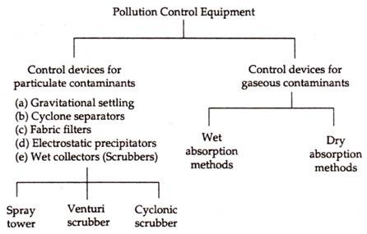
Air Pollution Control

Slide 329
Water Pollution Control
Physical Treatment Equalisation Settling Floatation Filtration Reverse Osmosis
Chemical Treatment Chlorination Demineralisation Softening
Biological Treatment Anaerobic treatment Aerobic treatment

Slide 330
G-1 Installation of Environmental Protection and Measuring Systems
Learner
Beginner
Organized
Achiever
World class
Plan
No awareness regarding environmental protection and measuring equipments
Training provided on environmental protection and measuring equipments to key people on the shop floor. But commissioning of production units not held up if ETPs or emission control equipment are not ready
+ Service manuals are in place for all environmental protection and measuring equipments. Regular calibrationof these equipments are carried out for effective reading and output
+ Satisfactory dry trial runs of all environmental protection and measuring equipments are completed before commissioning of the complex
+ Highly intelligent measurement systems are also installed to track the performance of the effluent treatment and emission control equipment
Deploy
No equipment installed, No system of measuring environmental discharges and compliance
Selective equipment only along with production units
All Necessary equipments deployed in firm
Pollution control facilities Installation happens before taking up any commisioning activities
Highly intelligent measurement systems are integrated with the production process
Monitor, refine and deliver outcome
No environmental protection and measuring equipment identified. Main focus is on completion of production units
Selective environmental management equipments taken up simultaneously with the production units
+ Necessary environmental management equipments, measuring devices and production units form total package of the project
+ Installation of all production units and environmental management & measuring systems are completed before taking up commissioning activities and Continuous equipment upgradation in place
+ EMS backed by highly intelligent measurement systems are fully integrated with the production process and are in place prior to commissioning

Slide 331
Exercise - 4
Can you explain how commitment level improves from Level 1 to 4 towards timely installation of the pollution control equipment ?
Can you give 3 examples of Air pollution and Water pollution control systems ?

Slide 332
H-1 Planned Maintenance

Slide 333
Planned maintenance of environmental control systems
Ensure the maintenance of equipment installed for environmental control to keep them operational with lowest downtime.

Slide 334
Maintenance types
Breakdown maintenance
Regular maintenance
Preventive maintenance
Predictive maintenance

Slide 335
H-1 Planned Maintenance of Environmental Management Systems
Learner
Beginner
Organized
Achiever
World class
Plan
No PM plan for environmental management systems
PM plan available for <50% environmental management systems
PM plan for 50%-70% critical environmental management systems
PM plan available for 70%-99% environmental management systems
PM plan for all environmental management systems
Monitor, refine and deliver outcome
No system of planned maintenance
Adherence to planned maintenance is <50%
Adherence to planned maintenance is 50%-75%
Adherence to planned maintenance is 76%-99%
Adherence to planned maintenance is 100%
Monitor, refine and deliver outcome
Effectiveness not measured for environmental management systems
Adherence measured on adhoc basis for environmental management systems
+ MTTR and MTBF measured at <30% environmental management systems
+ MTTR and MTBF measured at 30-60% environmental management systems
+ MTTR and MTBF measured at >60% environmental management systems and it shows an improving trend

Slide 336
I-1 Design Compliance

Slide 337
Design compliance with regulatory requirements
Develop and design the product to fulfil compliance with environmental regulatory requirements for products.

Slide 338
Eco friendly product
Eco Mark criteria of MoEFCC
(a) Production process including source of raw material; (b) Conserving Natural Resources; (c) Likely impact on the environment; (d) Energy conservation in the production of the product; (e) Effect & extent of waste arising from the production process; (f) Disposal of the product and its container; (g) Utilization of "Waste" and recycled materials; (h) Suitability for recycling or packaging (i) Biodegradability;

Slide 339


Eco Friendly Design

Slide 340
I-1 Design Compliance with Regulatory Requirements
Learner
Beginner
Organized
Achiever
World class
Plan
No process to consider compliance requirements in design and development
Design ensures customer requirements are met
+ Design meets customer specifications, regulatory and statutory requirements
+ System in place integrating environmental regulatory requirements while designing and developing products in addition to meeting customer specifications, regulatory and statutory requirements
+ Proactive approach in developing environment friendly products using environment friendly raw materials which go beyond the regulatory environmental considerations
Deploy
No design review done
Reactive approach in place for review and error rectification of designs
+ Regulatory queries are maintained with reasons for failures investigated & suitable actions taken for prevention of design failure
+ Designs are reviewed and approved by cross function team on periodic basis. ECN/ECR(Engineering change note/record) process is in place
+ Designs are optimized for robustness using advanced tools and techniques to meet regulatory requirement in addition to review by cross functional team
Monitor, refine and deliver outcome
No procedure for testing and accepting products for regulatory compliance requirements
Standards followed in adhoc cases for testing and accepting products for regulatory compliance requirements
+ Standards defined by customer is followed for regulatory compliance requirements
+ Meets national standards for regulatory compliance requirements
+ Meets International regulatory standards for all products for regulatory compliance requirements

Slide 341
J-1 Disposal after use

Slide 342
Disposal after Use
Have information to educate consumer for product disposal in an environmentally safe manner and to provide for disposal systems where required by statute or environment impact level is high

Slide 343
J-1 Disposal After Use
Learner
Beginner
Organized
Achiever
World class
Plan
No instructions on environmentally safe disposal of products after use
Only basic information on use, storage and safe disposal of its products after use mentioned on the packaging
+ Organisation has done assessment for disposal of product in an environment friendly manner after its use and communicated through product literatures to its customers
While designing and manufacturing of a product life cycle of product has been considered (Crude to grave)
+ Complete information on safe disposal of its products after use printed on packaging.
Wide publicity of the same for educating the customers is done. Education in the form of forums, blogs Videos / On-line channels like Youtube etc. done
+ As a policy,organisation reviews the potential negative impacts of its products after use and adopts state-of-the-art technology including use of alternate raw materials to reduce such impacts.
Deploy
Consumer education on safe disposal not done
Adhoc instructions on safe disposal
Detailed instructions on safe disposal and return policy for environmentally unsafe disposal items
Detailed instructions on its use, storage and safe disposal mentioned on the packaging
Customers are educated in addition to detailed instructions on packaging
Monitor, refine and deliver outcome
No monitoring and Review Mechanism
30% Products are covered
50% products are covered
All products are covered
Customer awareness survey Index
Continuous monitoring and review in place

Slide 344
Q-3 Environment Management Performance

Slide 345
Environmental Performance
To asses the reduction in environmental impact of pollutants generated by processes

Slide 346
Measurement of Environmental Performance
Parameters to be monitored are identified
The discharge norms to be met are recorded
Whether the pollution control plant and equipment installed are performing to their design efficiency

Slide 347
Q-3 Environmental Performance, Air/Effluent, Solid Wastes
Initial
Beginner
Organized
Achiever
World class
Monitor, refine and deliver outcome
Environmental performance measures are not defined and not monitored
Critical environmental performance indicators are monitored occasionally. No CAPA if actions fall below expectations
+ All environmental parameters are monitored and organisation shows compliance at least 75% time. CAPAs are in place and regular reviews happen to discuss performance
+ Compliance of all environmental performance parameters up to 100 % of time
+ Achieves up to 5% beyond regulatory norms in environmental performance at all times.

Slide 348
Exercise-1
Pertaining to the following requirements:
1. Technology Selection Environment Mgmt
2. Pollution Control
3. Environment Protection Equipment
4. Planned Maintenance
5. Design Compliance
6. Design After Use
7. Environment Management Performance
Develop:
Three main questions to assess the requirement
Three main steps to implement

Slide 349
Day 3 Session 2

Slide 350
Natural Resources Management

Slide 351
Systems for natural resource conservation
Design or select processes that eliminate or reduce natural resource use and substitute conventional energy sources with renewable sources

Slide 352
Natural Resources Management
# | Clause | Topic
1 | F-4 | System for Natural Resources Conservation
2 | Q-1 | Optimal use of Natural Resources

Slide 353
F-4 Natural Resource Conservation

Slide 354
Natural Resource Management – some aspects
Type of Natural Resource
Renewable
Non-renewable (Finite)
Energy – wind, solar, wave, geo-thermal Bio-mass – bio-gas, bio diesel, bio-plastic (from starch, veg fat, veg oil) Sustainable forestry Food – from sustainable agriculture Air ? Water ?
Coal Crude oil Natural gas Minerals Nuclear fuels Top soil
Natural Resource Conservation aspects in ‘Green Building’ initiative – Water conservation incl rain water harvesting, recycling after treatment, water efficient appliances Energy efficiency thro’ use of energy efficient appliances, optimising natural lighting, solar panels, solar water heaters, use of recycled materials

Slide 355
Conservation of Natural Resources
Save Reduce Reuse Recycle

Slide 356
F-4 Systems for Natural Resource Conservation
Learner
Beginner
Organized
Achiever
World class
Plan
No focus on natural resource conservation
Identification of the natural resources used by the organization, establishing a system of measurement of natural resources consumption
+ Organisation has developed an action plan for reduced use of natural resources
+ Goals for natural resource conservation in place and >60% of its targets are achieved
+ Action plan in place to reduce the use of natural resources by 2 - 5% every year
Deploy
No actions identified for natural resource conservation
Ad-hoc low cost measures for natural resource conservation developed e.g.. Natural lighting, paper re-use, water wastage prevention etc. People are trained on conservation
+ Identified important areas of resource conservation such as (as applicable) heat exchangers, solar water heating / P V panels, investments in hydro / wind projects
+ Time bound action plan in place for conservation of identified natural resources and increasing use of renewable resources
+ Processes including raw materials are continually reviewed to maximize conservation of natural resources. A strong education program in place for judicious use of natural resources. Visual management highlighting benefits of natural resource consumption in place
Monitor, refine and deliver outcome
Nothing in place for checking natural resource conservation
System in place for yearly checking of natural resource conservation
+ System in place for half yearly checking of natural resource conservation
+ Quarterly internal audit and yearly external audit of natural resource conservation is carried out
+ Publishes its 'natural resource conservation" report
Monitor, refine and deliver outcome
No improvement observed in variances
<50% improvement observed in variances
50%-75% improvement observed in variances
75%-95% improvement observed in variances
>95% improvement observed in variances

Slide 357
Q-1 Outcome of Natural Resource Conservation

Slide 358
Q-1 Optimal Use of Natural Resources
Initial
Beginner
Organized
Achiever
World class
Monitor, refine and deliver outcome
No data exists to optimize use of natural resources
Parameters to measure natural resource usage has just been defined
+ Organisation works towards continual improvement plan to improve all applicable parameters, one or more of the following :
25 % conversion from fossil fuels to clean fuel
Apart from evaporation, 50 % water recycled
50% own plantation and no virgin forest is cut where wood is a consumable
+ Organisation works towards continual improvement plan to improve all applicable parameters, one or more of the following
50 % conversion from fossil fuels to clean fuel
Apart from evaporation, 75% water recycled
Rain water harvesting and recharging of ground water is practiced
100% own plantation and no virgin forest is cut (where wood is a consumable)
+ Organisation works towards continual improvement plan to improve all applicable parameters , one or more of the following
80% conversion from fossil fuels to clean fuel
Apart from evaporation, 90% water recycled
Organization is water positive through rain water harvesting, recharging of ground water
Net positive contributor to plantation (where wood is a consumable)
Organization uses renewable sources of energy in non-critical areas

Slide 359
Exercise - 6
Name 4 Renewable and 4 Non-renewable resources
What are the methods for conserving natural resources ?
Name 4 aspects included in ‘Green Building Initiative’ which address Natural Resource Conservation

Slide 360
Day 3 Session 3

Slide 361
Defense Sector - Parameters

Slide 362
Day 3 Session 4

Slide 363
Understanding Assessment

Slide 364
Understanding the Assessment Process

Slide 365
Chapter 3: Understanding the Assessment Process
Desktop Assessment
About
The outcome of this process will decide the onward movement of the applicant in the ZED Certification scheme.
The applicant MSME will be advised to proceed to the site-assessment stage if cleared after the desktop assessment and a brief report will be forwarded.
If the applicant MSME is not advised to proceed further, a detailed report with a roadmap for improvement will be provided to the applicant MSME.
The complete process is IT enabled and through a web application
This process is in 3 stages:
Payment of relevant fee by the applicant MSME for this process.
Submission of relevant evidences as advised in the self-assessment stage.
Evaluation (by the desktop assessor) of the self-assessment vis-à-vis evidences submitted.

Slide 366
Chapter 3: Understanding the Assessment Process
Desktop Assessment
The Process
Understanding Online Self-assessment by applicant
Allocation of Desktop assessor to applicant MSME
Reviewing evidences uploaded – checking relevance & adequacy
Evidence recall; additional evidence
Deciding maturity level vis-à-vis evidence available
Technical review by QCI
Clearing or rejecting MSMEs for site-assessment
Report generation after desktop review
HOW TO: Web application for desktop assessment – an insight

Slide 367
Chapter 3: Understanding the Assessment Process
Site Assessment
About
The Site Assessment process is a comprehensive physical assessment & evaluation of the existing systems and processes of the applicant MSME.
The process will typically take about 4 man-days (irrespective of MSME size) and will be conducted by trained and certified assessors from accredited rating agencies.
Trained & Certified Assessor(s) will participate in this process and assess/evaluate the existing systems and processes of the manufacturing unit on the parameters selected during the online self-assessment stage and collect additional relevant evidences as applicable.
The complete process is IT enabled, through a mobile application
The assessment report will be evaluated by the NMIU which will result in a Certification as appropriate.

Slide 368
Chapter 3: Understanding the Assessment Process
Site Assessment
Understanding checklists in each parameters
Ladder Climbing Maturity Level
Achieved Maturity Level
Sub-categories of parameters
Understanding evidences needed for each parameter
Sectoral relevance
Suggested Questions
Need of additional evidences
Using mobile application during site-assessment: an insight
Tasks & responsibilities of an assessor
Documentation required during site-assessment

Slide 369
Chapter 3: Understanding the Assessment Process
Site Assessment
The Site Assessment Process
Assessment preparation & planning with co-assessor
Online Self assessment and Desktop Assessment (DA) Reports
Evidences available from DA stage
Scheduling of assessment
Opening Meeting with MSME
A formal opening meeting, shall be held with the MSME’s management and, where appropriate, those responsible for the functions or processes to be assessed. The purpose of the opening meeting, usually conducted by the assessment team leader, is to provide a short explanation of how the assessment activities will be undertaken.
During the opening meeting, the Team leader shall collect information on the situation and on changes concerning MSME, equipment, raw materials, processes and anything else relevant.

Slide 370
Chapter 3: Understanding the Assessment Process
Site Assessment
The Site Assessment Process … contd.
The assessment process using mobile application – an insight
Pictures / Documents / Records collection of evidences of good practices & sensitive areas
Closing Meeting
A formal closing meeting, where attendance shall be recorded, shall be held with the MSME’s management and, where appropriate, those responsible for the functions or processes assessed. The purpose of the closing meeting, usually conducted by the assessment team leader, is to present the assessment conclusions.

Slide 371
Chapter 3: Understanding the Assessment Process
Site Assessment
The Site Assessment Process … contd.
Report Generation
The rating agency shall provide a system generated report for onsite assessment to QCI. The assessment team may identify opportunities for improvement but shall not recommend specific solutions. Ownership of the assessment report shall be maintained by the rating agency.
Certification Decision by Rating Committee (RC)
The submitted report shall be reviewed for decision on certification by Rating Committee of QCI, if found suitable. For any clarification on report, the RA team shall provide further information as required by Rating Committee.

Slide 372
UNDERSTANDING ZED SCHEME GUIDELINES

Slide 373
ONLINE SELF-ASSESSMENT PROCESS

Slide 374
STEP 2: SELF ASSESSMENT (1)
Interested and registered MSME to take ZED Self-Assessment
Self-Assessment is an ONLINE activity
Self Assessment is guided through a guided checklist
MSME Units have maximum three chances for Self Assessment
There will be system-generated report for every Online Self Assessment, attempted by MSME
There is no fees to be paid by MSME for participating in Online Self-Assessment.
NOTE: The MSME shall clearly indicate if any activities covered under the criteria for Certification are carried out at any premises other than the plant location, to enable covering the same under Assessment.

Slide 375
STEP 2: SELF ASSESSMENT (2)
D E M O
ONLINE SELF ASSESSMENT PROCESS

Slide 376
ZED CERTIFICATION: 7 STEP PROCESS
1
Registration
Online Registration by MSMEs
2
Online Self-Assessment
MSMEs to self-assess based on ZED parameters
3
Desktop Assessment
Assessment based on documents submitted by MSMEs
7 Step Process
30 Days
4
OnSite Assessment
On-site assessment of only MSMEs, selected in Desktop Assessment
8 Weeks
5
ZED Rating & Certification
Final ZED Rating and Certificate (valid for 4 years)
6
Gap Analysis & Handholding
Option to avail services of Gap Analysis & Handholding
7
Re-Assessment
Option to apply for re-assessment
Surveillance: OnSite Surveillance 2 times in a cycle (4 years)

Slide 377
STEP 3: DESKTOP ASSESSMENT (1)
DESKTOP ASSESSMENT – KEY POINTS
QCI shall assign a suitable competent empanelled Desktop Assessor from its pool of approved Desktop Assessors or Rating Agencies for Desktop Assessment activity.
Applicant MSME shall pay a fee for Desktop Assessment, as per approved fee structure, along with the evidences required as per the Online Self Assessment.
The Desktop Assessment activity shall be completed within stipulated time as per the norm and the report is finally submitted to applicant MSME, in either case, whether eligible or non-eligible for OnSite Assessment.
In the event of an applicant MSME is compliant to criteria, it shall be informed by QCI along with report and the OnSite Assessment is recommended.

Slide 378
STEP 3: DESKTOP ASSESSMENT (2)
DESKTOP ASSESSMENT – KEY POINTS
The outcome of this process will decide the onward movement of the applicant in the ZED Certification scheme.
The applicant MSME will be advised to proceed to the OnSite Assessment stage if cleared after the Desktop Assessment and a brief report will be forwarded.
If the applicant MSME is not advised to proceed further, a detailed report with a roadmap for improvement will be provided to the applicant MSME.
The complete process is IT enabled and through a web application
This process is in 3 stages:
Payment of relevant fee by the applicant MSME for this process.
Submission of relevant evidences as advised in the Self Assessment stage.
Evaluation (by the Desktop Assessor) of the Self-Assessment vis-à-vis evidences submitted.

Slide 379
STEP 3: DESKTOP ASSESSMENT (3)
DESKTOP ASSESSMENT – KEY POINTS
The Process
Understanding Online Self Assessment done by applicant
Allocation of Desktop Assessor by QCI
Key agenda is reviewing evidences uploaded – checking relevance & adequacy, with reference to the Self Assessment done – does the evidence submitted match with the level ?
Evidence recall; additional evidence
Deciding maturity level vis-à-vis evidence available
Technical review by QCI, including evidences of self-certification of the applicable statutory & regulatory requirements of the MSME, with reference to Quality, Environment and Safety
Clearing or rejecting the applicant for OnSite Assessment
Desktop Assessment Report – for both cleared and rejected applicants

Slide 380
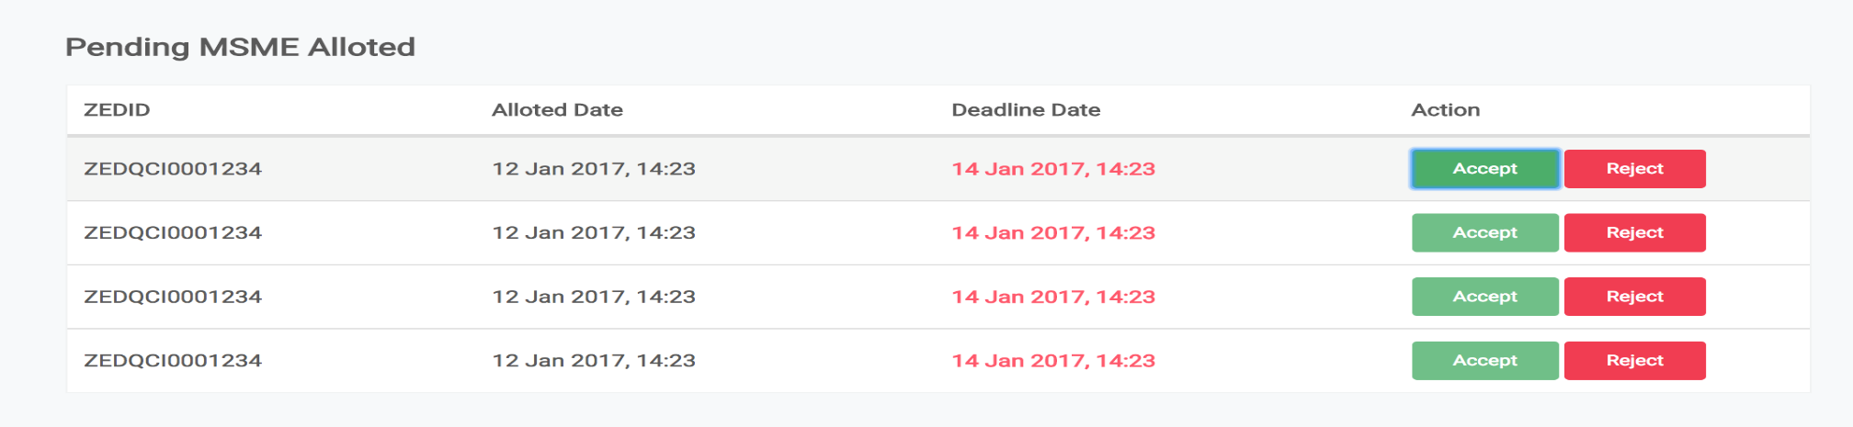
STEP 3: DESKTOP ASSESSMENT (4.2)
Upon submitting a Self Assessment by MSME, it will be intelligently allocated to a
Desktop Assessment Body (DAB)
2. Every DAB will have an authorized person who can add/manage Allocated Assessments and
add/manage Assessors
3. Every time he gets a new request for a DA, he can see it on his Dashboard under Pending
MSME
4. He can Accept or Reject
- Upon Accept, he will have to assign an Assessor for this DA
- Upon Reject, the MSME request will be re-allocated to another DAB
5. Once Accepted, an email will be sent to the Assessor to get started on the DA.
6. Assessor can only be assigned if he’s an Approved Assessor by ZED-QCI.
4. He can Accept or Reject
Upon Accept, he will have to assign an Assessor for this DA
Upon Reject, the MSME request will be re-allocated to another DAB

Slide 381
STEP 3: DESKTOP ASSESSMENT (4.3)
7. After logging in as an Assessor, he will get to see every question with the Option Selected
and the Evidence Uploaded, if any.
8. There are 3 actions for every question in every parameter:
Agree:
Agree to the option selected by the MSME
When either the evidence uploaded supports his answer OR
When the option selected doesn’t need any evidence
Change
Disagree to the option selected by the MSME and can increase or decrease accordingly
When the submitted evidence makes the MSME eligible for an even higher rating OR
When there was no submitted evidence even though it was suggested.
Review
Mark as Review is an option to mark a Question’s evidence for Review which will be shown at the time of SA to double-check or take another picture for an extra proof etc.
9. Once the Assessment is completed, the Assessor will submit the Desktop Assessment
Report to his DAB.
10. DAB then reviews it again and if everything is right, DAB can Forward to ZED
11. After forwarding to ZED, ZED Master DAB will review the assessment report manually and
then either Approve or Reject it.

Slide 382
Day 4 Session 1

Slide 383
Site Assessment Report Gap Analysis in Group & Presentation

Slide 384
Day 4 Session 2

Slide 385
CASE EXERCISE 1: VISUALIZATION
CASE EXERCISE 1-1:
VISUALIZING THE MSME UNIT HOLISTICALLY

Slide 386
DESKTOP ASSESSMENT
CASE EXERCISE 1- 2:
VISUALIZING THE MSME UNIT HOLISTICALLY

Slide 387
ONSITE ASSESSMENT
CASE EXERCISE 1- 3:
VISUALIZING THE MSME UNIT HOLISTICALLY

Slide 388
Day 4 Session 3

Slide 389
Reducing Variation between Assessors

Slide 390
ASSESSOR SKILLS

Slide 391
ASSESSOR SKILLS (1)
ASSESSOR SKILL IS A COMBINATION OF
ABILITY TO FIND AND EVALUATE FACTS
TIME MANAGEMENT
REPORTING

Slide 392
ASSESSOR SKILLS (2): FACT FINDING
PURPOSE OF AN ASSESSMENT IS TO FIND FACTS SUPPORTED BY OBJECTIVE EVIDENCE. THESE MAY BE:
DOCUMENTS (Eg. POLICY, OBJECTIVES, PLANS, PROCEDURES ETC)
RECORDS (MANY EXAMPLES POSSIBLE)
DATA SUMMARIES, ANALYSIS, METRICS AND PERFORMANCE INDICATORS
REPORTS FROM OTHER SOURCES (Eg. CUSTOMER FEEDBACK, VENDOR RATINGS, ETC)
ACTUAL OBSERVATIONS OF ACTIVITIES
OBSERVATION OF SURROUNDING WORK ENVIRONMENT AND CONDITIONS
SOMETIMES, EVEN STATEMENTS OF INFORMED PERSONS

Slide 393
FACT FINDING SKILLS
ASSESSOR SKILLS (3): FACT FINDING
READING
COMMUNICATIONS
INTERVIEWING
LISTENING
FIRST QUESTION
USE OF CHECK LIST
TAKE NOTES
SPOT CHECK DOCUMENTS
RECORDS / SAMPLES
OBSERVATION
BODY LANGUAGE
QUESTIONING
USE OF THOUGHT SPEED
UNASKED QUESTIONS
TO-AND-FRO CHECKING
SELECT SAMPLE YOURSELF

Slide 394
COMMUNICATING WITH THE ASSESSEE
ASSESSOR SKILLS (4): FACT FINDING
MESSAGE TO BE IN LINE WITH
- PURPOSE
- AUDIENCE
- SITUATION
USE OF SIMPLE LANGUAGE
STRUCTURED / ORGANIZED MESSAGE
IMPACT OF A MESSAGE IS
- 7 % VERBAL
- 38% VOCAL
- 55% BODY LANGUAGE

Slide 395
ASSESSOR SKILLS (5): FACT FINDING
QUESTIONING SKILLS
LEADING QUESTIONS LIKE
DO YOU?…………DON’T YOU ?
CLOSED QUESTIONS LIKE
DO YOU……….. ?
CAN YOU ……… ?
WILL YOU ………. ?
OPEN QUESTIONS LIKE THOSE
WHAT, WHEN, WHERE, WHO, WHY, HOW AND “SHOW ME”
ONE QUESTION AT A TIME
QUESTIONS RELEVANT TO THE ACTIVITY BEING AUDITED.

Slide 396
ASSESSOR SKILLS (6): FACT FINDING
LISTENING SKILLS
BARRIERS TO LISTENING
DECIDING IN ADVANCE THAT THE SUBJECT IS NOT INTERESTING
EVALUATING THE SPEAKER
BECOMING EMOTIONALLY INVOLVED
LISTENING FOR FACTS, NOT IDEAS
TAKING COPIOUS NOTES
FAKING ATTENTION
GETTING DISTRACTED
AVOIDS DIFFICULT LISTENING
FAILING TO CAPITALIZE ON “THOUGHT SPEED”

Slide 397
ASSESSOR SKILLS (7): FACT FINDING
THOUGHT SPEED
AVERAGE PERSON SPEAKS ABOUT 120 WORDS PER MINUTE; WHILE BRAIN CAN PROCESS 450-500 WORDS PER MINUTE.
A GOOD LISTENER USES THIS EXCESS CAPACITY TO:
ANTICIPATE WHAT THE PERSON IS GOING TO SAY
ANALYZE WHAT HE IS SAYING
SUMMARISE WHAT HAS BEEN SAID
MENTALLY FRAME THE NEXT QUESTION
UNDERSTAND ANY EMPHASIS BEING MADE
UNDERSTAND BODY LANGUAGE

Slide 398
ASSESSOR SKILLS (8): FACT FINDING
BODY LANGUAGE
EYE CONTACT
CLENCHED FISTS
CROSSED ARMS AND LEGS
DIRECTION OF FEET AND LEGS
CARE ABOUT PERSONAL SPACE
SILENCE AT THE END OF A QUESTION
and, MANY MORE

Slide 399
TIME MANAGEMENT SKILLS
ASSESSOR SKILLS (9): TIME MANAGEMENT
PLANNING AND PREPARATION
PUNCTUALITY
CONSCIOUSNESS ON TIME WASTERS
INTRODUCTION / PRESENTATION
WALK ROUND THE PLANT
LUNCH / TEA / COFFEE
FALSE TRAILS
UNIMPORTANT ISSUES
FRIENDLY TALKS
TOP BRASS

Slide 400
ROLES & RESPONSIBILITIES OF ASSESSOR, TEAM LEADER AND TECHNICAL EXPERTS

Slide 401
WHO ARE INVOLVED IN A ZED ASSESSMENT
ASSESSMENT TEAM ROLES (1)
ASSESSOR:
A PERSON WHO IS COMPETENT AND IS AUTHORISED TO PERFORM ALL OR ANY PORTION OF THE ZED ASSESSMENT
TEAM LEADER:
AN ASSESSOR WHO IS COMPETENT AND IS AUTHORIZED TO MANAGE THE ZED ASSESSMENT
TECHNICAL EXPERT:
A PERSON WHO PROVIDES SPECIFIC KNOWLEDGE OR EXPERTISE
TO THE ZED ASSESSMENT TEAM: Does not act as ASSESSOR

Slide 402
ASSESSMENT TEAM ROLES (2)
TEAM LEADER:
- LEAD THE TEAM OF ASSESSORS
- REPRESENT THE DESKTOP ASSESSMENT BODY / RATING AGENCY
- MANAGE THE ASSESSMENT ACTIVITIES
- REPORT ASSESSMENT FINDINGS TO QCI
- PLANNING THE ASSESSMENT
- REVIEW OF ASSESSMENT TEAM’S WORK
- PREVENT & RESOLVE CONFLICTS
- LEAD THE ASSESSMENT TEAM TO REACH CONCLUSIONS
- CONTROL OF THE OPENING AND CLOSING MEETINGS
- PREPARATION AND SUBMISSION OF THE REPORT

Slide 403
ASSESSOR:
COMMUNICATING AUDIT REQUIREMENTS TO THE ASSESSEE REPRESENTATIVES
CONDUCTING THE ASSESSMENT
DOCUMENTING OBSERVATIONS WITH EVIDENCE
REPORTING RESULTS TO THE TEAM LEADER
CO-OPERATING WITH AND ASSISTING THE TEAM LEADER IN THE EFFECTIVE CONDUCT OF THE ASSESSMENT

Slide 404
ASSESSMENT TEAM COMPETENCE

Slide 405
ASSESSMENT TEAM COMPETENCE
Assessor Competence
Education
Graduates in Engineering/Diploma (3 years) or Masters (in Science or Technology) qualification.
Working Experience
Minimum 5 years for B.Tech / M.Sc with at least two years in relevant Zed Sector
Minimum 8 years for Diploma with at least two years in relevant Zed Sector
Or
50 man-days of consulting/certification auditing/maturity model assessment/accreditation assessment experience in any of the ZED relevant sectors.
Maturity Assessment Experience
at least one maturity assessment model assessment or one complete ZED on-site assessment as an observer.
Assessor having any maturity model assessment experience with ZED Assessor Training may be considered suitable for onsite assessment.

Slide 406
ASSESSMENT TEAM COMPETENCE
Assessor Competence
Knowledge
The assessor shall have the following knowledge/expertise in the following minimum 5 ZED Disciplines
Group | ZED Disciplines | Area of Knowledge /Expertise
A (minimum 1 required) | QMS | Quality Management System: Experience in design, implementing, auditing, maintaining and improving QMS. Including Maturity model implementation and assessment expertise.
 | Environment Management | Environment Management System: Expertize of implementing, maintaining, auditing and improving EMS. Aspects & Impacts Analysis and Environment Initiative implementation. Natural Resource Management (NRM) techniques. Maintenance of environment /NRM equipment.

Slide 407
ASSESSMENT TEAM COMPETENCE
Assessor Competence
Knowledge
The assessor shall have the following knowledge/expertise in the following minimum 5 ZED Disciplines
Group | ZED Disciplines | Area of Knowledge /Expertise
B (minimum 1 required) | Best Business Practices | Best Business Practices: Balanced Score Card, Periodic Management Review, and Cross Functional Practices for NPD, Waste Reduction, Improvement initiatives and customer complaints etc. Maintenance planning/Autonomous maintenance/Improvement in MTTR/MTBR etc.
 | Best Manufacturing Practice | Best Manufacturing Practices : Knowhow of best business practices like Lean Six Sigma / TPS, TQM, TPM, FMEA, SPC, MSA, NPD (APQP & PPAP), Producing Zero Defect, Pokayoke / mistake proofing, Product and Process Validation Methodologies etc. now how, control and improvement expertise of different manufacturing processes.
 | Supply Chain Management | Supplier initial evaluation / assessment, feedback and continual development monitoring expertise in manufacturing domain. Supply Chain Management, Material Management, Inventory Management, JIT, Material Movement, Storage, Traceability, Packaging and Delivery management. Disposal after use.

Slide 408
ASSESSMENT TEAM COMPETENCE
Assessor Competence
Knowledge
The assessor shall have the following knowledge/expertise in the following minimum 5 ZED Disciplines
Group | ZED Disciplines | Area of Knowledge /Expertise
B (minimum 1 required) | Continual Improvement | Hands on experience in diagnostic / gap analysis study to identify scope of improvement and roadmap preparation and facilitation for implementation. Problem Solving (In-house Rejection, Customer Line / Field & Warranty Rejection, Customer complaints), Contingency Planning and Continual Improvement.
 | Energy Management | Energy management and energy saving techniques : Implementation, auditing and improving energy efficient techniques
 | IPR | Intellectual Property Rights: Safe guarding innovation & Creativity (Trademark, Patents, Copyright etc.)
 | HRM | Human Resource Development, Competency Mapping, TNI, OJT, Multiskilling, Employee Engagement Techniques experience
 | Finance Management | Financial Management, MSME Financial Matrix System

Slide 409
ASSESSMENT TEAM COMPETENCE
Assessor Competence
Soft skills
Oral communication skills
Written communication skills
Data interpretation & analysis skills
Ability to comprehend collated and tabulated information, and detect trends and patterns
Planning assessments based on audit / time resources
Ability to ask logical, sequential probing questions in an assessment situation
Ability to unambiguously conclude on maturity status through logical audit trails and synthesis of information collected
Ability to handle IT tools used for assessments
.

Slide 410
ZED SECTORS
NIC Code | Sector | NIC Code | Sector | NIC Code | Sector
10 | Manufacture of food products | 16 | Manufacture of wood and products of wood and cork, except furniture; manufacture of articles of straw and plaiting materials | 22 | Manufacture of rubber and plastics products
11 | Manufacture of beverages | 17 | Manufacture of paper and paper products | 23 | Manufacture of other non-metallic mineral products
12 | Manufacture of tobacco products | 18 | Printing and reproduction of recorded media | 24 | Manufacture of basic metals
13 | Manufacture of textiles | 19 | Manufacture of coke and refined petroleum products | 25 | Manufacture of fabricated metal products, except machinery and equipment
14 | Manufacture of wearing apparel | 20 | Manufacture of chemicals and chemical products | 26 | Manufacture of computer, electronic and optical products
15 | Manufacture of leather and related products | 21 | Manufacture of pharmaceuticals, medicinal chemical and botanical products | 27 | Manufacture of electrical equipment

Slide 411
ZED SECTORS
NIC Code | Sector | NIC Code | Sector | NIC Code | Sector
28 | Manufacture of machinery and equipment n.e.c. | 31 | Manufacture of furniture | 35 | Electricity, gas, steam and air conditioning supply
29 | Manufacture of motor vehicles, trailers and semi-trailers | 32 | Other manufacturing
30 | Manufacture of other transport equipment | 33 | Repair and installation of machinery and equipment

Slide 412
Grant of new Discipline/industry sector
For extension to a new ZED Discipline within the same Industry sector for which an assessor is approved, the Rating Agency shall demonstrate that the assessor has the required competence through relevant training in the new ZED Discipline, and either
One year of work experience in the new ZED Competency Discipline or 15 man-days of inspection/audit/consulting/accreditation assessment/maturity model assessment experience in the industry sector.
or
four Rating assessments under the supervision of a qualified assessor in the new ZED Competency Discipline

Slide 413
Maintaining Assessor Qualification
For maintaining the qualification of the assessor, the Rating Agency shall ensure that assessors have performed either a minimum of five assessments or ten assessment days per year, under the ZED Maturity Model.

Slide 414
ASSESSMENT TOOLS & TECHNIQUES

Slide 415
ASSESSMENT PRINCIPLES
ASSESSMENT PRINCIPLES
INTEGRITY
FAIR PRESENTATION
DUE PROFESSIONAL CARE
CONFIDENTIALITY
INDEPENDANCE
EVIDENCE BASED APPROACH – OBJECTIVITY
UNBIASED
Source: ISO 19011:2011

Slide 416
INTERVIEWING
ASSESSMENT TECHNIQUES (1)
HELD WITH PERSONS FROM DIFFERENT LEVELS /FUNCTIONS (ESPECIALLY WITHIN THE SCOPE OF AUDIT)
SHOULD BE CONDUCTED DURING NORMAL WORK HOURS AND NORMAL WORK PLACE
PUT THE INTERVIEWED PERSON AT EASE PRIOR TO THE INTERVIEW
REASON FOR INTERVIEW AND NOTE TAKING EXPLAINED
INITIATE BY ASKING DESCRIPTION OF THEIR WORK
RESULTS SUMMARISED AND REVIEWED WITH THE PERSON
QUESTIONS LEADING TO BIAS TO BE AVOIDED
THANK FOR PARTICIPATION AND CO-OPERATION

Slide 417
AUDIT TRAILS
ASSESSMENT TECHNIQUES (2)
POLICY AND COMPANY LEVEL OBJECTIVES
DEPLOYED OBJECTIVES
PROCESS DOCUMENTATION
PROCESS INPUTS
RESOURCES
OPERATION OF PROCESS
CONTROL OF PROCESS
MONITORING AND MEASUREMENT
OUTPUTS
PERFORMANCE INDICATORS
DATA ANALYSIS
USE OF DATA FOR IMPROVEMENT

Slide 418
SPECIAL REQUIREMENTS FOR MATURITY ASSESSMENTS

Slide 419
MATURITY ASSESSMENTS (1)
ASSESSMENT AND RATING
Auditing vis-à-vis Assessment
Determining Compliance/Fulfilment vis-à-vis Evaluating Progression/ Maturity
Pass/Fail decision making vis-à-vis Graduating to higher levels
Statutory, Regulatory, Market Access or Customer requirements fulfilment vis-à-vis pursuing journey of excellence
“Non Conformance Report (NCR)” vis-à-vis “Strengths” and “Areas for Improvement”
Improvement oriented vis-à-vis Transformational
ZED CERTIFICATION IS BASED ON A MATURITY ASSESSMENT PROCESS

Slide 420
SPECIAL REQUIREMENTS
MATURITY ASSESSMENTS (3)
UNDERSTANDING THE MATURITY LEVELS FOR PARAMETERS
(Recall sessions on the 10 DISCIPLINES and 50 PARAMETERS on Day 1 and Day 2)
UNDERSTANDING THE EVIDENCES FOR THE DIFFERENT MATURITY LEVELS FOR PARAMETERS
(Recall sessions on ONLINE SELF ASSESSMENT and DESKTOP ASSESSMENT)
CONCEPT OF ACHIEVED LEVEL OF MATURITY AND NEXT MATURITY LEVEL

Slide 421
Enablers and Results
- What is meant by ‘Practice’
- What is meant by ‘Performance’
Notes:
ENABLERS: APPROACH
Integration is not very efficient, if different parts of organisation are not at comparable level of maturity

Slide 422
Enablers: Approach
Approach covers what an organization does or plans to do, and the reasons for it. The score awarded will take account of the:
Appropriateness of methods, tools and techniques used
Existence of well defined and developed processes based on stakeholder requirements
Supporting Strategy
Integrated with other approaches appropriately
Notes:
ENABLERS: APPROACH
Integration is not very efficient, if different parts of organisation are not at comparable level of maturity

Slide 423
Enablers: Deployment
This covers what an organization does to deploy the approach. The score awarded will take account of whether the approach is:
Implemented vertically and horizontally in all relevant areas, processes, products and services
Is structured and enables flexibility and Organizational agility
Notes:
ENABLERS: DEPLOYMENT

Slide 424
Enablers: Assessment and Refinement
This covers what an organization does to assess and review the approach and the deployment of the approach. The score awarded will take account of whether:
Appropriate measurement of the approach and deployment has been identified and undertaken
Creativity and learning activities are undertaken
Output from measurement, creativity and learning is analyzed and used to identify, prioritize, plan and implement improvements and innovation
Notes:
ENABLERS: ASSESSMENT AND REVIEW
Organisations depend on the measurement and analysis of results. Such measurements should derive from business needs and strategy, and they should provide critical data and information about effectiveness of approach (or key processes) and deployment (level of implementation).
Analysis is carried out to extract larger meaning from data and information to support evaluation, decision making, and improvement. It helps in understanding cause and effect relationships that might not otherwise be evident.
Learning activities may include :
benchmarking studies with the leaders
study groups, deep analysis
experts/Consultants inputs
training and education (new tools, techniques, concepts etc.).
Learning is extracting generic principles from specific experiences which can be used to company’s advantage (Products, Process, Performance and for Planning, Control, Improvement)

Slide 425
Results caused by Approach
TECHNOLOGY
QUALITY MATERIALS
PRODUCT QUALITY
COMPETENCE
SOUND PROCESSES

Slide 426
Results: Excellence of Results
Evaluate the Performance on the following attributes:
The existence of positive trends and /or sustained good performance. (continuous improvement ) over a period of 3 years
Whether targets are set and consistently achieved for key results inline with strategic goals.
Comparisons with Relevant external organizations are made and are favorable for key results inline with strategic goals.
The Confidence of future sustainability of the results based on established cause and effect relationship. (sustainability : doubtful, hopeful, forceful)
Trends, Targets, Comparisons, Alignment with processes give deeper insight to organisation’s Performance
Notes:
RESULTS: EXCELLENCE OF RESULTS
Measuring performance by itself has no meaning. Meaning is only assigned by comparison. Comparison against the past, for example, provides valuable information on performance improvements and underlying trends but is of limited use for providing direction. It is therefore necessary also to define targets for each of the selected measures. However, internal measures lack the view to the outside. Even a 100 per cent improvement might indicate a moderate performance if the performance standards of other organizations are considerably higher. It is therefore, of crucial importance to evaluate internal measures against the performance of competitors as well as the performance of companies with similar processes in other industries. The need for benchmarking has widely been recognized. Benchmarks are not the focus but it is important to recognize that they should be considered when designing performance measurement systems.
In summary, it is necessary to constantly compare actual performance against past, targets and benchmarks, and check the sustainability of good performance by looking at its linkage with the organisation approaches/initiatives.

Slide 427
Results: Relevance and Usability
The score for Relevance and Usability of results will take account of :
the relevance of and extent to which the results cover all the related areas of the organization (refer KFs, key initiatives in enablers relevant to result area).
the extent to which a full range of results, relevant to the criterion, are presented, accurate and reliable
the extent to which the scope & relevance of the results presented is understood (segmentation, relative importance, used for improvement)
Notes:
RESULTS: SCOPE

Slide 428
Measures : Maturity Levels
Benchmark
Learning, Leadership
Improvement
Analysis and Action
Variation Reduction
Deployment across the orgn.
Targets
Planning, Management Priority
Segmented
Detailed View, Micro Level
Global
General View, Macro Level,
None
Gazing, No Questions Asked
Notes:
MEASURES: MATURITY LEVELS

Slide 429
Day 4 Session 4

Slide 430
Conducting Assessment

Slide 431
PLANNING FOR ONSITE ASSESSMENT

Slide 432
ZED CERTIFICATION: 7 STEP PROCESS
1
Registration
Online Registration by MSMEs
2
Online Self-Assessment
MSMEs to self-assess based on ZED parameters
3
Desktop Assessment
Assessment based on documents submitted by MSMEs
7 Step Process
30 Days
4
OnSite Assessment
On-site assessment of only MSMEs, selected in Desktop Assessment
8 Weeks
5
ZED Rating & Certification
Final ZED Rating and Certificate (valid for 4 years)
6
Gap Analysis & Handholding
Option to avail services of Gap Analysis & Handholding
7
Re-Assessment
Option to apply for re-assessment
Surveillance: OnSite Surveillance 2 times in a cycle (4 years)

Slide 433
STEP 4: ONSITE ASSESSMENT (1)
ONSITE ASSESSMENT – KEY POINTS
The recommended applicant MSME shall pay a fee for OnSite Assessment as per
approved fee structure and shall be assigned to QCI Approved Rating Agency
(RA) for OnSite Assessment, based on approved competency of RA.

Slide 434
STEP 4: ONSITE ASSESSMENT (1)
ONSITE ASSESSMENT – KEY POINTS
Assessment Team Selection:
The RA shall assign the qualified ZED Assessor team as per the defined
competence criteria and type/scope of MSME. The OnSite Assessment to be
conducted with minimum two qualified ZED Assessors, supported by technical
experts, if needed. The team selected shall be such, so as to be competent to
assess all the applicable parameters opted by MSME (Unit). One of the
assessors must have competency in the environmental aspects/ areas. For
Defence Sector scope, the assessor must have minimum of 5 years of work
experience in Defence field in addition to other competence required.

Slide 435
STEP 4: ONSITE ASSESSMENT (2)
ONSITE ASSESSMENT – KEY POINTS
3. OnSite Assessment Time:
The OnSite Assessment shall be carried out at MSME for minimum 3 man-days
in Micro, minimum 4 man-days in Small and minimum 5 man-days in Medium
type enterprise. The assessment time includes the onsite time at the
organization’s location, assessment planning and document reviewing and
reporting. The assessment man-days are based on 8 hours per day.
Adjustments may be required based on local, regional, or national legal
requirements.
Online Assessment Report, Desktop Assessment Reports and evidences of
Desktop Assessment will be made available to assessment team in advance.

Slide 436
STEP 4: ONSITE ASSESSMENT (2)
ONSITE ASSESSMENT – KEY POINTS
4. Opening Meeting:
A formal Opening Meeting shall be held with the MSME’s management and,
where appropriate, those responsible for the functions or processes to be
assessed. The purpose of the Opening Meeting, usually conducted by the
assessment team leader, is to provide a short explanation of how the
assessment activities will be undertaken.
During the Opening Meeting, the Team leader shall collect information on the
situation and on changes concerning MSME, equipment, raw materials,
processes and anything else relevant.

Slide 437
STEP 4: ONSITE ASSESSMENT (3)
ONSITE ASSESSMENT – KEY POINTS
5. OnSite assessment will be based on specific ZED certification requirements. The
assessment is app-based and in accordance with check list provided by QCI.
During the assessment, the assessment team shall periodically check
assessment progress and exchange information. The assessment team leader
shall re-assign work as needed between the assessment team members and
periodically communicate the progress of the assessment and any concerns to the
MSME.
When conducting OnSite assessment, the assessor shall collect and verify
evidence related to performance of various processes/activities of the MSME as
per ZED certification module / parameter which includes as a minimum:
— Operational Control;
— Monitoring Measurement and Analysis.

Slide 438
STEP 4: ONSITE ASSESSMENT (4)
ONSITE ASSESSMENT – KEY POINTS
During the assessment, information relevant to the assessment objectives, scope
and criteria (including information relating to interfaces between functions,
activities and processes) shall be obtained and verified to become assessment
evidence.
Methods to obtain information shall include, but are not limited to:
a) interviews;
b) observation of processes and activities;
c) review of documentation and records

Slide 439
STEP 4: ONSITE ASSESSMENT (5)
ONSITE ASSESSMENT – KEY POINTS
6. Safety during assessments
Assessment involves risks linked to the need to travel to work environments. Responsibility for risk analysis and the identification of the most suitable means of protection is of the MSME that manages the building or factory.
However, assessors must have personal protective equipment which may be reason-ably required to run in the security checks. In particular, each assessor must go to the sites to verify with at least:
helmet;
safety shoes;
goggles;
ear protectors;
high visibility vest

Slide 440
STEP 4: ONSITE ASSESSMENT (6)
ONSITE ASSESSMENT – KEY POINTS
7 Closing Meeting:
A formal Closing Meeting, where attendance shall be recorded, shall be held with the MSME’s management and, where appropriate, those responsible for the functions or processes assessed. The purpose of the Closing Meeting, usually conducted by the assessment team leader, is to present the assessment conclusions.
8. OnSite Assessment Report:
The Rating Agency shall provide a system generated report for OnSite Assessment to QCI. Ownership of the assessment report shall be maintained by the Rating Agency.

Slide 441
STEP 4: ONSITE ASSESSMENT (6)
ONSITE ASSESSMENT – KEY POINTS
8. Certification Decision by Rating Committee (RC)
The submitted report shall be reviewed for decision on certification by Rating
Committee of QCI, if found suitable. For any clarification on report, the RA team shall
provide further information as required by Rating Committee. For each accepted
reports, the RA shall be paid for the OnSite Assessment conducted as per the fee
structure.
The Certificate will be issued by QCI.

Slide 442
STEP 4: ONSITE ASSESSMENT (4)
ONSITE ASSESSMENT – KEY POINTS
The Process
1. Assessment preparation & planning with co-assessor
2. Scheduling of assessment
3. Opening Meeting with MSME
4. Understand the MSME’s products, systems and processes
5. Understand the applicable statutory & regulatory requirements of the
MSME with reference to Quality, Environment and Safety
6. The assessment process using Tablet
7. Closing Meeting
8. Report Generation

Slide 443
STEP 4: ONSITE ASSESSMENT (4)
D E M O (DRAFT WORKFLOW)
ONSITE ASSESSMENT PROCESS
(Under development)

Slide 444
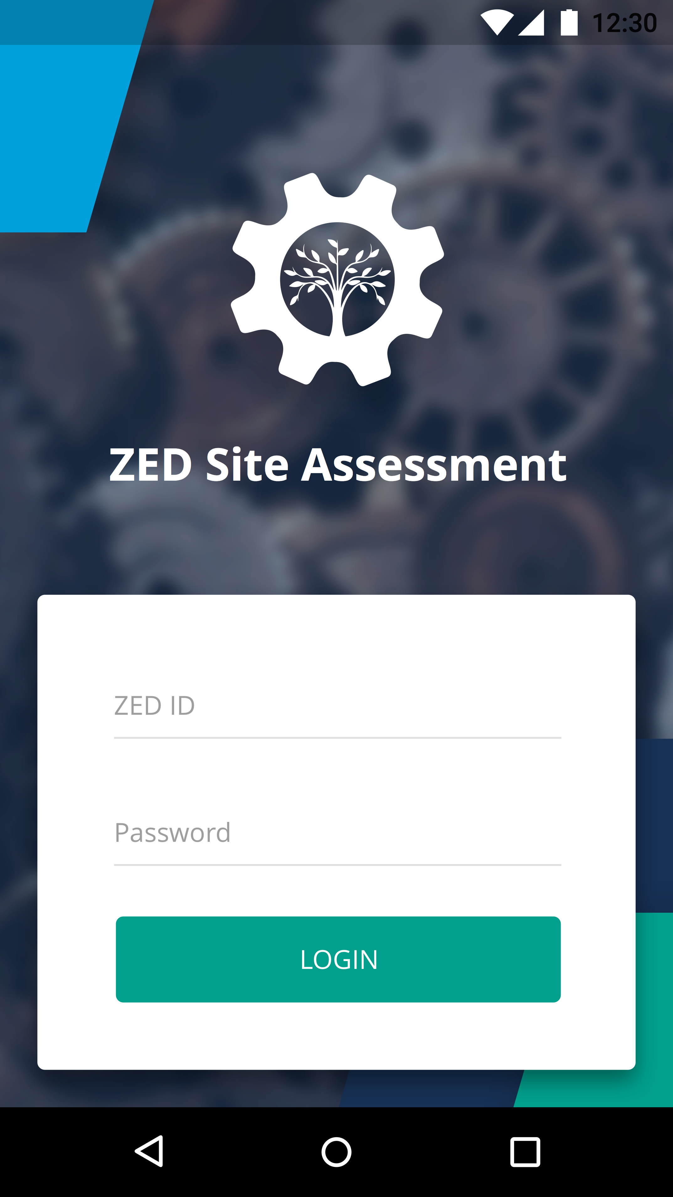
STEP 4: ONSITE ASSESSMENT (5.1)
Upon finally approving and finishing a DA, MSME can register and apply for a Site
Assessment
After successful payment for SA, the request will be auto-allocated to a Site Assessment
Body (SAB)
Similar to DA, authorised person from SAB can then choose the Allocated MSME and either Accept or Reject based on their Assessor’s availability.
After assigning it to a Site Assessor, he can login from the Mobile App and get started on the Site Assessment:

Slide 445
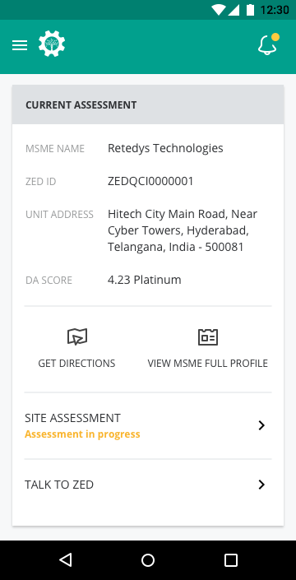
STEP 4: ONSITE ASSESSMENT (5.2)
5. On his Dashboard, he can see the Current Assessment he is assigned to based on the date:

Slide 446
STEP 4: ONSITE ASSESSMENT (5.3)
6. Similar to the OSA, a Site Assessor will go through every parameter from the MSME’s sector
and check on every question’s Evidence Suggested Vs. Evidence Uploaded Vs. DA Comments
(if any)
7. Wherever needed, the SA should Agree, Change or Re-upload evidences and decide a final
option to the question in context.
8. Every Evidence he captures as a Photo using his smartphone will be saved with it’s location
identifiers (latitude, longitude) and also a timestamp.
9. Whatever option the SA selects in the end will be the final one that is used in certifying /
rating the MSME.
10. Finally, once the SA finishes on the mobile app, it will be submitted to the SAB who will
then review and Forward to ZED similar to the process on DA.
11. Once ZED reviews the final file and approves it, the MSME will be rated and certified as per
the review by SA.

Slide 447
Day 5 Session 1

Slide 448
EXERCISE ON ONSITE ASSESSMENT PLANNING

Slide 449
ONSITE ASSESSMENT
CASE EXERCISE 2:
EXERCISE ON
ONSITE ASSESSMENT PLANNING

Slide 450
ON SITE ASSESSMENT EXECUTION

Slide 451
Instructions for Case Study
You have been provided the following documents:
Please read the following documents, end to end, in the following order:
Organization Profile
Assessment Findings
Exhibits (Evidences)
Assessment Findings (repeat reading)
Output Forms (Assessment Planning for Maturity Assessment)

Slide 452
Instructions for Case Study
You have to assess the Organization only for the parameters they have applied for
The Exercises are divided function wise. This is how regular assessment would also take place
However rating for any parameter should be based on all information gathered by the audit team (in the case study, this is described)

Slide 453
Guidelines for rating during on-site assessment
Rating on the parameter should be based on fulfilment of all the criteria mentioned in a cell and the preceding cells
Assessors have to ask themselves the questions
why cant we give a higher rating
Is every criteria requirement of the previous cell fulfilled
Record the justifications and the related evidences

Slide 454
How to evaluate the strength of findings
For enablers:
Is the practice based on conscious decisions
Is the practice sound in approach – are there any perceived weaknesses
Is the practice fully and consistently deployed in all applicable areas or only evidences are ad-hoc
Is there some evidence of monitoring and measurement control
Are there evidences of improvement of practices based on internal reviews, audits, measurements

Slide 455
How to evaluate the strength of findings
For results:
Are results based on strategies and practices or based on incidental factors
Are results analyzed and trended to enable interpretation of progress or decline
Do results demonstrate that stated / intended targets are being achieved
How do results compare with industry averages, best companies

Slide 456
Additional Guidance
Ratings should be given using intelligent assessment and not blindly on ad-hoc evidences
Assessors should be prepared to justify their assessment to the company as well as to the Review Committee
Assessors are not required to determine or recommend the steps required to progress to the next level

Slide 457
ONSITE ASSESSMENT
CASE EXERCISE 3-1:
EXERCISE ON
ONSITE ASSESSMENT EXECUTION

Slide 458
Production Systems
- Technology Upgradation (A-1)
- Low Cost Automation (A-3)
- Swachh Workplace (C-1)
- Daily Works Management (C-2)
- Plant Layout (K-1)
- Safe Working Environment (A-5)

Slide 459
Production Systems
- Planned Maintenance (C-3)
- OEE (P-4)
- Waste Management (A-4)
- Material Handling (K-3)
- Transport & Storage (E-1)
- Timely Delivery (E-2)

Slide 460
ON SITE ASSESSMENT EXECUTION

Slide 461
ONSITE ASSESSMENT
CASE EXERCISE 3-2:
EXERCISE ON
ONSITE ASSESSMENT EXECUTION

Slide 462
Quality Management & Design
- Process Capability (A-2)
- Process Validation (B-1)
- Process Control (C-4)
- Design Capability (D-1)
- Design Process (D-2)
- Outgoing Quality (O-1)
- In-house Quality (O-2)
- Field Performance Quality (O-3)
- Scrap Reduction (P-2)

Slide 463
ONSITE ASSESSMENT
CASE EXERCISE 3-3:
EXERCISE ON
ONSITE ASSESSMENT EXECUTION

Slide 464
Environment Management - & Energy Management
- System For Abatement of Effluents, Emissions, etc (F-2)
- Planned Maintenance of EMS (H-1)
- System For Natural Resource Conservation (F-4)
- System For Energy Efficiency (F-3)
- Optimal use of Natural Resources (Q-1)
- Energy Performance (Q-2)
- Environmental Performance (Q-3)

Slide 465
Human Resource Management
- Employee Involvement (L-2)
Business performance
- Turnover Growth (R-1)
- Profitability Growth (R-2)
- Inventory Turnover (R-3)

Slide 466
Day 5 Session 2

Slide 467
MOCK ASSESSMENT: ROLE PLAY

Slide 468
Day 5 Session 3 & 4

Slide 469



